Slide 1



Common Operating Picture
Blayne Smith
Brandon Young

Slide 2

Clarity
Notes:
https://unsplash.com/@budhelisson

Slide 3

Shared Consciousness

Slide 4
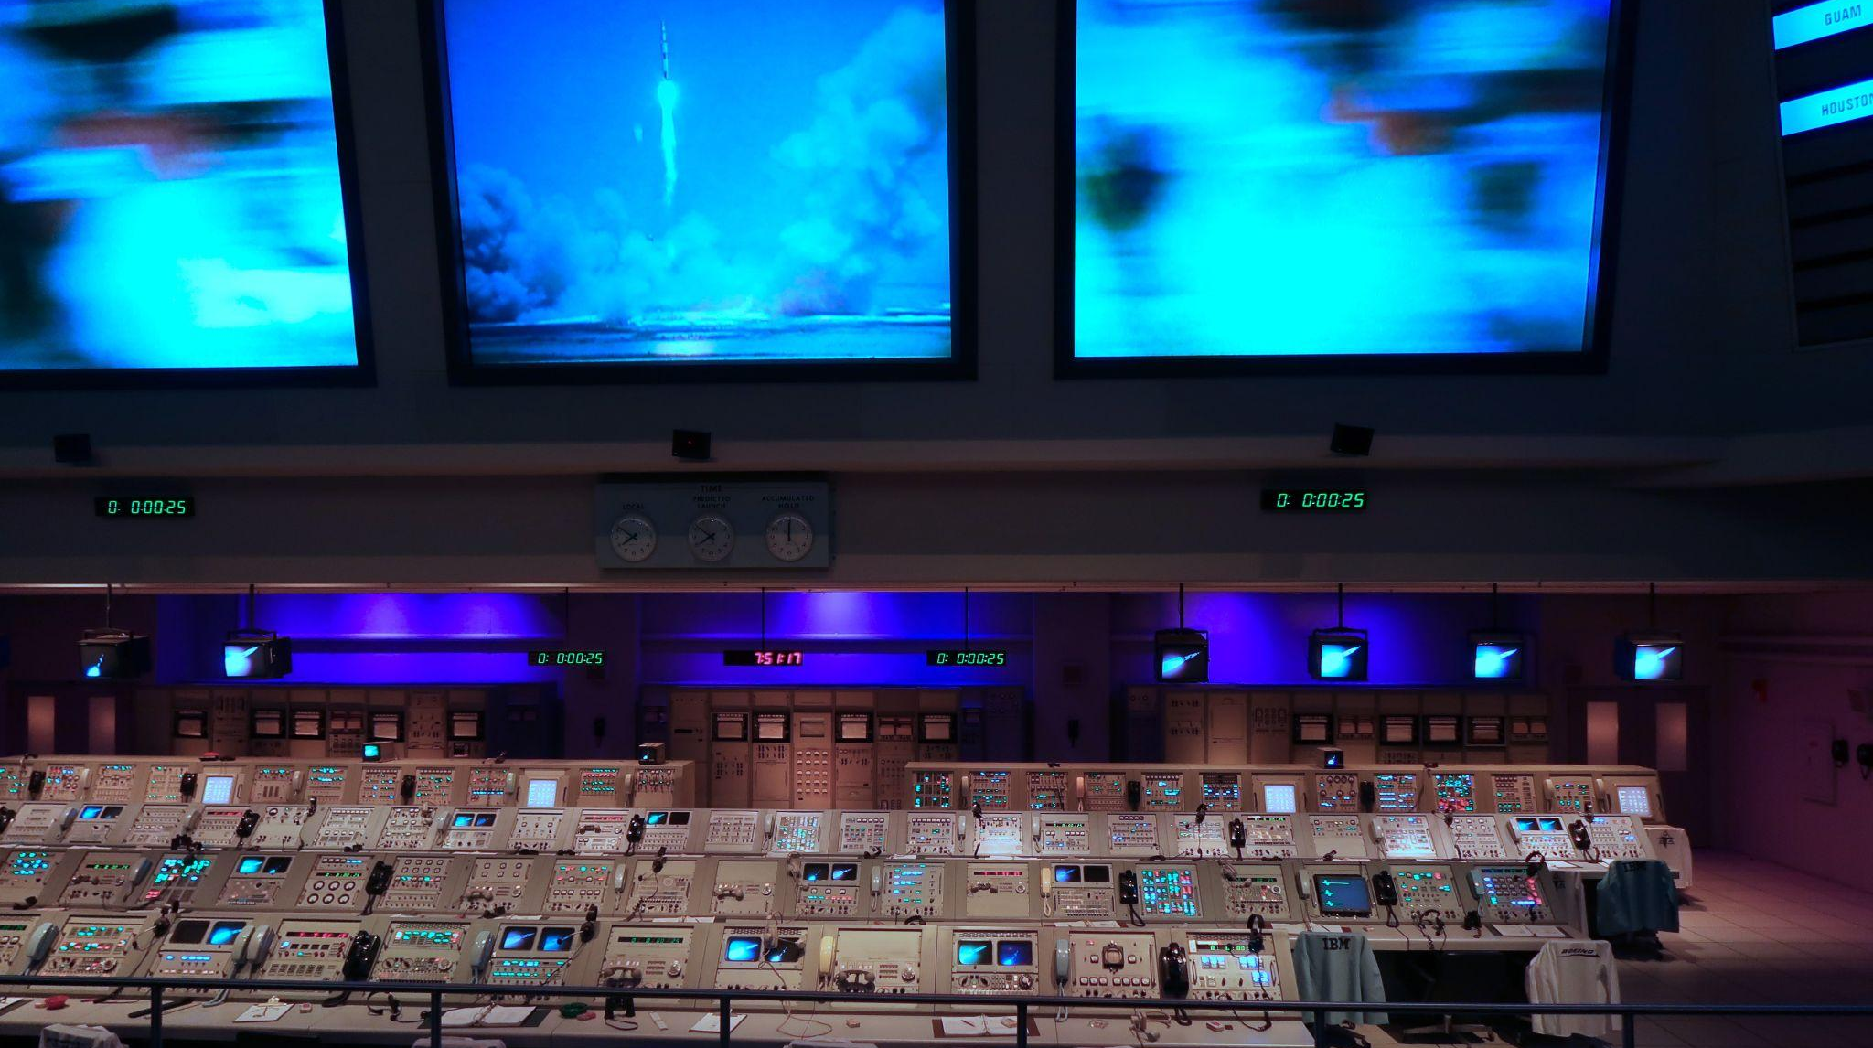
Perspectives

Slide 5
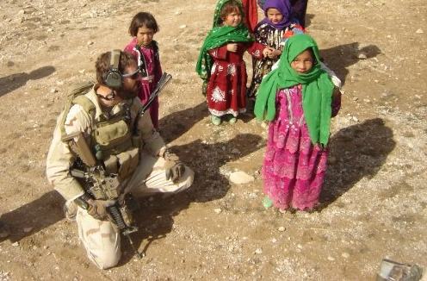

Slide 6
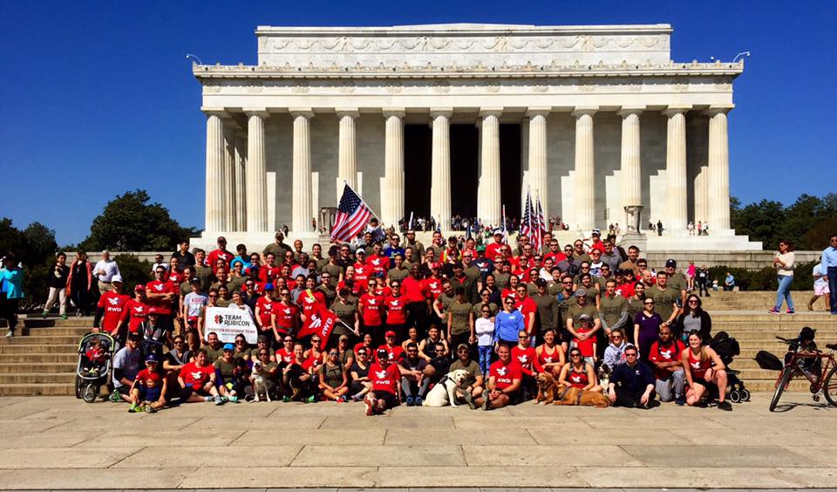

Slide 7
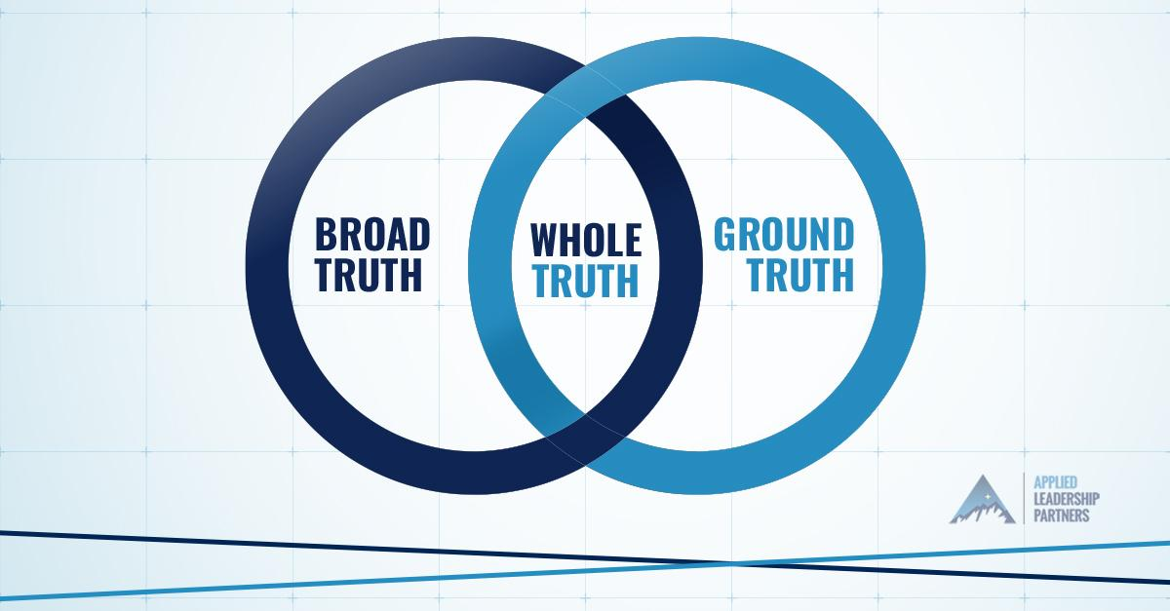

Slide 8

What do you think?
How often do you feel like you have the whole picture when you respond to a situation that pops up in the midst of the day?
Often
Sometimes
Rarely
Notes:
@johannes-plenio

Slide 9
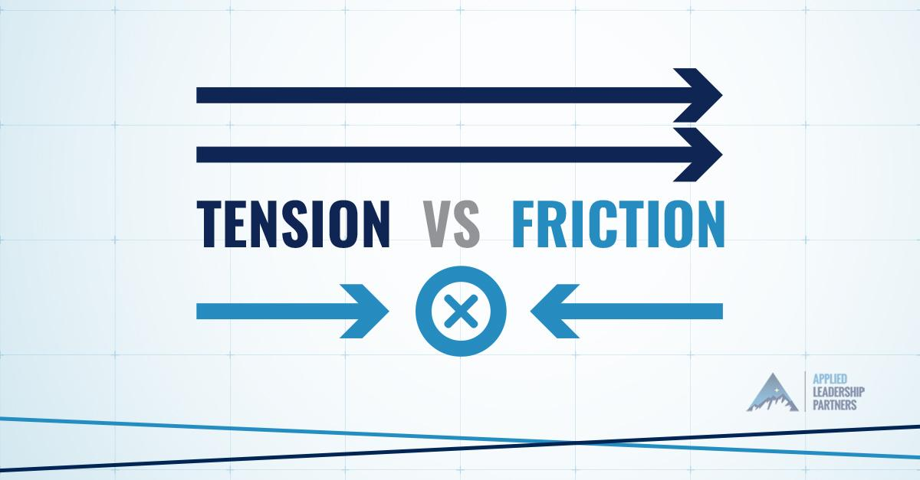

Slide 10

Friction

Slide 11
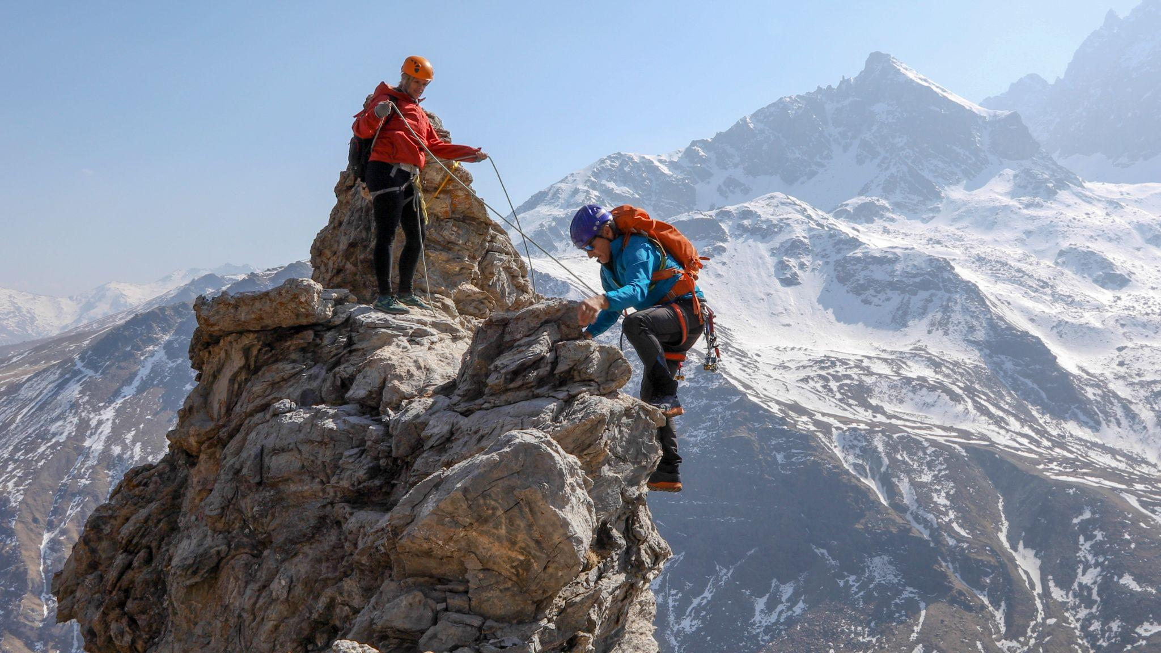
Tension

Slide 12
What do you think?
When trying to get to the whole truth of a stressful situation, what do you experience more commonly?
Healthy Tension
Unhealthy Friction
Where does friction most commonly arise?
People
Processes
Technology
Resources
Notes:
@johannes-plenio

Slide 13
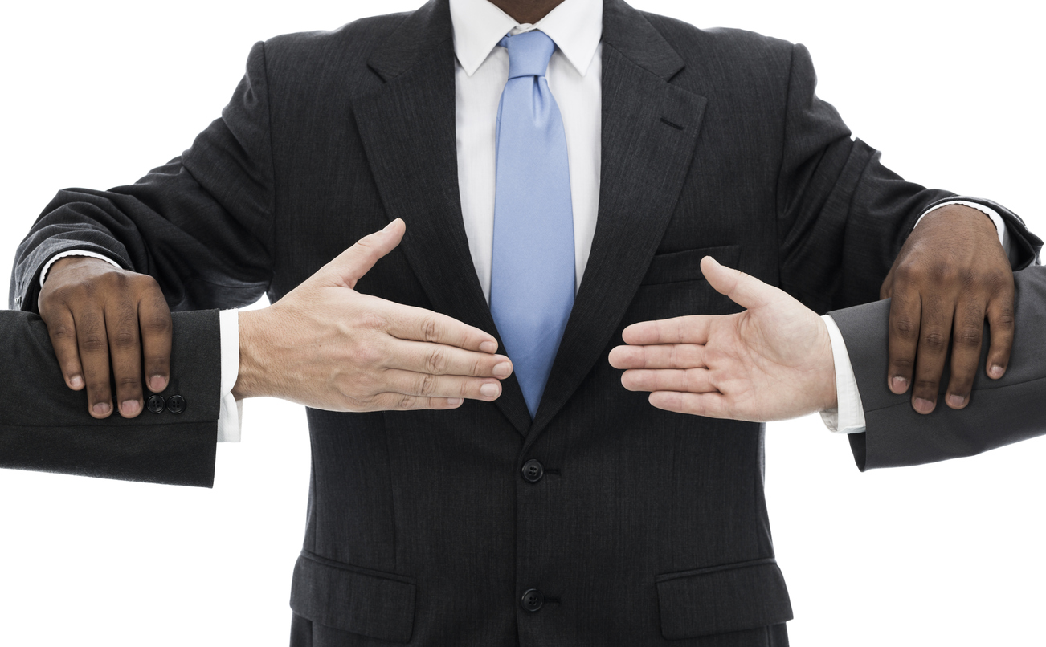

Slide 14
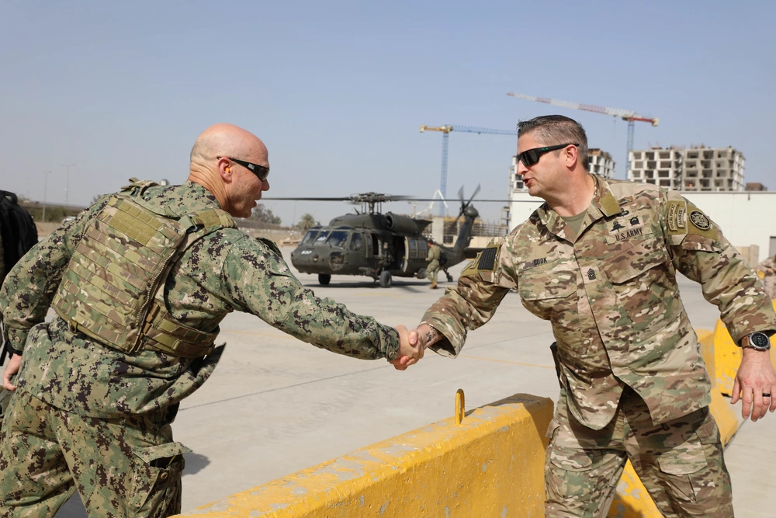
Build Trust
Add Value

Slide 15

Trust is the Foundation of Relationship

Slide 16
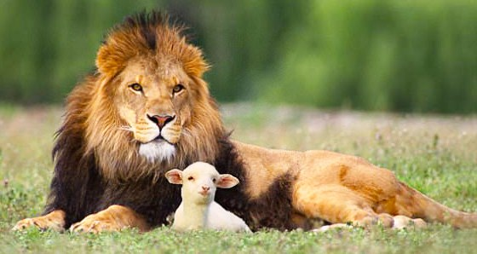
TRUST
Success is measured by your ability to be trusted.

Slide 17
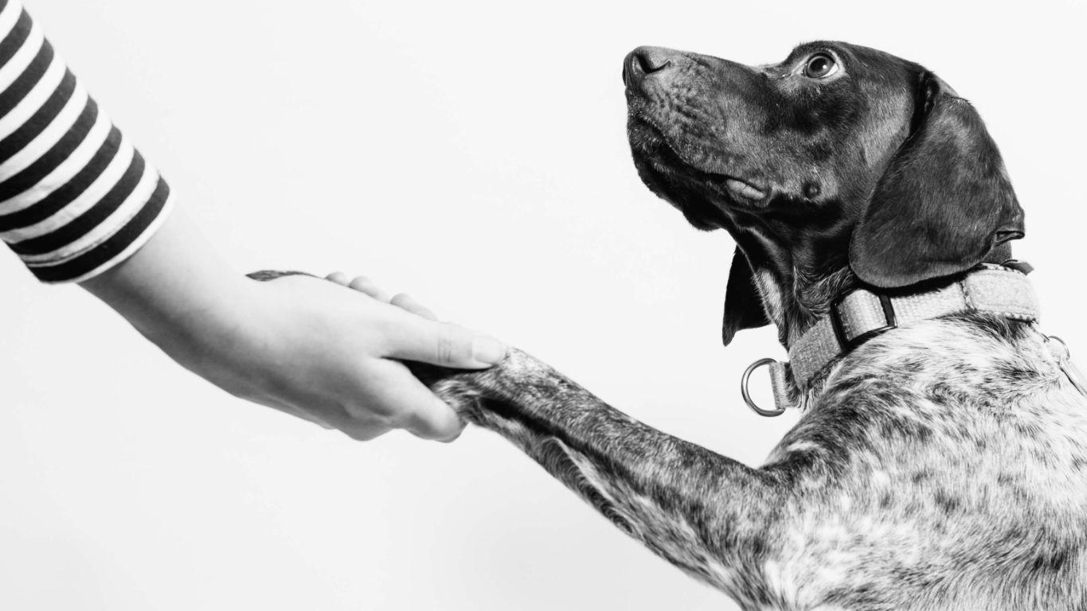
Building Trust
Candor Authenticity Reliability Empathy

Slide 18
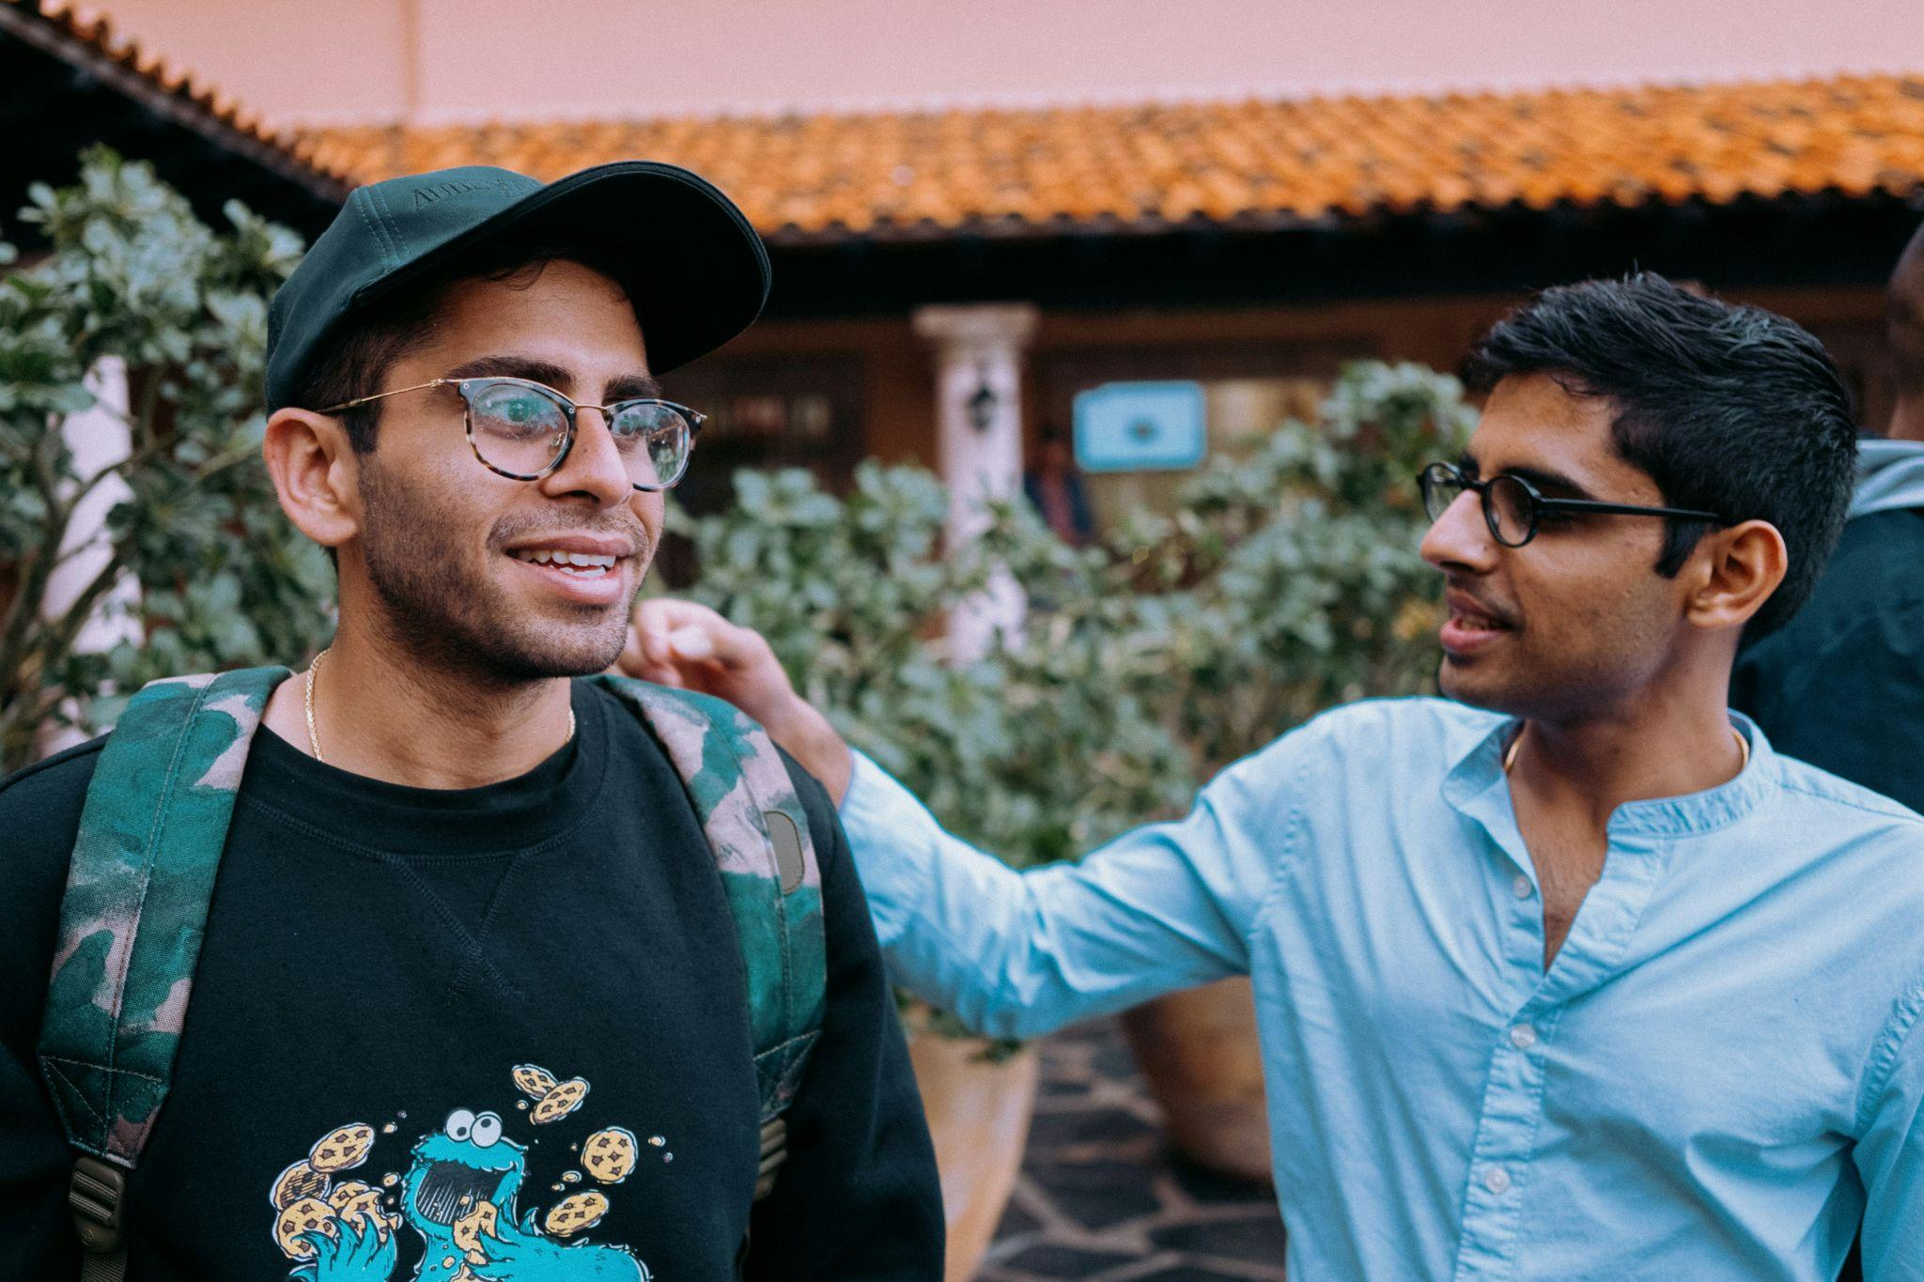
Candor

Slide 19

Authenticity

Slide 20
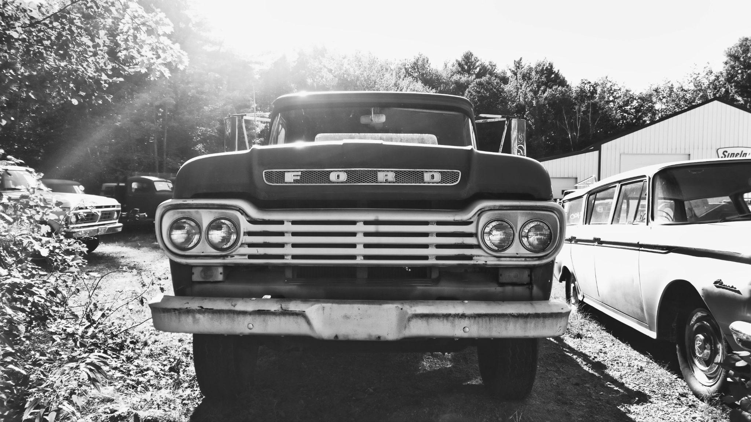
Reliability

Slide 21
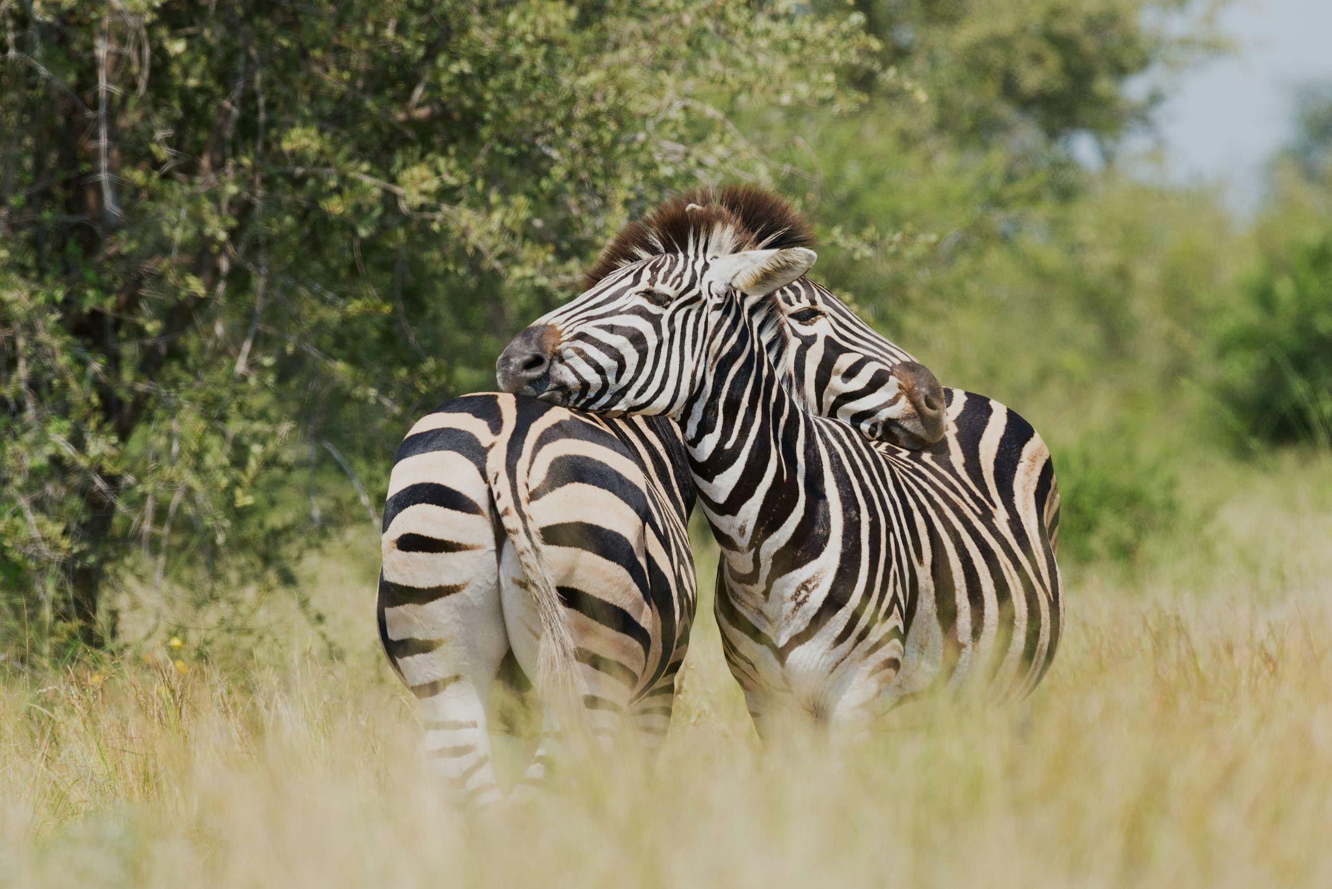
Empathy

Slide 22
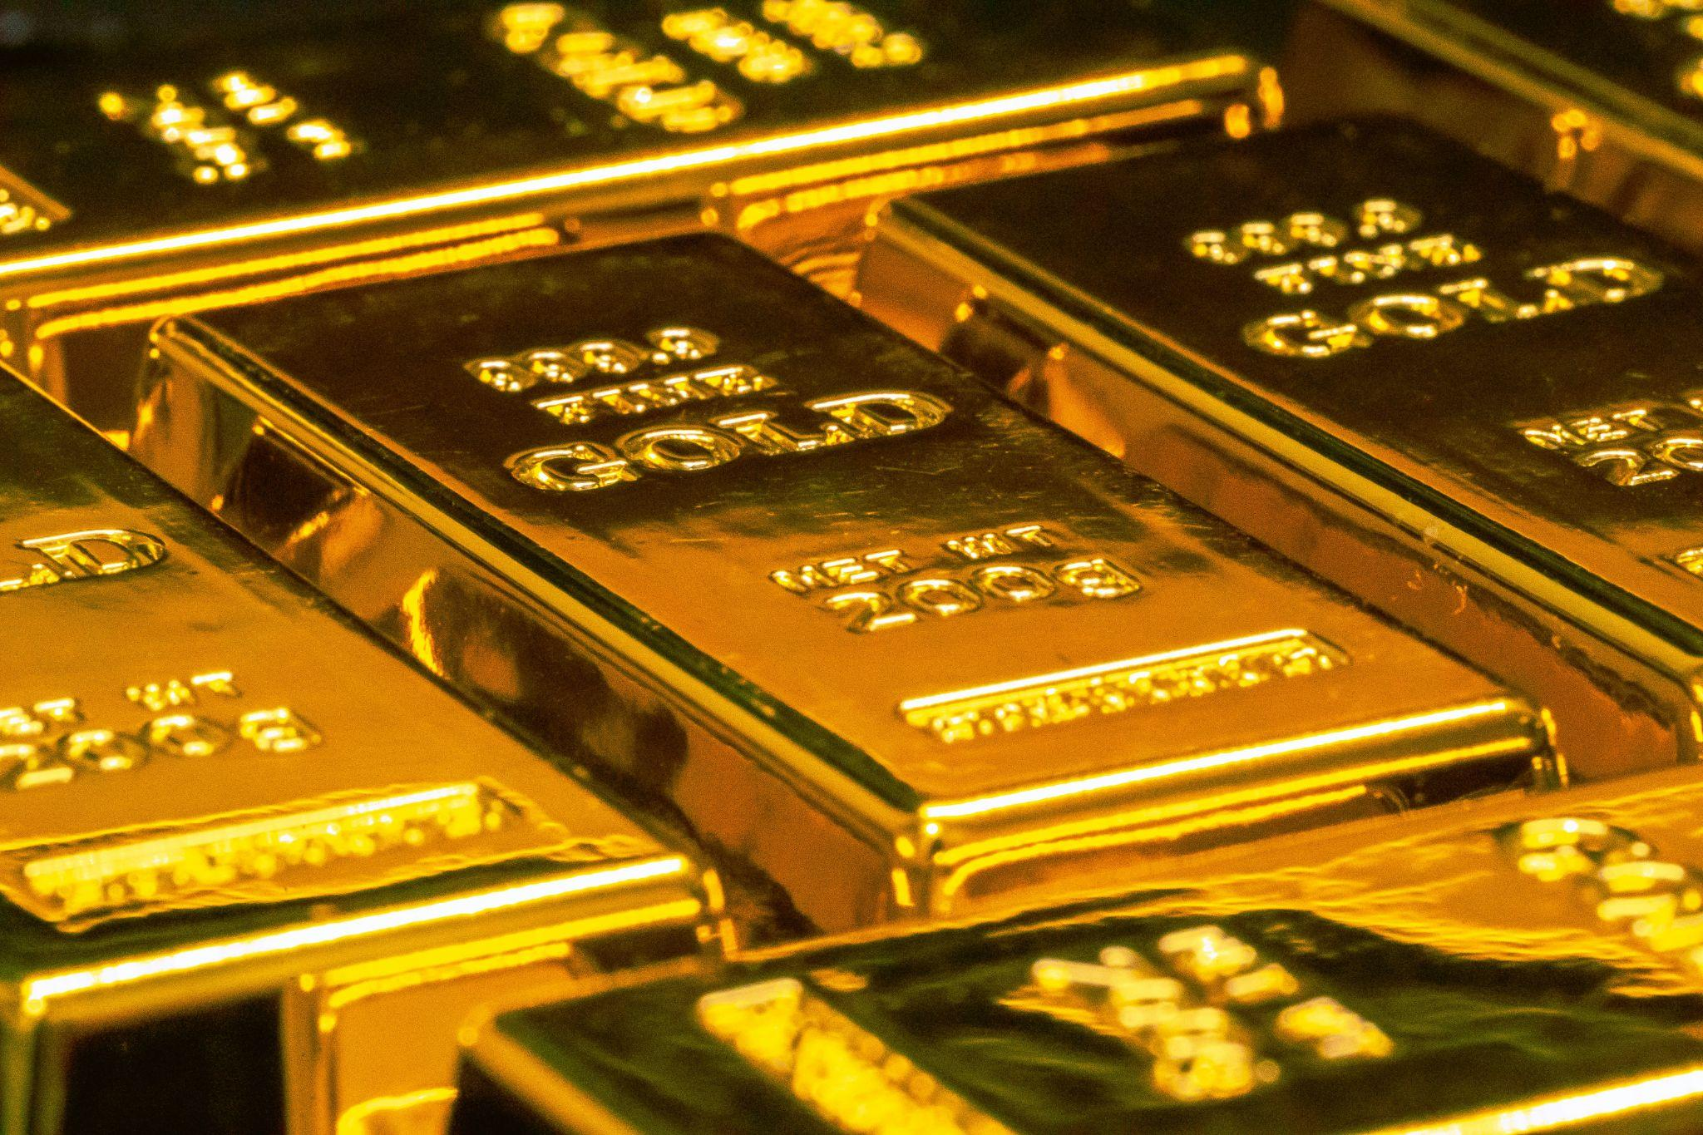
Adding Value

Slide 23
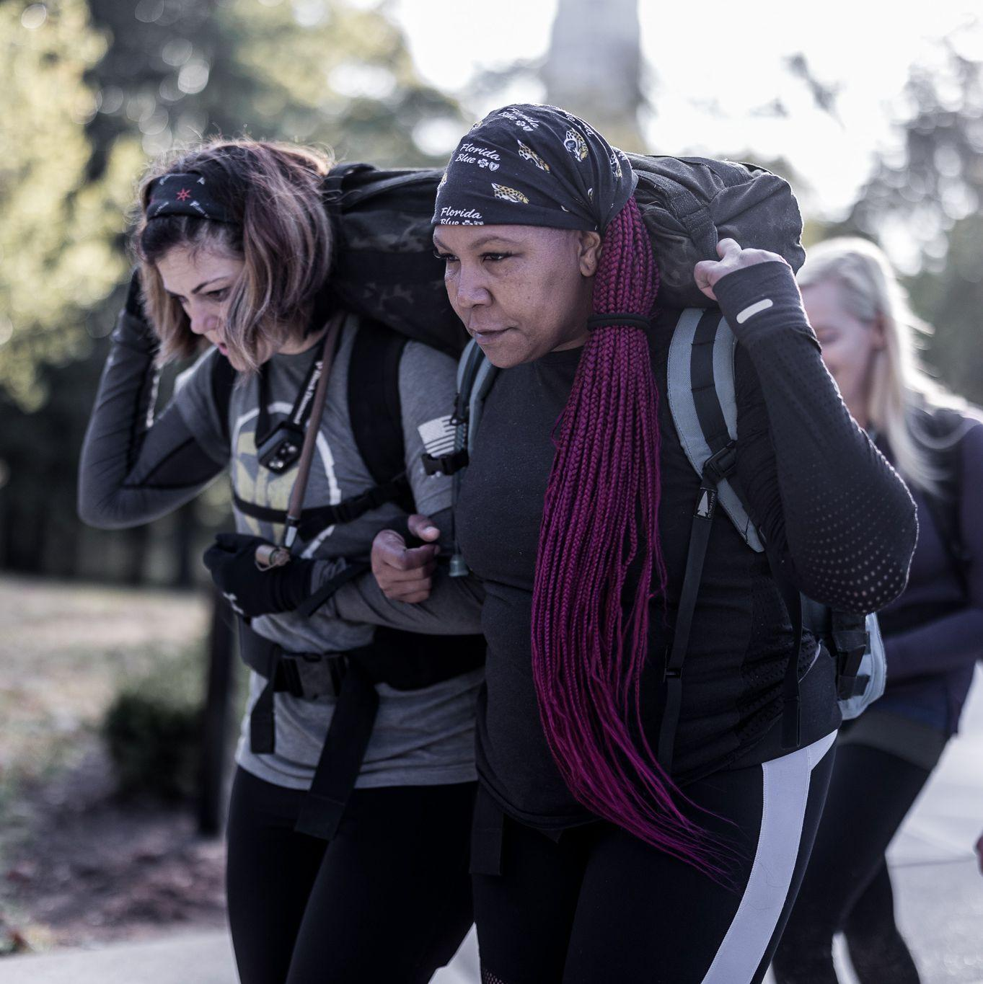
Value
RACE TO 51%

Slide 24

Intelligence Overcomes Biases
Biases Include:
Optimism
Proximity
Endowment Effect
Loss Aversion
Notes:
@johannes-plenio

Slide 25
What do you think?
Which do you find to be the most difficult or uncomfortable for you to apply?
Candor, Authenticity, Reliability, or Empathy
Which bias are you most prone to?
Optimism - disagreeing because of our disposition.
Proximity - being so close to a part of the truth that it blinds us to other parts.
Endowment Effect - Over attachment to anything that is ours.
Loss Aversion - Failing to see what is there because we are afraid of losing something.
Notes:
@johannes-plenio

Slide 26
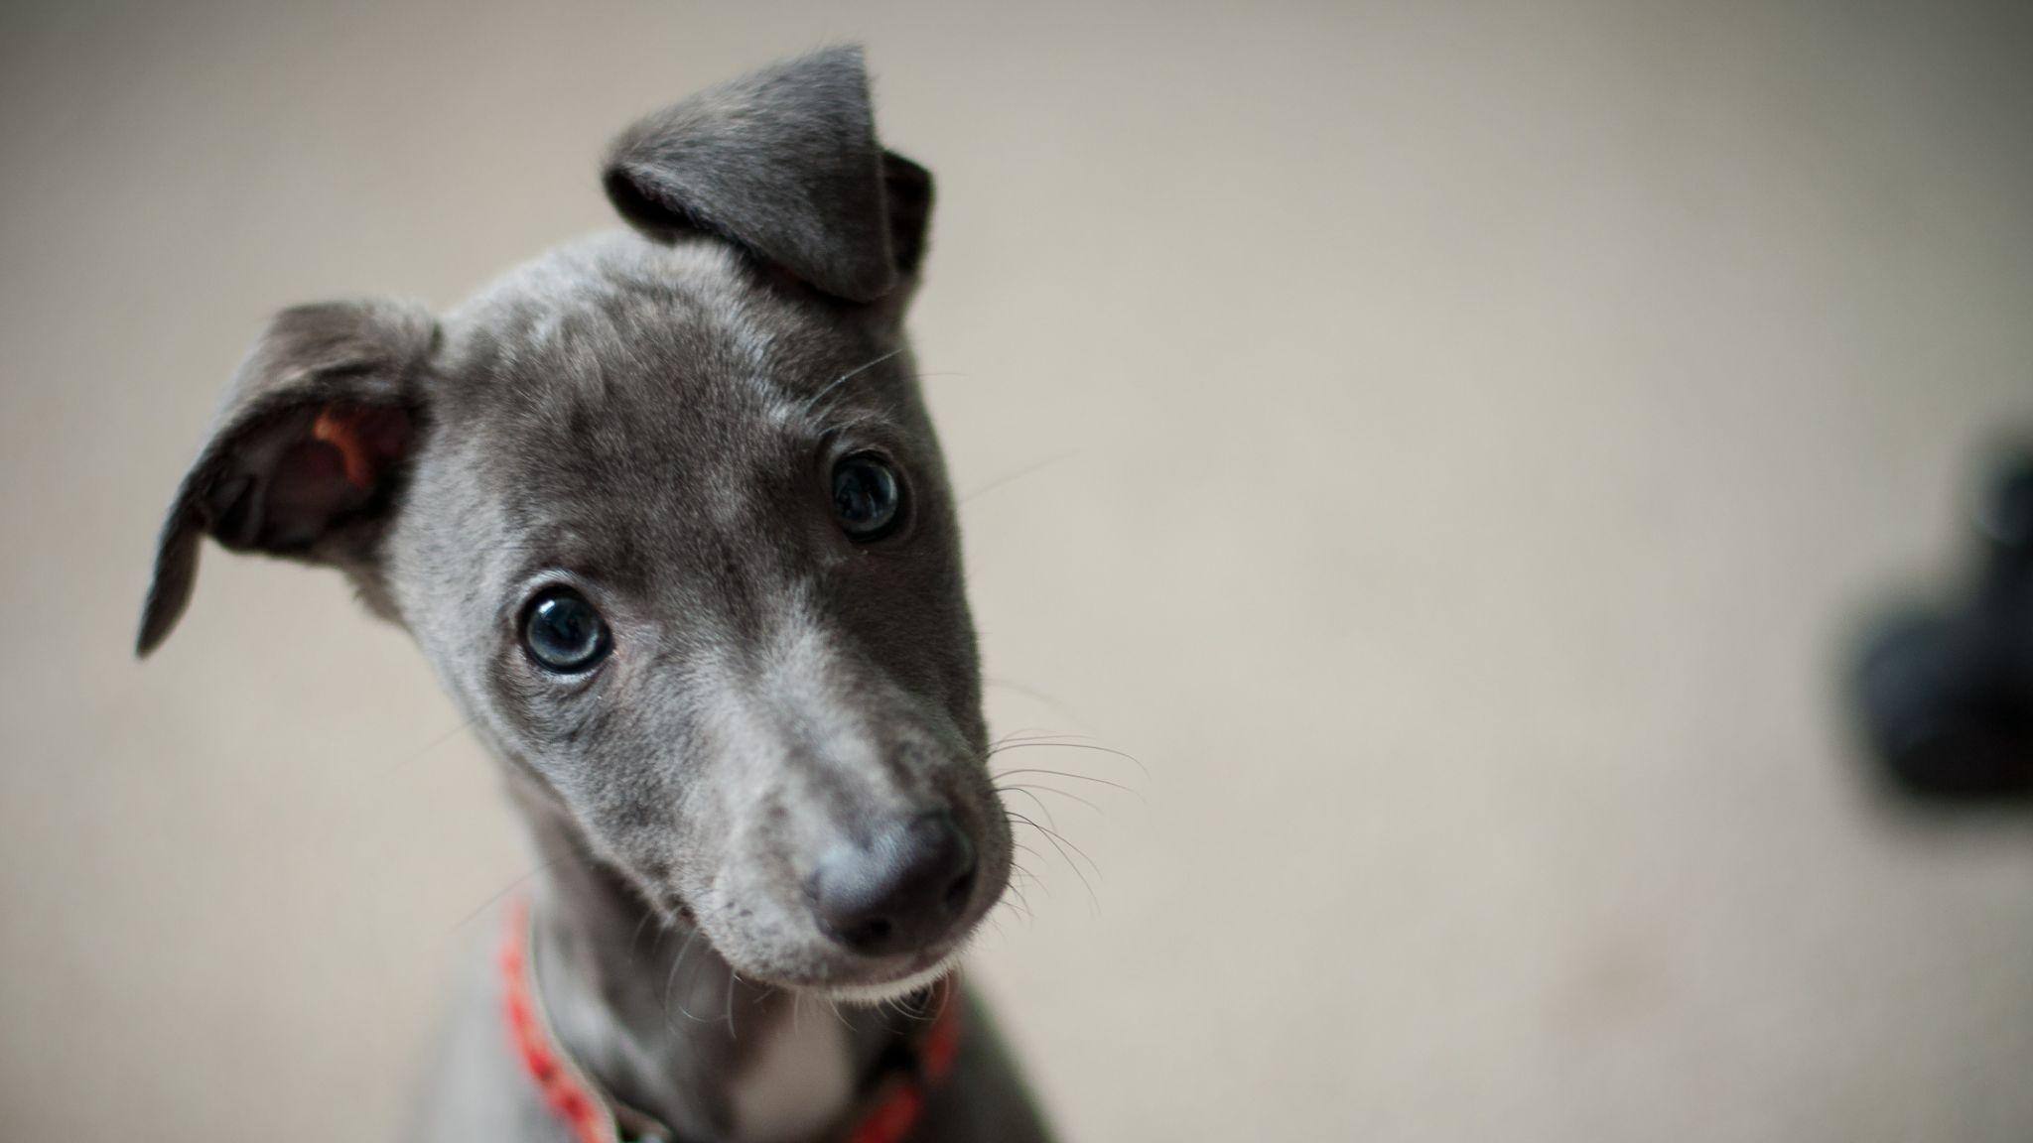
Questions?
Insights

Slide 27

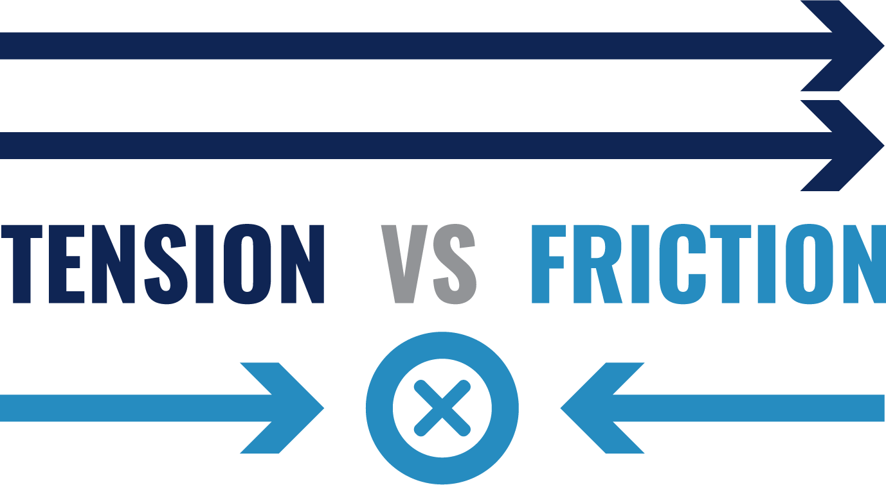
Review
Build Trust
Add Value
Notes:
@johannes-plenio

Slide 28

Let’s Go!
Notes:
@johannes-plenio

Slide 29
Instructions:
Partner up in your tables.
Get some space between your group and other groups.
We will conduct three different activities.
Each activity will conclude with a short reflection.
Notes:
@johannes-plenio

Slide 30
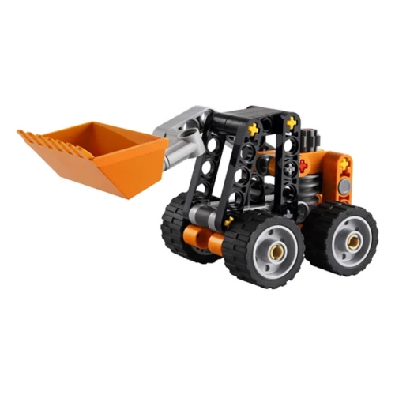
Activity 1 Instructions:
Assemble this lego project as shown on the screen here.
All pieces in the bag, you may reference this picture. You have 10 min.
You may ask us questions.
Notes:
@johannes-plenio

Slide 31
Activity 1 Reflection:
Were you able to complete the project on time?
What made it most difficult?
How did you try to create a shared approach?
Notes:
@johannes-plenio

Slide 32
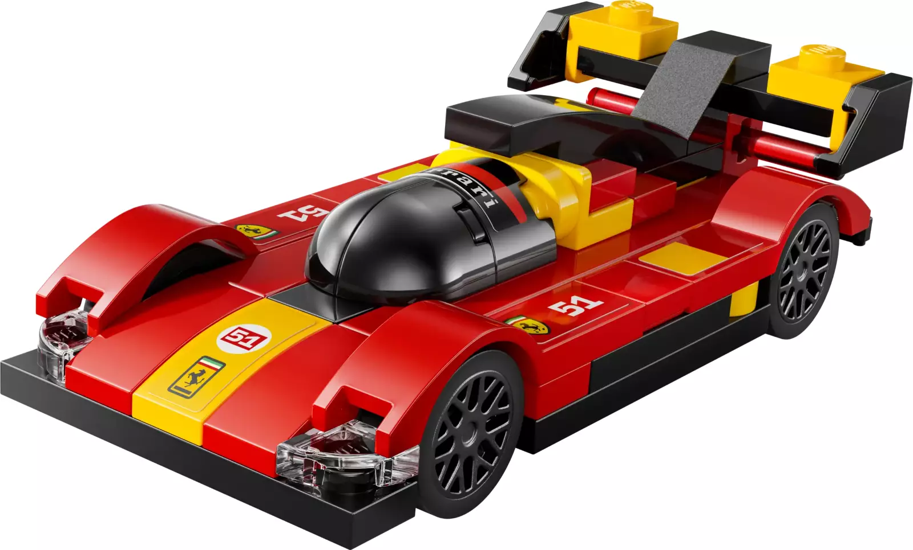
Activity 2 Instructions:
Assemble this lego project in accordance with the instructions.
All pieces in the bag, including the instructions manual. You have 10 min.
You may either touch the pieces, or see the instructions, but you cannot do both. The person with the instructions may not use hand gestures.
Notes:
@johannes-plenio

Slide 33
Activity 2 Reflection:
Did you get closer to completion than last
time?
What made this activity easier?
What difficulties did you encounter?
How did you work to create a shared picture?
Notes:
@johannes-plenio

Slide 34
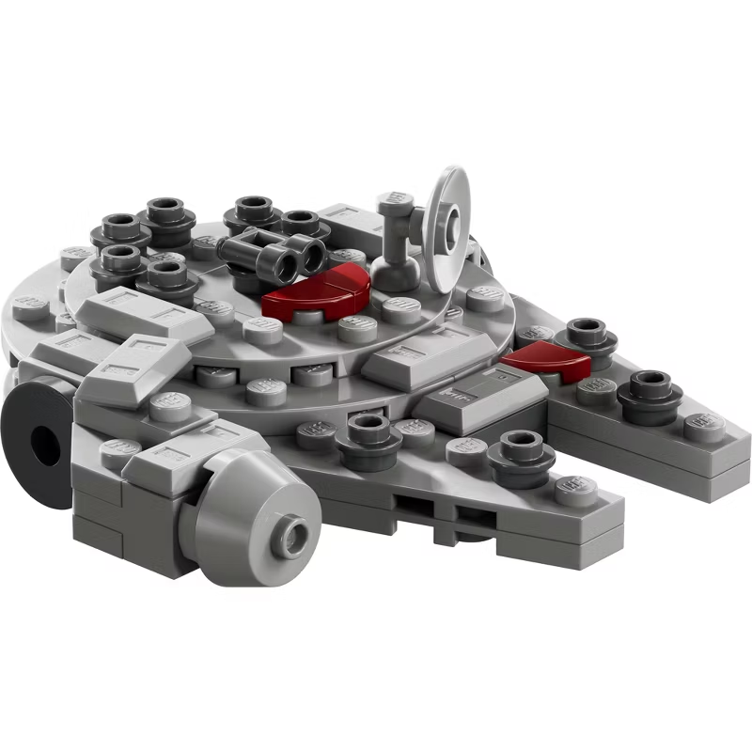
Activity 3 Instructions:
Assemble this lego project as shown on the screen here.
All pieces in the bag, including
the instructions manual. You have 10 min.
All team members may touch the pieces and see the instructions.
Notes:
@johannes-plenio

Slide 35
Activity 3 Reflection:
Were you able to complete the project on time?
How did this project feel compared to the
other two?
What made this project work better?
Notes:
@johannes-plenio

Slide 36
Wrap Up
Notes:
@johannes-plenio

Slide 37

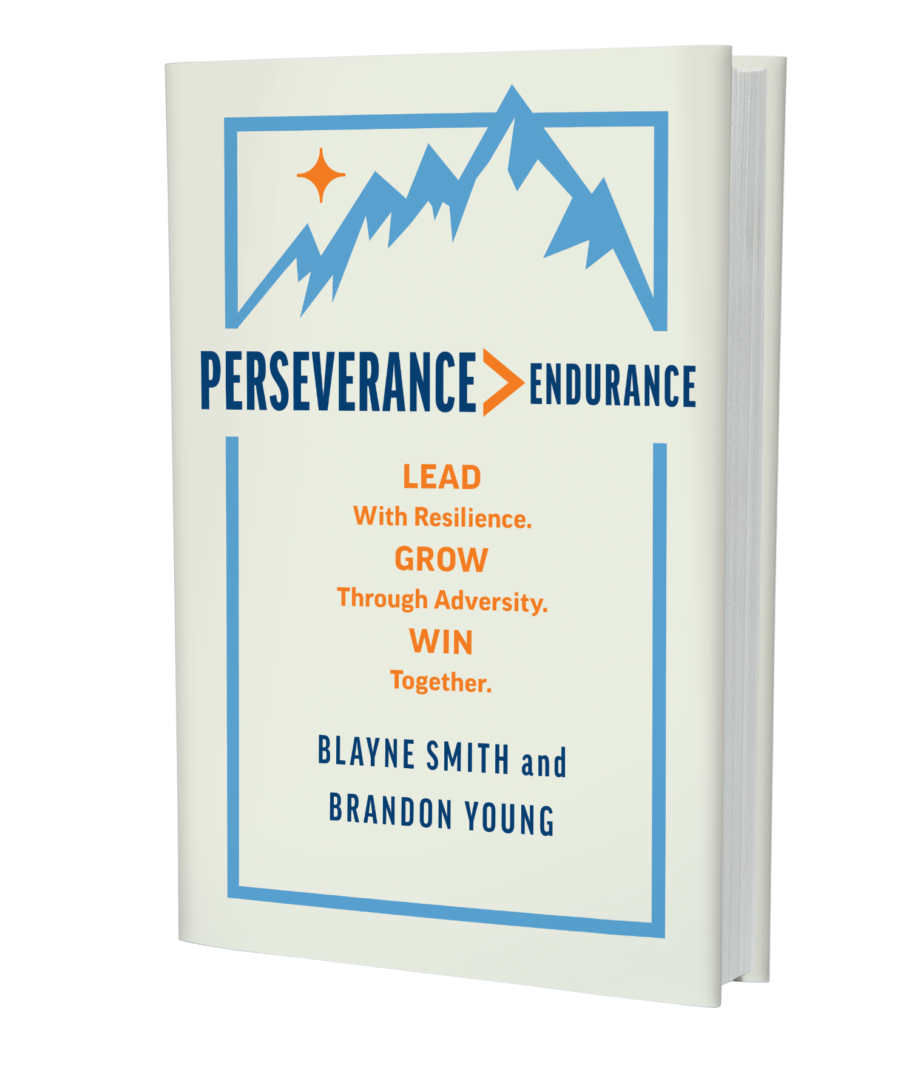
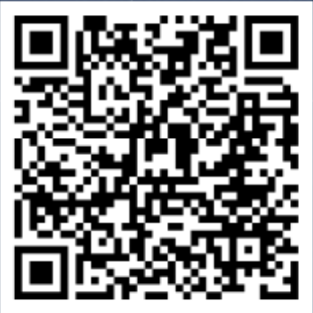
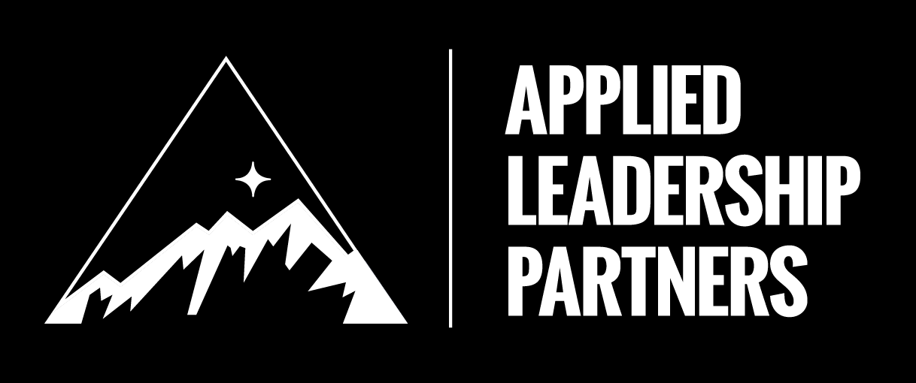




“Supremely entertaining and brilliantly practical. Two former Army special operators translate their extraordinary experiences into invaluable lessons for leadership and life. They can’t make your journey easier, but their hard-earned wisdom will make you better prepared for it.”
General Stanley McChrystal, CEO and Chairman, The McChrystal Group and NYT Best Selling Author of Team of Teams

