Slide 1




Welcome
to
the Inaugural Leadership Forum
Austin, TX
2025

Slide 2
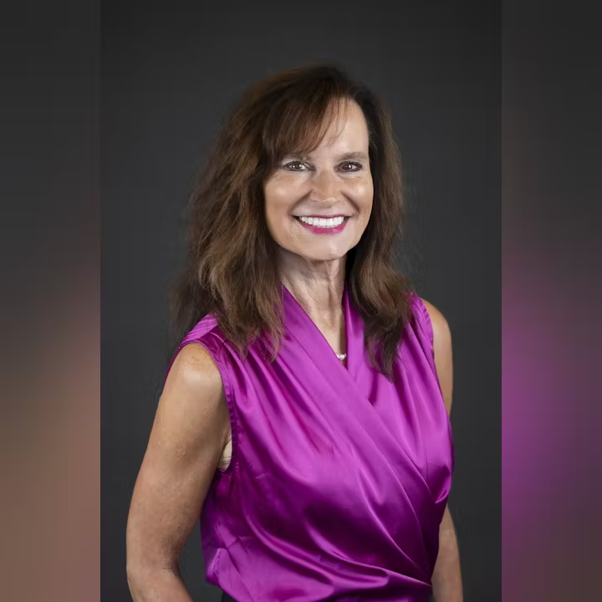
Ann Terry, National President, NSDA and CEO, Colorado Special District Association

Slide 3



Thank you to key special district supporters

Slide 4
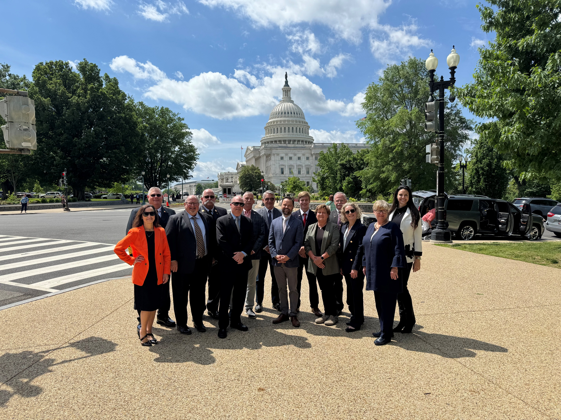
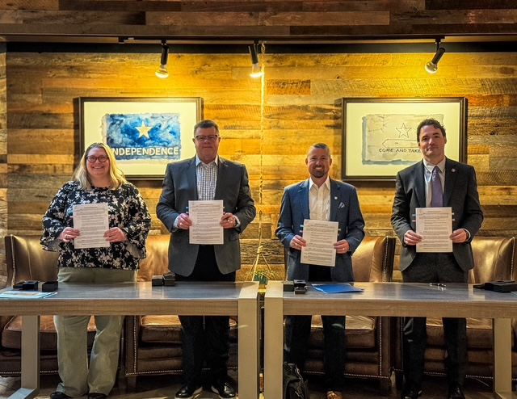
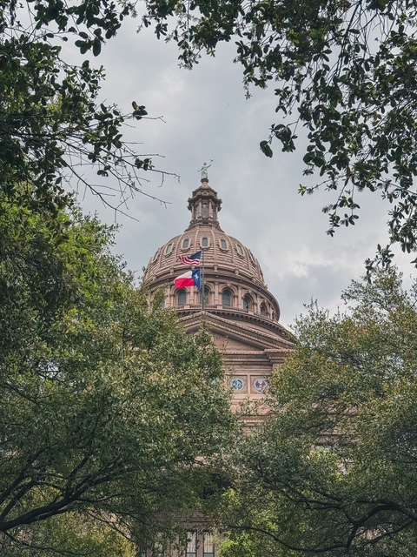
Thank you for joining our national movement

