Slide 1
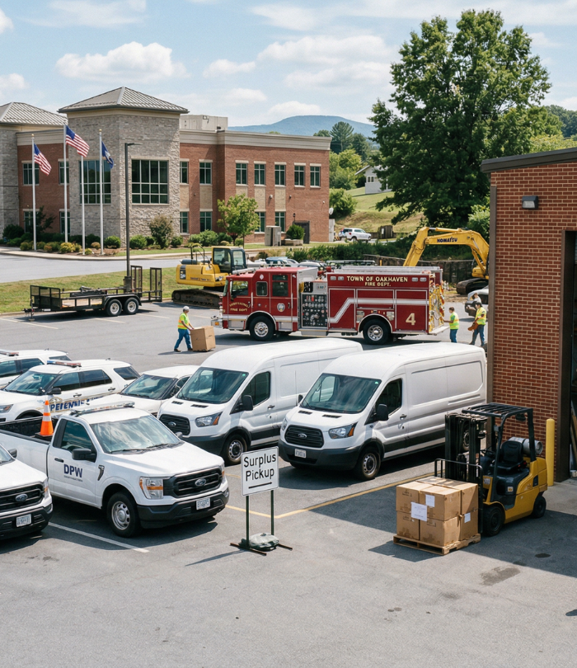
Improving Accountability
and Transparency
in Surplus Sales
for Special Districts
A practical framework for using online auctions to protect public trust, document value, and create stronger outcomes from surplus assets.
National Special Districts Association
Jason Weber
Director, Business Development | GovDeals
Notes:
Opening slide. Set the stage around public trust: special districts do essential work with public assets, and the surplus process should be just as accountable as procurement or budgeting.
[Sources]
- Visual on this slide was generated with Microsoft Copilot.
- NSDA describes itself as “40,000+ Special Districts. One Voice.” Source: turn1search8.
- GovDeals is listed by NSDA as a Gold Level Affiliate and online marketplace for surplus assets from government, educational, and related entities. Source: turn1search16.

Slide 2
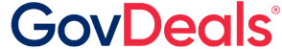

Why surplus sales matter to special districts
Special districts are expected to do more with limited staff, public dollars, and assets that often sit outside daily operations.
Public trust
Operational capacity
Revenue recovery
Compliance
Ratepayers expect fairness and visibility
Surplus is rarely a department’s main job
Broader buyer reach improves competition
Policies vary by district and state
Competitive sales reduce questions about favoritism
Items can depreciate while waiting for a local sale
Assets can be sold when ready
Documentation matters
Clear records support board and audit review
Digital workflows reduce manual follow-up
Funds can be redirected to district priorities
Audit trails protect staff and governing bodies
Bottom line: a surplus program is not “extra.” It is a public-facing process that should be transparent, documented, and repeatable.
Notes:
Talk track: “For special districts, surplus is usually not the headline issue. But when a district sells a truck, pump, meter, tool, property, or IT asset, the process is still public business. The goal is not only to get a good price, but to be able to explain how the district got there.”
[Sources]
- NSDA states it provides resources and best practices for special districts nationwide. Source: turn1search8.
- CSDA describes its GovDeals-powered surplus marketplace as transforming district surplus assets from a burden to an opportunity. Source: turn1search14.

Slide 3
A simple accountability framework
1
2
3
4
Open
competition
Documented process
Clear
controls
Visible
outcomes
Who had an opportunity to bid?
What happened from declaration to payment?
Who had authority, and what limits applied?
What sold, for how much, and when?
If your surplus process can answer these four questions clearly, you are already improving accountability.
Notes:
Talk track: “I like to simplify accountability into four questions. Who could bid? What record do we have? What controls were in place? And what was the final outcome? GovDeals is valuable because it helps connect those questions to a digital record.”
[Sources]
- GovDeals procurement page states every transaction is documented, every buyer is verified, and the platform is built for compliance. Source: turn1search6.

Slide 4

How GovDeals fits into the surplus workflow
1
2
3
4
5
Declare
List
Market
Sell
Report
District declares asset surplus
Asset is listed on GovDeals
GovDeals markets to buyers
Auction closes and buyer pays
District receives proceeds and records
The point is not to make surplus complicated. The point is to make it controlled, visible, and easy to repeat.
Notes:
Talk track: “The process does not need to be complicated. What matters is consistency. The item is declared surplus, listed, marketed, sold, paid for, removed, and reported. The more consistent that flow is, the more defensible the program becomes.”
[Sources]
- GovDeals-HowItWorks describes the online auction process: declared ready for auction, listed on GovDeals, marketed, sold, buyer removes item, agency receives proceeds. Source: turn1search103.
- Visual on this slide was generated with Microsoft Copilot.

Slide 5

Why GovDeals as the provider
Transparency and control
Full visibility into bids, auctions, reporting, and historical activity
Government-focused marketplace
Purpose-built for government surplus across vehicles, equipment, office, computers, and more
Compliance-oriented documentation
Documented transactions, verified buyers, and traceable sale outcomes
Reduced administrative burden
Support for listing, marketing, payment collection, buyer communication, and reporting
Notes:
Talk track: “When I talk about GovDeals, I try not to make this sound like a software pitch. The value is practical: buyer reach, control, documentation, and reducing the amount of time district staff spend chasing down the mechanics of a sale.”
[Sources]
- GovDeals procurement page says it provides control over auctions with visibility into bids and reporting, total transparency, documented transactions, verified buyers, and compliance-oriented processes. Source: turn1search6.
- GovDeals procurement page lists asset categories including vehicles, heavy equipment, office equipment, computers, educational equipment, emergency equipment, laboratory equipment, and consumer goods. Source: turn1search6.
- Visual on this slide was generated with Microsoft Copilot.

Slide 6
Controls that protect the district
Role-based access
Reserve / minimum controls
✓
✓
Give users the right permission level for their job function.
Protect high-value assets while still testing buyer demand.
Bid history and audit trail
Real-time reports
✓
✓
Track bid activity, winning bidders, sale dates, and transaction records.
Provide purchasing, finance, and leadership with current and historical data.
Custom terms
Payment and proceeds reporting
✓
✓
Post district-specific auction rules and conditions when needed.
Connect buyer payment, proceeds, and reconciliation.
Accountability is not a slogan. It is a system of documented decisions and accessible records.
Notes:
Talk track: “This is where transparency becomes operational. It is one thing to say a sale is public. It is another thing to show the bid history, the winning bidder, the transaction record, and who had access to the information.”
[Sources]
- Goose Creek proposal draft states GovDeals provides secure, auditable reporting including number of bids, date and time of each bid, winning bidder names, cumulative data, real-time reports, detailed bid history, and audit trail. Source: turn1search91.
- Siloam Springs proposal draft states access can be tailored through five security levels, including a view-only setting for accounting staff. Source: turn1search92.

Slide 7
From surplus to community value
Revenue recovery
Funds returned to district priorities instead of idle inventory.
Space reclaimed
Yards, shops, and storage areas become useful again.
Sustainability
Reuse and resale can reduce waste and extend asset life.
Public confidence
“Surplus should create value, not waste.”
Open competition and records help build trust.
Notes:
Talk track: “The best surplus program does more than sell things. It helps return dollars, clears space, supports reuse, and gives the community confidence that assets were disposed of fairly.”
[Sources]
- CSDA states the surplus marketplace helps transform surplus assets and inventory from a burden to an opportunity. Source: turn1search14.
- Visual on this slide was generated with Microsoft Copilot.

Slide 8

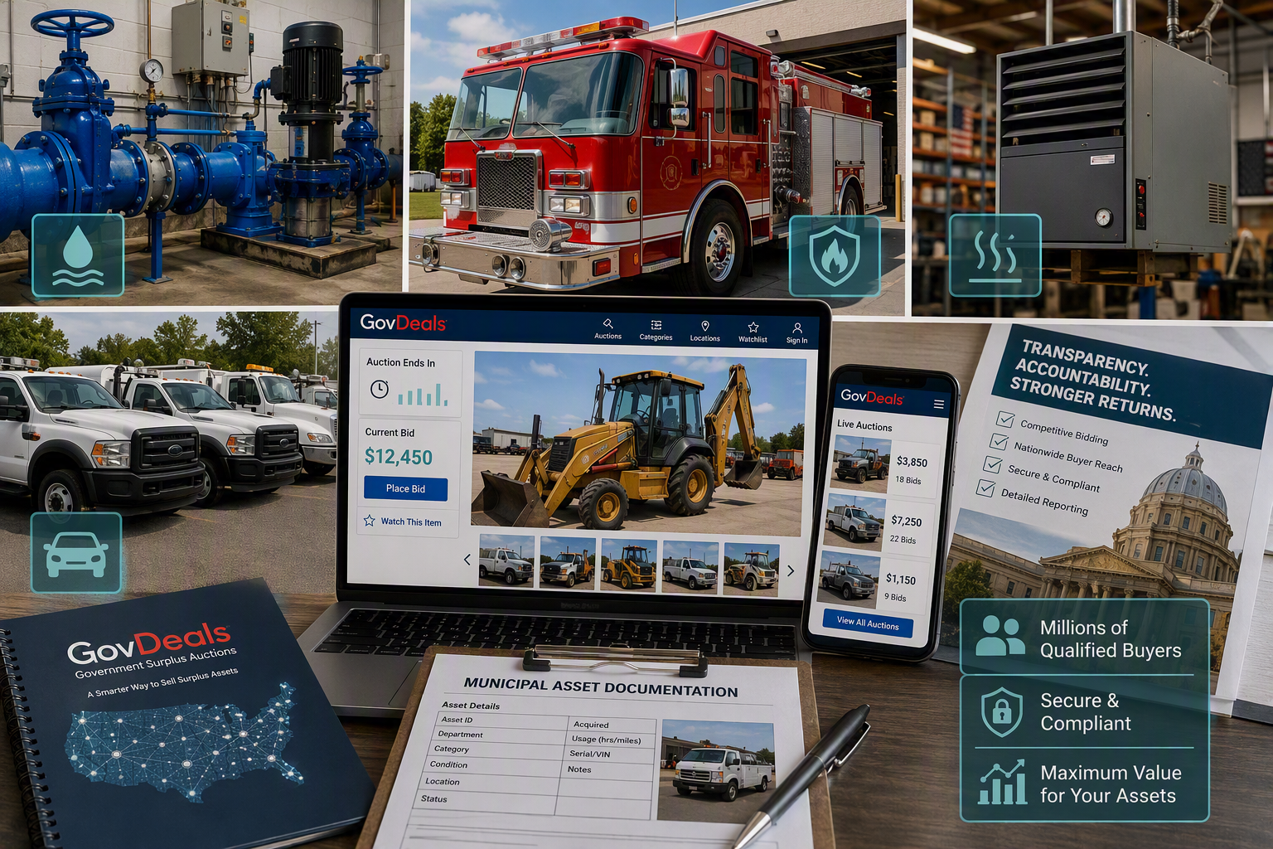
Auction example 1: Modernizing a water district surplus program
Northern Colorado Water Conservancy District
What this shows
Modernizing a water district surplus program
$1.7M
700+
4-week
surplus asset sales
items sold
average auction cycle
Why it matters
Moved from annual county auctions to a more frequent digital model.
Funds and storage capacity are recovered faster.
Reliability and transparency were identified as key requirements.
Notes:
Talk track: “This example helps make the point real. Instead of talking only about the platform, show what happens when the market is opened up and the process is documented.”
[Sources]
- Case study reports $1.7M surplus asset sales, 700+ items sold, and a 4-week average auction cycle. Source: turn1search114.
- Internal NSDA Colorado Case Study also states the district has generated $1.7M since partnering with GovDeals in 2016. Source: turn1search98.

Slide 9

Auction example 2: High-value fire district fleet asset
Umatilla Rural Fire Protection District, Oregon
What this shows
High-value fire district fleet asset
$56,250
99
2019
sold amount
bids
Ford F-550
Why it matters
Shows how specialized public assets can attract competition beyond a local sale.
A clear bid count makes buyer demand explainable.
Useful for districts with apparatus, utility trucks, and response vehicles.
Notes:
Talk track: “This example helps make the point real. Instead of talking only about the platform, show what happens when the market is opened up and the process is documented.”
[Sources]
- SDAO-2026 draft references Umatilla Rural Fire Protection District, Oregon, 2019 Ford F-550, sold for $56,250 with 99 bids. Source: turn1search85.

Slide 10
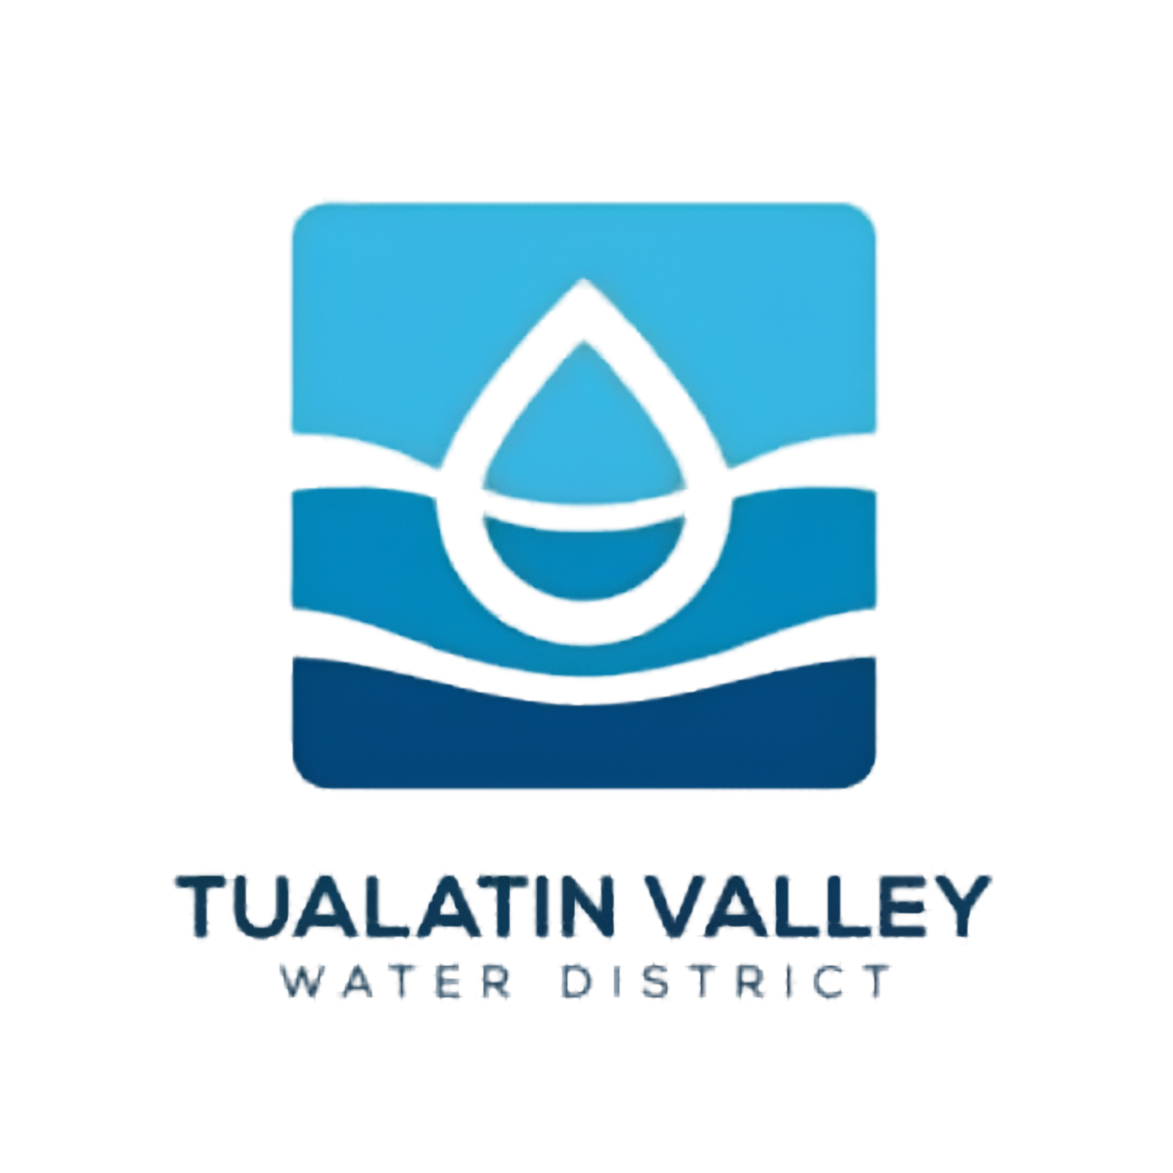
Auction example 3: Utility shop equipment with measurable demand
Tualatin Valley Water District, Oregon
What this shows
Utility shop equipment with measurable demand
$2,278
34
Shop
sold amount
bids
heater auction
Why it matters
Not every valuable asset is a vehicle.
Shop equipment, utility assets, tools, and surplus materials can still find national buyer interest.
Bid activity and sale outcome are easy to document.
Notes:
Talk track: “This example helps make the point real. Instead of talking only about the platform, show what happens when the market is opened up and the process is documented.”
[Sources]
- SDAO-2026 draft references Tualatin Valley Water District, Oregon, Charlyne used oil shop heater sold for $2,278 with 34 bids. Source: turn1search85.

Slide 11
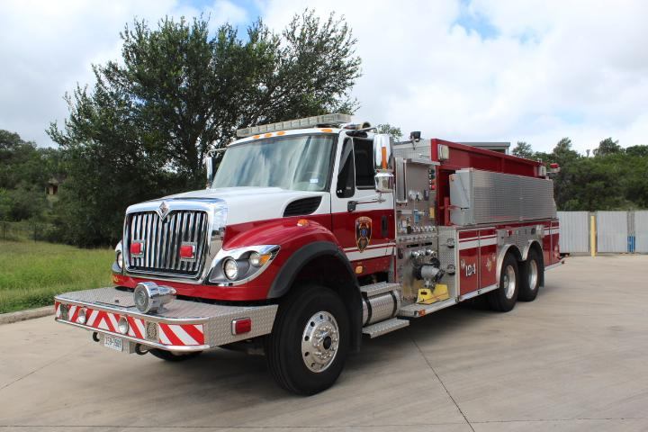
Auction example 1
2007 International E-One 3,500 Gallon Tanker
Final Sale Amount
$204,750
Bexar County Emergency Service District #3, TX
Notes:
Talk track: “This example helps make the point real. Instead of talking only about the platform, show what happens when the market is opened up and the process is documented.”
[Sources]
- SDAO-2026 draft references Tualatin Valley Water District, Oregon, Charlyne used oil shop heater sold for $2,278 with 34 bids. Source: turn1search85.

Slide 12
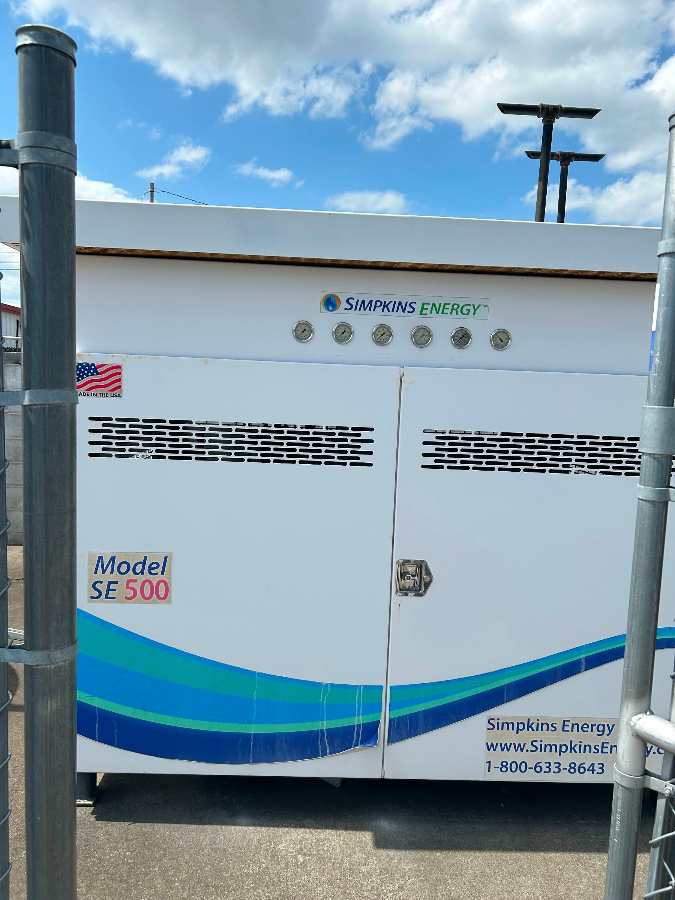
Auction example 2
Simpkins Energy SE 500 CNG Compressor
Final Sale Amount
$28,575
Elk River Public Utility District, TX
Notes:
Talk track: “This example helps make the point real. Instead of talking only about the platform, show what happens when the market is opened up and the process is documented.”
[Sources]
- SDAO-2026 draft references Tualatin Valley Water District, Oregon, Charlyne used oil shop heater sold for $2,278 with 34 bids. Source: turn1search85.

Slide 13
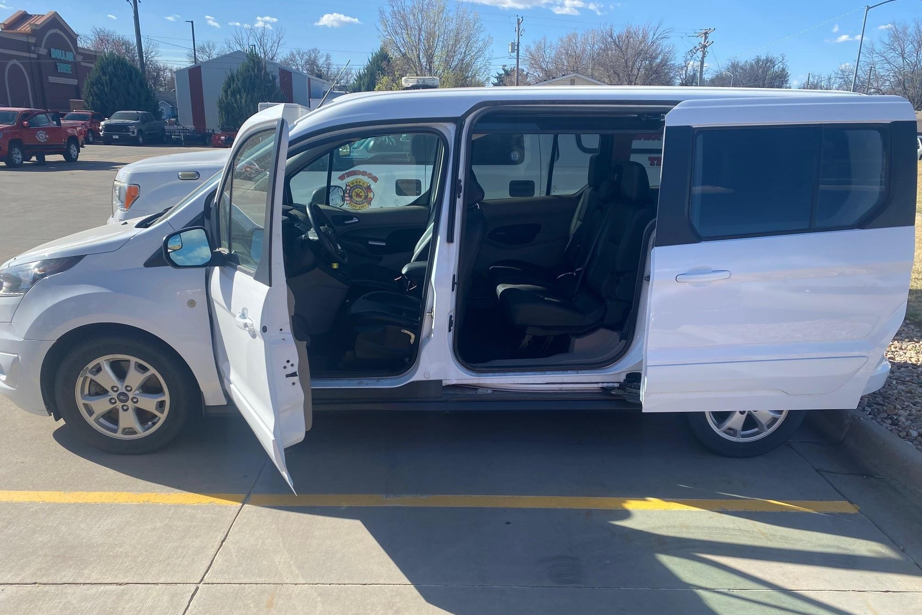
Auction example 3
2015 Ford Transit Connect
Final Sale Amount
$12,937.50
Windsor-Severance Fire Protection District, CO
Notes:
Talk track: “This example helps make the point real. Instead of talking only about the platform, show what happens when the market is opened up and the process is documented.”
[Sources]
- SDAO-2026 draft references Tualatin Valley Water District, Oregon, Charlyne used oil shop heater sold for $2,278 with 34 bids. Source: turn1search85.

Slide 14
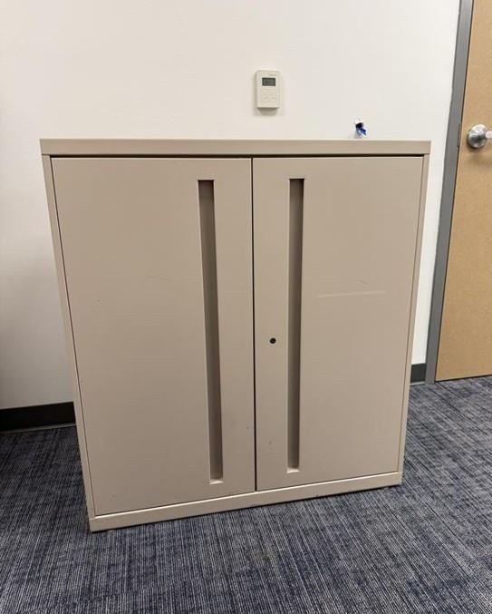
Auction example 4
Vertical Storage Cabinet
Final Sale Amount
$15.05
Brushy Creek Municipal Utility District, TX
Notes:
Talk track: “This example helps make the point real. Instead of talking only about the platform, show what happens when the market is opened up and the process is documented.”
[Sources]
- SDAO-2026 draft references Tualatin Valley Water District, Oregon, Charlyne used oil shop heater sold for $2,278 with 34 bids. Source: turn1search85.

Slide 15
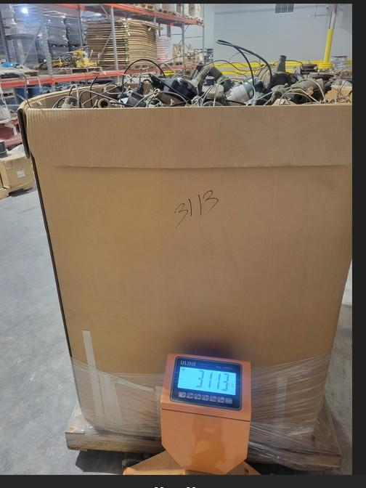
Auction example 5
Scrap Water Meter
Final Sale Amount
$10,125
Water District Number One of Johnson County (WaterOne), KS
Notes:
Talk track: “This example helps make the point real. Instead of talking only about the platform, show what happens when the market is opened up and the process is documented.”
[Sources]
- SDAO-2026 draft references Tualatin Valley Water District, Oregon, Charlyne used oil shop heater sold for $2,278 with 34 bids. Source: turn1search85.

Slide 16
A practical playbook for special districts
1
Clarify policy
Confirm board authority, surplus declaration process, and disposal methods.
2
Segment assets
Group assets by vehicles, equipment, IT, tools, real property, and low-value misc.
3
Set controls
Define reserves, approval rights, terms, buyer restrictions, and internal approvals.
4
List consistently
Use clear photos, accurate descriptions, condition notes, documents, and pickup terms.
5
Report outcomes
Export sale results, bid history, proceeds, and records for finance and leadership.
Notes:
Talk track: “If a district is just getting started, I would not overcomplicate it. Clarify surplus policy, segment your assets, set controls, list consistently, and report outcomes. That turns surplus from a one-off scramble into a defensible process.”
[Sources]
- Sample Surplus Personal Property Policy states records should be maintained for each disposition, including asset description, method of disposal, sale proceeds, buyer information, and date of transfer. Source: turn1search35.
- GovDeals proposal materials state draft auctions may be reviewed by the district before they are sent live and that marketing plans can be developed for specialized assets. Source: turn1search93.

Slide 17


The goal is not just to sell surplus.
It is to sell it in a way your district can stand behind.
Open competition protects public trust.
Documented records protect staff and boards.
Broader buyer reach can improve outcomes.
GovDeals helps make the process visible, repeatable,
and accountable.
Questions
Jason Weber | GovDeals
Notes:
Closing: “If there is one point I would leave you with, it is this: surplus assets are still public assets. GovDeals helps districts turn those assets into measurable value while giving leadership, staff, and the public a clearer view of how the sale happened.”
[Sources]
- Visual on this slide was generated with Microsoft Copilot.
- GovDeals procurement page positions the platform around ROI, control, documented transactions, verified buyers, transparency, and compliance. Source: turn1search6.

