Slide 1

SAFEGUARDING PUBLIC FUNDS
Tom Tight
Managing Director
July 23, 2025
National Special Districts Association Texas Leadership Forum

Slide 2
Legal disclosure
The information provided in this presentation does not, and is not intended to, constitute legal advice; instead, all information, content, and materials discussed herein are for general informational purposes only. Information in this presentation may not constitute the most up-to-date legal or other information. Viewers of this presentation should contact their attorney to obtain advice with respect to any particular legal matter. No reader, user, or audience member should act or refrain from acting on the basis of information in this presentation without first seeking legal advice from counsel in the relevant jurisdiction. Only your individual attorney can provide assurances that the information contained herein – and your interpretation of it – is applicable or appropriate to your particular situation.
The views expressed at, or through, this presentation are those of the presenter(s) in their individual capacities only – not those of their respective employers, PTMA Financial Solutions (“PTMA”), or affiliates of PTMA. All liability with respect to actions taken or not taken based on the contents of this presentation are hereby expressly disclaimed. The content in this presentation is provided "as is;" no representations are made that the content is error-free.
The information presented should not be used in making any investment decisions. This material is not a recommendation to buy, sell, implement, or change any securities or investment strategy, function, or process. The foregoing is for informational purposes only and should not be considered a solicitation of investment advisory services.

Slide 3
disclaimer
Data unaudited. The information contained herein has been obtained from sources that we believe to be reliable, but its accuracy and completeness are not guaranteed. The materials in the attached are opinions of PTMA Financial Solutions (“PTMA”) or their affiliates, and should not be construed as investment advice. The presentation is not a recommendation to buy, sell, implement, or change any securities or investment strategy, function, or process. Any financial and/or investment decision should be made only after considerable research, consideration, and involvement with an experienced professional engaged for the specific purpose. All comments and discussion presented are purely based on opinion and assumptions, not fact. These assumptions may or may not be correct based on foreseen and unforeseen events. All calculations and results presented and are for discussion purposes only and should not be used for making and calculations and/or decisions.
Many factors affect performance including changes in market conditions and interest rates and in response to other economic, political, or financial developments. Performance comparisons will be affected by changes in interest rates. Investing involves risk including the possible loss of principal. No assurance can be given that the performance objectives of a given strategy will be achieved. PTMA is not a bank. An investment in PTMA is not insured or guaranteed by the Federal Deposit Insurance Corporation or any other government agency. Although the PTMA stable NAV fund(s) seek to preserve the value of your investment at $1.00 per share, this is not guaranteed. Please review the applicable Information Statement(s) before investing. Past performance is not an indication of future performance. Any financial and/or investment decision may incur losses.
The investment advisor providing these services is Public Trust Advisors, LLC, an investment adviser registered with the U.S. Securities and Exchange Commission (SEC) under the Investment Advisers Act of 1940. PMA Securities, LLC, an affiliate of Public Trust Advisors, is a broker-dealer and municipal advisor registered with the SEC and MSRB and is a member of FINRA and SIPC and provides marketing, and securities and other institutional brokerage services.​ Registration with the SEC does not imply a certain level of skill or training. Public Trust is required to maintain a written disclosure brochure of our background and business experience. If you would like to receive a copy of our current disclosure brochure, Privacy Policy, or Code of Ethics, please contact us.
There is no guarantee that investment strategies will achieve the desired results under all market conditions, and each investor should evaluate its ability to invest long-term, especially during periods of a market downturn. This information may contain statements, estimates, or projections that constitute “forward-looking statements” as defined under U.S. federal and other jurisdictions’ securities laws. Any such forward looking statements are inherently speculative and are based on currently available information, operating plans, and projections about future events and trends. As such, they are subject to numerous risks and uncertainties.

Slide 4
Today’s agenda
1.
Investment Programs and Policies
2.
Investment Types
3.
Investment Risks
4.
Cash Flow Analysis
5.
Investment Strategy and Return Analysis
6.
Economy Update
.
Trivia a Questions
Please refer to the disclaimer for important information about this presentation and/or data.
Notes:
We’ll go over Florida statute requirements for Local Government Investment Policies:
Areas of focus for written investment policies
Types of authorized investments
Risks associated with investments
Benefits of a cash flow analysis
Primer on investing bond proceeds and arbitrage
Trivia questions
Questions?

Slide 5
INVESTMENT programs and policies
Please refer to the disclaimer for important information about this presentation and/or data.

Slide 6

The seven habits of highly effective investment programs
Have a Comprehensive Plan In Place (Investment Policy)
Have a Detailed Asset/Liability Matching Model (aka: Cash Flow Model)
Have a Responsible Amount of Interest Rate Risk and Credit Risk
Don’t Try to Time the Market (Unrealized vs. Realized Gains and Losses)
Have an Informed Opinion on Market Conditions
Benchmark Your Investment Program and Portfolio
Provide Quality, Timely, Transparent Reporting
The Investment Portfolio is One of the Only Areas of State and Local Governments Where Income Can Be Generated Without Charging Taxes or Fees to the Citizenry.
Please refer to the disclaimer for important information about this presentation and/or data.

Slide 7





Safety
Liquidity
Yield
Compliance
Transparency
Please refer to the disclaimer for important information about this presentation and/or data.

Slide 8
Special Districts: Best Practices
Investment Program Objectives: Safety, Liquidity, and Income
LIQUIDITY
The investment portfolio shall be structured to timely meet expected cash outflow needs and associated obligations which might be reasonably anticipated. This objective shall be prioritized by matching investment maturities with forecasted.
02
SAFETY OF PRINCIPAL
Safety of principal is the foremost objective of the investment program. Investments shall be undertaken in a manner that seeks to ensure the preservation of capital in the overall portfolio. To attain this objective, diversification of security types, sectors, issuers, and maturities is necessary in order that potential losses on individual securities do not exceed the income generated from the remainder of the portfolio.
01
INVESTMENT INCOME
The investment portfolio shall be designed to earn a market rate of investment income in relation to prevailing budgetary and economic cycles, while taking into account investment risk constraint, and liquidity needs of the portfolio.
03
Please refer to the disclaimer for important information about this presentation and/or data.

Slide 9
Investment Policy: What & Why?
A written investment policy is the single most important element in a public funds investment program
Defines primary objectives: safety, liquidity, and yield/income
Sets forth types and characteristics of eligible instruments, the investment process, and the management of the portfolio
Can improve the quality of decisions and demonstrates a commitment to the fiduciary care of public funds, with emphasis on balancing safety of principal and liquidity with yield/income
Adherence to an investment policy signals that an entity is well managed and is earning interest income suitable to its situation and economic environment
-GFOA Creating an Investment Policy Best Practices
Source: www.gfoa.org
Please refer to the disclaimer for important information about this presentation and/or data.

Slide 10
Local government investment policies
Investment Control
Investment Parameters
Periodical Revision
Look to Peers
A
B
C
D
Please refer to the disclaimer for important information about this presentation and/or data.
Notes:
A written plan is not required, but having one allows you to take control of how you invest
Meant to put parameters on your investment activities
Revise periodically to reflect current conditions
Look at Florida peers

Slide 11
Local government investment policies
Written investment policies must address the following 15 points
adopted by the Government Body (e.g. Ordinance, and/or Resolution)
Investment
Objectives
Performance
Measures
Prudence &
Ethical
Standards
Authorized Investments
Scope
Maturity & Liquidation
Requirements
Portfolio
Composition
Risk &
Diversification
Authorized
Broker/
Dealers
Third-Party
Custodial
Arrangements
Master
Repurchase
Agreements
Bid
Requirements
Internal Controls
Continuing
Education
Reporting
Requirements
Please refer to the disclaimer for important information about this presentation and/or data.

Slide 12



Local government investment policies
SAFETY
LIQUIDITY
YIELD
Please refer to the disclaimer for important information about this presentation and/or data.
Notes:
Scope - Applies to funds in excess of those required to meet current expenses (does not apply to pension funds or funds related to debt where other policies or indentures apply)
Investment Objectives (in priority order) –
Safety - “Will I get my principal back?”
Liquidity - “Can I access my funds when I need them?
Yield - Am I receiving an appropriate return?
Transparency is key as well!

Slide 13

Prudent person standard
Investments should be made with judgement and care, under circumstances then prevailing, which persons of prudence, discretion, and intelligence exercise in the management of their own affairs not for speculation, but for investment, considering the probable safety of their capital as well as the probable income to be derived from the investment.
Please refer to the disclaimer for important information about this presentation and/or data.

Slide 14
Local government investment policies
Prudence and Ethical Standards
Maturity and Liquidity Requirements
Sufficient liquidity when required
Conflicts of interest
Please refer to the disclaimer for important information about this presentation and/or data.
Notes:
Prudence and Ethical Standards –
Conflicts of interest: Activities which could conflict with the proper execution and management of the investment program or could impair the ability to make impartial decisions.
Maturity and Liquidity Requirements –
The investment policy shall require that the investment portfolio is structured in such a manner as to provide sufficient liquidity to pay obligations as they come due. To the extent possible, an attempt will be made to match investment maturities with known cash needs and anticipated cash flow requirements

Slide 15
Local government investment policies
Typical Investments Used by Local Governments
1.
Cash and Cash Equivalents
2.
United States Government
Securities
3.
Federal Instrumentalities
4.
Interest Bearing Deposits
(United States Government Sponsored Enterprises)
(Time Deposits, CDs, or Savings Accounts)
5.
State and/or Local Government
Taxable and/or Tax-Exempt Debt
6.
Registered Investment
Companies
(Money Market Mutual Funds – AAAm)
7.
Intergovernmental Investment
Pools
8.
Commercial Paper
(AAAm)
9.
Corporate Bonds
Please refer to the disclaimer for important information about this presentation and/or data.

Slide 16

Local government investment policies
Issues
Portfolio
Composition
Issuers
Maturities
Please refer to the disclaimer for important information about this presentation and/or data.
Notes:
Portfolio Composition -
Establishes guidelines and limits on security:
Issues
Issuers
Maturities
Sets the structure of your portfolio.

Slide 17
Local Government investment policies
Authorized Investment – Sector Type | Minimum Rating Requirement | Maturity Limits | Maximum Allocation | Individual Issuer Limit
Cash and Cash Equivalents | N/A | N/A | 100% | N/A
Local Government Investment Pools | AAAm | N/A | 25% | N/A
United States Government Securities | N/A | 5 years | 100% | N/A
Federal Instrumentalities (United States Government Sponsored Enterprises) | N/A | 5 years | 50% | 30%
Interest Bearing Time Deposit, Certificates of Deposit or Savings Accounts – | N/A | 1 year | 10% | 10%
State and /or Local Government Taxable and/or Tax-Exempt Debt | Aa3 and AA- | 5 years | 25% | 5%
Registered Investment Companies (Money Market Mutual Funds) | AAAm | N/A | 50% | 10%
Sample for informational purposes only
Please refer to the disclaimer for important information about this presentation and/or data.

Slide 18
Local government investment policies
Risk and Diversification Considerations
Investments held should be diversified to the extent practicable to control the risk of loss resulting from overconcentration of assets
Risk & Diversification helps ensure your portfolio composition structure results in a well-balanced, resilient portfolio
Ongoing review and adjustment - for example: A particular corporate issuer gets downgraded to the lowest allowable credit rating under policy
Risk & Diversification asks: Even though we are still in compliance, should we proactively reduce exposure to this issuer before further deterioration?
Please refer to the disclaimer for important information about this presentation and/or data.

Slide 19
Internal controls
Designed to prevent loss
The internal controls shall be reviewed by independent auditors as part of any financial audit periodically required of the entity. The written internal controls should address, at a minimum, (a) transfers of all funds, (b) recordkeeping, (c) custodial safekeeping, (d) delegation of authority and supervisory control of employee actions, (e) written confirmation of telephone transactions, (f) repurchase agreements, (g) separation of transaction authority from accounting and recordkeeping, (h) wire transfer agreements, (i) banking service contracts, (j) collateral/depository agreements and (k) "delivery-vs-payment" procedures.
Sample for informational purposes only
Please refer to the disclaimer for important information about this presentation and/or data.

Slide 20

Local government investment policies
Questions to Ask Yourself
Are you able to allocate investments across all asset classes that you deem appropriate?
01
Are you comfortable with a certain level of price volatility, particularly if you intend to hold investments until maturity?
Has the entity’s risk profile evolved since your initial investment strategy was established?
04
02
Do you have a clear understanding of your cash flow requirements? Are you strategically investing a portion of your core funds further along the yield curve?
03
Please refer to the disclaimer for important information about this presentation and/or data.
Notes:
In Closing, a few Questions to Ask Yourself –
Are you able to allocate investments across all asset classes you deem appropriate?
Has the entity’s risk profile evolved since your initial investment strategy was established?
Do you have a clear understanding of your cash flow requirements? Are you strategically investing a portion of your core funds further along the yield curve?
Are you comfortable with a certain level of price volatility, particularly if you intend to hold investments until maturity?

Slide 21
INVESTMENT TYPES
Please refer to the disclaimer for important information about this presentation and/or data.

Slide 22
Demand deposit accounts
Transactional Checking Accounts
Earnings Credit Rate
Savings/Money Market Accounts
Payroll, A/P
Rates applied to non-interest-bearing balances to offset service charges
Used to calculate compensating balance
Typically settles monthly
Compounding, frequency varies
Please refer to the disclaimer for important information about this presentation and/or data.
Notes:
Demand Deposit Accounts –
Transactional Checking Accounts
Payroll, A/P
Earnings Credit Rate
Rates applied to non-interest-bearing balances to offset services charges
Used to calculate compensating balance
Typically settles monthly
Savings/Money Market Accounts
Compounding, frequency varies

Slide 23
COLLATERAL
The Treasurer needs to make sure that all deposits are covered by adequate collateral pledged
The Treasurer shall require that financial institutions deposit collateral to secure deposits of the public entity in each institution. The amount of collateral shall be not less than the amount of the deposit, less the amount insured
Such rules help protect the school district in the event of a default, financial failure or insolvency of the public depository
Source: 2024 Oklahoma Statutes Title 70. Schools §70-5-115.
Local treasurer - Surety bond - Duties - Cash and investment ledgers
23
https://oksenate.gov/sites/default/files/2019-12/os70.pdf
Please refer to the disclaimer for important information about this presentation and/or data.

Slide 24


COLLATERAL
The agreement must be:
In writing
Signed by the proper parties
Approved by Bank’s Board of Directors
Collateral must be held by a third-party custodian
FDIC Advisory Opinion (FCIC-93-10)
“Circumstances Under Which the FDIC as Receiver Will Not Seek to Avoid Security Interest or Collateral Pledge Under 12 U.S.C. 1823(e).”
Please refer to the disclaimer for important information about this presentation and/or data.

Slide 25
INVESTMENT TYPES
U.S. Treasury Securities
Treasury Bills
Government Notes
Government Bonds
Issued by U.S. Treasury
Maturities of 1 year of less
Discount of face value
Maturities of 2 to 10 years
Purchase at par, premium, or discount
Interest (coupons) paid semi-annually
Maturities of 10 to 30 years
Purchase at par, premium, or discount
Interest (coupons) paid semi-annually
Please refer to the disclaimer for important information about this presentation and/or data.
Notes:
US Treasury Securities –
Treasury Bills
Issued by US. Treasury – maturities of 1-year or less; discount of face value
Government Notes
Maturities of 2 to 10 years – Purchase at par, premium or discount
Interest (Coupons) paid semi-annually
Government Bonds
Maturities of 10 to 30 years – Purchase at par, premium or discount
Interest (Coupons) paid semi-annually

Slide 26
INVESTMENT TYPES
Government-Sponsored Enterprises (GSEs)
Financing entities that support lending to sectors of the economy
  Housing
  Agriculture
  Home finance
Unsecured debt obligations
  Implied guarantee of U.S. Government
Generally higher interest rates compared to Treasuries
Federal National Mortgage Association
(Fannie Mae)
Federal Home Loan Mortgage Corporation
(Freddie Mac)
Federal Home Loan Bank
(FHLB)
Federal Farm Credit System
(FFC)
Please refer to the disclaimer for important information about this presentation and/or data.
Notes:
Government-Sponsored Enterprises (GSEs) –
Financing entities established to support lending to specific sectors of the economy, such as housing, agriculture, and home finance.
Unsecured debt obligations with implied guarantee of US Government
Federal National Mortgage Association (Fannie Mae)
Federal Home Loan Mortgage Corporation (Freddie Mac)
Federal Home Loan Bank (FHLB)
Federal Farm Credit System (FFC)
Generally higher interest rates compared to treasuries

Slide 27
INVESTMENT TYPES
Local Government Investment Pools (LGIPs)
Pooling resources to potentially achieve higher rates of return
Various styles
  Prime
  Government
Own shares of beneficial interest in the pool/fund
Not a bank deposit; not FDIC insured
Please refer to the disclaimer for important information about this presentation and/or data.
Notes:
Local Government Investment Pools (LGIPs) –
Pooling resources to potentially achieve higher rates of return
Styles – Government & Prime
Own shares of beneficial interest in the pool / fund
Not a bank deposit; not FDIC insured

Slide 28
INVESTMENT TYPES
Local Government Investment Pools (LGIPs)
Stable NAV
Variable NAV
Seeks to maintain $1 in/$1 out
Highest S&P rating is “AAAm”
Short-term
WAM to Reset < 60 days
Fluctuating NAV
Added Interest Rate Risk/Duration
Designed to outperform over time
Highest S&P rating is “AAAf/S1”
Intermediate
WAM for bond fund > 90 days
Please refer to the disclaimer for important information about this presentation and/or data.
Notes:
Local Government Investment Pools (LGIPs) –
Stable NAV
Maintain $1 in/ $1 out
Highest S&P rating is “AAAm”
Short-term
WAM to Reset < 60 days
Variable NAV
NAV fluctuates
Add Interest Rate Risk / Duration
Designed to outperform overtime
Highest S&P rating is “AAAf / S1”
Intermediate
WAM for bond fund > 90 days

Slide 29
INVESTMENT TYPES
SEC Registered Money Market Funds (2A-7s)
Various styles
  Prime
  Government
  Muni
Market rate
Safety-focused
Easy to use
Not a bank deposit; not FDIC insured
Please refer to the disclaimer for important information about this presentation and/or data.
Notes:
SEC Registered Money Market Funds (2A-7s) –
Styles – Government, Prime and Muni
Market rate
Safe
Easy to get in and get out
Also, not a bank deposit or FDIC insured

Slide 30
INVESTMENT TYPES
Municipal Securities
Obligation of a state, county, city, village, school district, or other special purpose district
General obligation
  Backed by the full faith & credit of the issuing entity – and its taxing power
Revenue
  Financed by a specific revenue source (i.e. tolls on a highway)
Please refer to the disclaimer for important information about this presentation and/or data.
Notes:
Municipal Securities –
Obligation of a State, County, City, Village, School District or other special purpose district
General Obligation
Not all GO bonds are the same
Limited versus Unlimited Tax
Some GO bonds have no separate tax levy Revenue
Essential service revenue bonds (water & sewer) - also, toll roads, airports, parking and many others

Slide 31
INVESTMENT TYPES
Commercial Paper
Corporate Bonds/Notes
Short-term unsecured promissory note
Default risk present
Industrial and financial firms are issuers
Typical higher returns, with slightly higher risk
Similar to CP, but with maturities > 1 year
Higher returns compared to government securities
Generally higher credit risk
Greatly varied risk and return
Please refer to the disclaimer for important information about this presentation and/or data.
Notes:
Commercial Paper –
Short-term unsecured promissory note Default risk present
Industrial & financial firms are issuers of CP
CP usually offers a higher return compared to other short-term investments, compensating for the slightly higher risk
Corporate Notes / Bonds –
Similar to commercial paper, but with maturities greater than 1 year
Can offer higher returns compared to government securities
Credit risk is generally higher
Risk and return can vary greatly depending on the specific security and the issuing corporation's financial health

Slide 32
INVESTMENT RISKS
Please refer to the disclaimer for important information about this presentation and/or data.

Slide 33
Investment risks
Credit Risk
Default Risk
Broad term that includes multiple factors
Risk of an issuer failing to make timely payments
Default Risk
Rare for investment grade securities
Downgrades in credit ratings
Security downgrade is more likely than a default
Shifts in economic conditions
Monitor security credit quality and ratings continuously
Changes in an issuer’s financial position
Please refer to the disclaimer for important information about this presentation and/or data.
Notes:
Credit Risk –
Broad term that includes multiple factors that may impact an issuer’s ability to meet its obligations:
Default risk
Downgrades in credit ratings
Shifts in economic conditions
Changes in an issuer’s financial position
Default Risk –
Risk of an issuer failing to make timely payments of interest or principal on its outstanding obligations
Happens occasionally but it is rare for investment grade securities
Securities are more likely to be downgraded than to default
Must monitor security credit quality and ratings on an ongoing basis to make sure they remain appropriate investments

Slide 34
Investment risks
Interest Rate Risk
Market Risk
Potential for investment value to decrease
Possibility of loss due to financial market factors
Affects fixed income investments
Systematic risk
Measured through duration
Economic recessions, geopolitical events, monetary policy changes, etc.
Please refer to the disclaimer for important information about this presentation and/or data.
Notes:
Interest Rate Risk –
Potential for the value of an investment to decrease as a result of changes in the level of interest rates
Affects fixed income investments such as bonds, where a rise in interest rates makes existing bonds less attractive, leading to a decrease in their prices
Measured through duration - the sensitivity of a bond’s or portfolio’s price to a change in interest rates
Market Risk –
Refers to the possibility of experiencing losses due to factors that affect the overall performance of financial markets.
Market risk is considered systematic risk, meaning it cannot be eliminated through diversification and affects the entire market or a broad segment of it.
Includes economic recessions, geopolitical events, monetary policy changes, and natural disasters - essentially, any factor that can broadly impact investor sentiment or market stability.

Slide 35
Investment risks
Timing Risk
Reinvestment Risk
Yields will be lower when reinvesting cash flows
Common to try to “time the market”
Callable bonds may hold higher reinvestment risk
Challenging to determine
Investing to a shorter maturity that needed increases reinvestment risk
“Time In” the market is a better approach
Important to maintain commitment over time
Please refer to the disclaimer for important information about this presentation and/or data.
Notes:
Reinvestment Risk –
The risk that yields will be lower when reinvesting cash flows such as maturities, calls, paydowns or coupons
Callable bonds may hold higher reinvestment risk because these bonds are typically called when interest rates decline
Investing to a shorter maturity than needed increases reinvestment risk
Timing Risk –
Many investors try to “time the market”, meaning they attempt to predict when the market will rise or fall
This extremely challenging even for the best and brightest in the industry
“Time In” the market typically produces better results over time than trying to time the market
It is important to invest to a plan and maintain commitment over time

Slide 36
Investment risks
Headline Risk
Liquidity Risk
Can you sell a security? At what price?
News can negatively affect investment performance
Vital to understand the liquidity of each investment
Information spreads through various channels faster than ever
Factors include low trading volume, market disruptions, economic conditions, etc.
Recent example: Silicon Valley Bank
Early withdrawal penalties
Please refer to the disclaimer for important information about this presentation and/or data.
Notes:
Liquidity Risk –
Can you sell a security? At what price?
Must understand the liquidity of each investment you make
Factors that may contribute to liquidity risk include low trading volume, market disruptions, changes in investor sentiment or economic conditions
Some investments (think CDs) have penalties for early withdrawals
Headline Risk –
Risk that news can negatively affect investment performance or public perception.
Information can spread through various channels faster than ever.
Recent example: Silicon Valley Bank

Slide 37
Investment risks
Managing Investment Risks
1
Effective Investment Planning is the best way to manage risks
2
Match assets and liabilities
3
Diversify
4
Limit investments to types you thoroughly understand
5
Don’t try to time the market
6
Monitor credit ratings and/or utilize a Registered Investment Advisor
Please refer to the disclaimer for important information about this presentation and/or data.
Notes:
Managing Investment Risks –
Effective Investment Planning is the best way to manage investment risks
Match assets and liabilities
Reduces reinvestment risk
Reduces liquidity risk
Promotes diversification
Diversify
Limit investments to ones you thoroughly understand
Don’t try to time the market
Monitor credit ratings and/or utilize a Registered Investment Advisor

Slide 38


Importance of diversification
Mitigates Interest Rate Risk
Enhances Yield Opportunities
Reduces Concentration Risk
As interest rates drop, existing fixed income securities with higher coupon rates become more valuable, but new issuances will offer lower yields. Diversifying across various fixed income instruments helps public governments manage and mitigate the risk of lower returns on new investments and potential capital losses on existing ones.
Diversification into different types of fixed income securities (e.g., corporate bonds, municipal bonds, inflation-protected securities) allows governments to take advantage of varying interest rate environments and credit spreads, potentially improving overall yield in a declining rate environment.
Relying too heavily on a single type of fixed income security or issuer can expose public governments to significant risk if that segment underperforms. Diversification across multiple sectors, credit qualities, and maturities helps to spread risk and reduce the impact of any single investment's poor performance.
Please refer to the disclaimer for important information about this presentation and/or data.
Notes:
Mitigates Interest Rate Risk: As interest rates drop, existing fixed income securities with higher coupon rates become more valuable, but new issuances will offer lower yields. Diversifying across various fixed income instruments helps public governments manage and mitigate the risk of lower returns on new investments and potential capital losses on existing ones.
Enhances Yield Opportunities: Diversification into different types of fixed income securities (e.g., corporate bonds, municipal bonds, inflation-protected securities) allows governments to take advantage of varying interest rate environments and credit spreads, potentially improving overall yield in a declining rate environment.
Reduces Concentration Risk: Relying too heavily on a single type of fixed income security or issuer can expose public governments to significant risk if that segment underperforms. Diversification across multiple sectors, credit qualities, and maturities helps to spread risk and reduce the impact of any single investment's poor performance.

Slide 39

Importance of diversification
Improves Liquidity Management
Facilitates Long-Term Stability
A diversified fixed income portfolio typically includes a mix of short-term and long-term securities, as well as varying credit qualities. This helps ensure that public governments can manage their liquidity needs effectively while still benefiting from potential returns as rates decline.
In a declining interest rate environment, longer-duration bonds may become more sensitive to rate changes. By diversifying across various durations and fixed income types, public governments can achieve a more balanced portfolio designed to provide stability and consistency in income, even as the rate environment evolves.
Please refer to the disclaimer for important information about this presentation and/or data.
Notes:
Improves Liquidity Management: A diversified fixed income portfolio typically includes a mix of short-term and long-term securities, as well as varying credit qualities. This helps ensure that public governments can manage their liquidity needs effectively while still benefiting from potential returns as rates decline.
Facilitates Long-term Stability: In a declining interest rate environment, longer-duration bonds may become more sensitive to rate changes. By diversifying across various durations and fixed income types, public governments can achieve a more balanced portfolio that provides stability and consistency in income, even as the rate environment evolves.

Slide 40
CASH FLOW ANALYSIS
Please refer to the disclaimer for important information about this presentation and/or data.

Slide 41
Fundamentals of a cash flow
The
Cash Flow Effect
Liquidity Management
Budgeting and Planning
Debt Service
Capital Investments
Risk Management
Credit Rating
Reporting
Please refer to the disclaimer for important information about this presentation and/or data.
7

Slide 42
Investment concepts/strategies
Now that we have a better understanding of the law, and we have investment
policy established…
01
How much can I invest?
02
How do I know how to choose maturity horizons?
03
How do I make payroll and have enough cash to cover debt service?
Cash Flow Forecasting
Please refer to the disclaimer for important information about this presentation and/or data.

Slide 43





Cash flow forecasting objectives
Increase investment earnings
Reduce idle cash
Reduce liquidity risk
Reduce reinvestment risk
Please refer to the disclaimer for important information about this presentation and/or data.

Slide 44
Understanding cash flow
How will projected cash flows change with the economic environment?
History does repeat itself…
Do you have enough liquidity to meet expected outflows within the year?
Additional liquidity for a “what if?” scenario
Poor cash flow data can hurt
Too much liquidity can be costly
Please refer to the disclaimer for important information about this presentation and/or data.

Slide 45
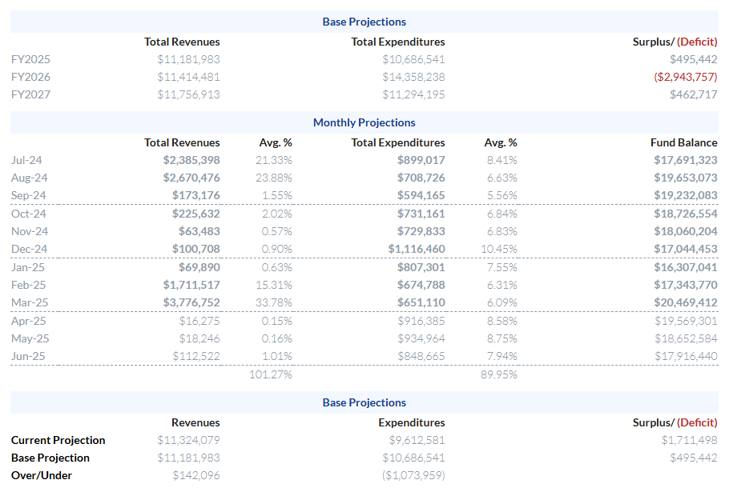
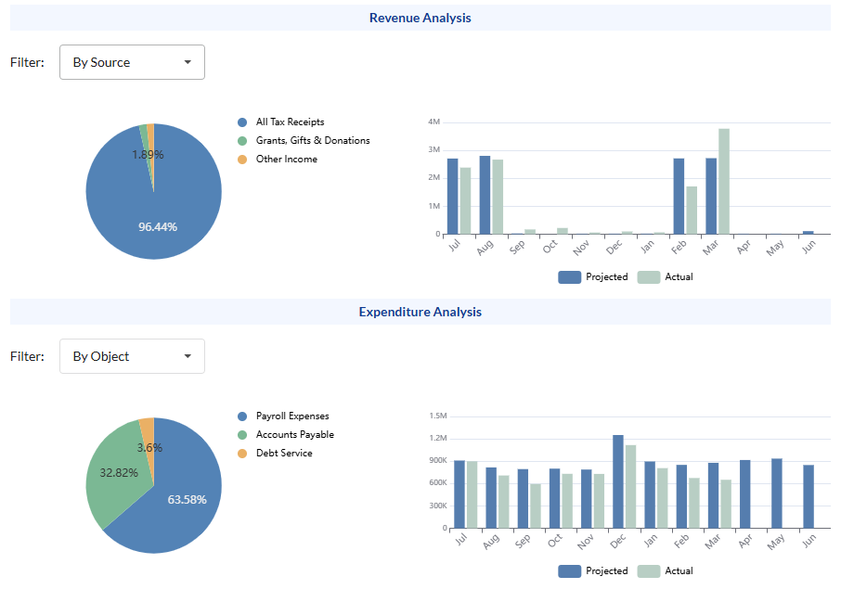
Structuring the cash flow
Please refer to the disclaimer for important information about this presentation and/or data.
Sample for informational purposes only, not intended to illustrate an actual investment scenario.

Slide 46
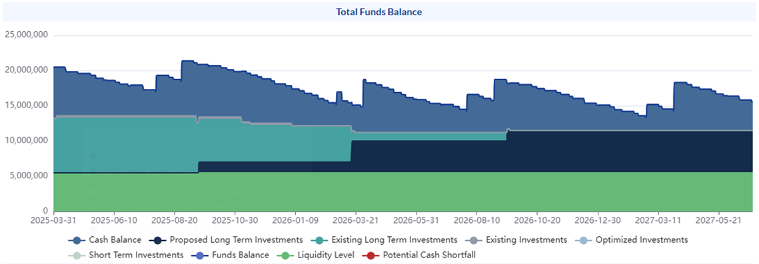
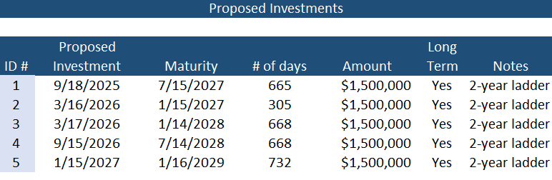
Structuring the cash flow
Please refer to the disclaimer for important information about this presentation and/or data.
Sample for informational purposes only, not intended to illustrate an actual investment scenario.

Slide 47
Investment concepts and strategies
Ladder Strategy
Match to cash flow
Purchase multiple securities with different maturities
Smooths out yield
Please refer to the disclaimer for important information about this presentation and/or data.

Slide 48
Understanding your cash flow - Key takeaways
Detailed Cash Flow Analysis is Essential
Comprehensive forecasting enables strategic financial management. It improves decision-making and fiscal health.
Interest Rate Environment Awareness
Strategic Matching Can Help Flatten Cash Flows when Possible
Different yield curves require different investment approaches. Adapt strategies as market conditions change.
Align investment maturities with payment obligations with reserve funds when applicable
Please refer to the disclaimer for important information about this presentation and/or data.

Slide 49
Investment Strategy Risk/Return Analysis
Please refer to the disclaimer for important information about this presentation and/or data.

Slide 50
BUILDING YOUR INVESTMENT STRATEGY
Based upon your specific goals and cash needs
0-5 Year
0-3 Year
Enhanced Cash
LGIP
Enhanced Cash
Short Duration
Short Duration
Intermediate Duration
Intermediate Duration
0-2 Years
0-3 Years
1-3 Years
0-5 Years
a
1-5 Years
For illustration only. Not intended to present an actual cash flow scenario and returns are not tied to the performance of any of our investment strategies. In this scenario, information displayed is intended to show that the further out the yield the investment, there is a potential increase in yield. Information should not be used to make an investment decision.
Please refer to the disclaimer for important information about this presentation and/or data.

Slide 51
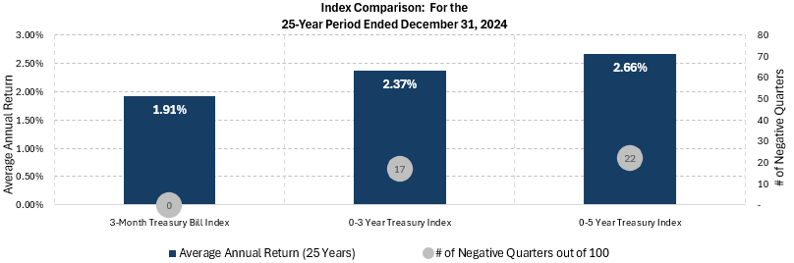
HISTORICAL RISK AND RETURN
Source: Bloomberg & Public Trust Advisors, LLC
Please refer to the disclaimer for important information about this presentation and/or data.

Slide 52
BOND PRICES AND CHANGES IN INTEREST RATES
Bond Prices
Interest Rates
Please refer to the disclaimer for important information about this presentation and/or data.

Slide 53
BOND PRICES AND CHANGES IN INTEREST RATES
Bond Prices
Rise
Interest Rates Decline
Please refer to the disclaimer for important information about this presentation and/or data.

Slide 54
BOND PRICES AND CHANGES IN INTEREST RATES
Interest Rates
Increase
Bond Prices
Decrease
Please refer to the disclaimer for important information about this presentation and/or data.

Slide 55
KEY INVESTMENT PROGRAM DECISIONS
Maintain an Updated Investment Policy
Perform a Thorough Cash Flow Analysis
Determine Appropriate Risk Tolerance For Your Entity
Determine Appropriate Portfolio Sizing For Liquidity and Core Portfolios
Evaluate Market Conditions and Economic Data
Consider Historical Perspective and the Current Environment
Understand Benefits (Enhanced Earnings, Dynamic Management Approach) and Risks involved with various Investment Strategies (Liquidity, Reinvestment, Credit)
Assess the Relative Value of Your Investment Options
Implement an Active and/or Passive Strategy for Core and Liquidity Funds based on Investment Management Goals and Objectives
Please refer to the disclaimer for important information about this presentation and/or data.

Slide 56
ECONOMY UPDATE
Please refer to the disclaimer for important information about this presentation and/or data.

Slide 57
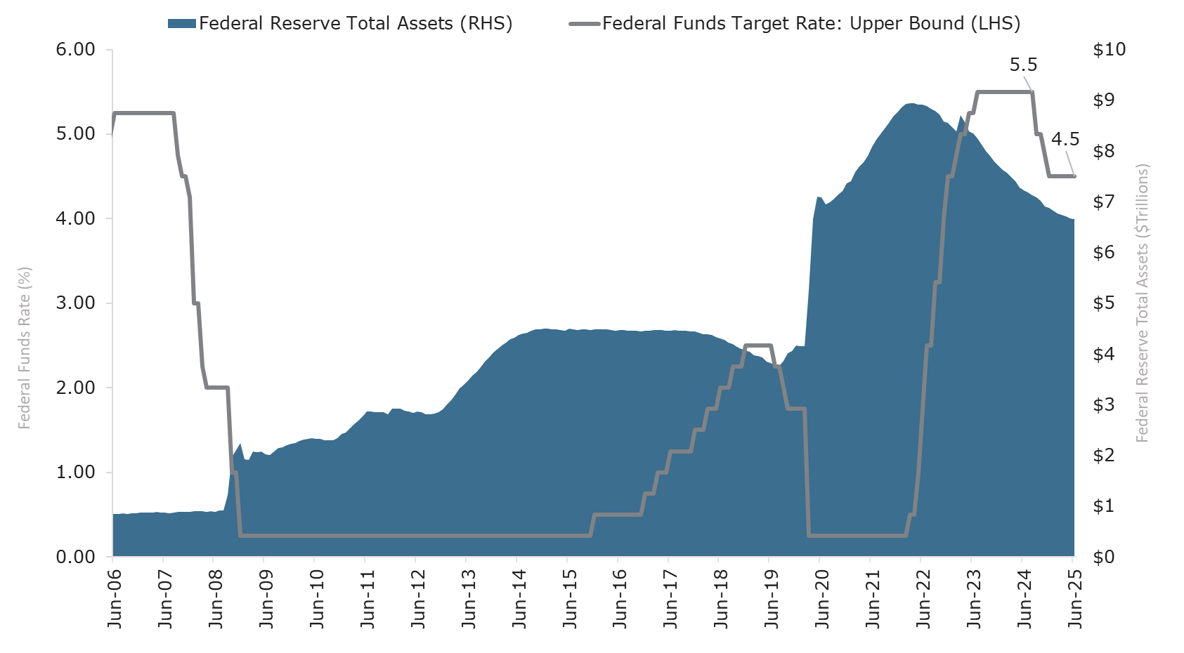
MONETARY POLICY: FED HOLDS RATES STEADY AND SLOWS BALANCE SHEET RUNOFF AMID RISING UNCERTAINTY
    Following 100 basis points (1.00%) of rate cuts in the final four months of 2024, the Fed voted to keep policy rates unchanged for a fourth consecutive meeting in June. At the press conference, Chair Powell noted the Fed expects greater clarity over the summer, particularly regarding the inflationary effects of tariffs and the resilience of the labor market. He emphasized that these developments will be key in shaping the committee’s confidence around when, or whether, to resume easing policy. The Fed’s updated economic projections pointed to slower growth and higher year-end inflation relative to March forecasts.
Source: Federal Reserve, Bloomberg
Data as of: 06/30/2025
Please refer to the disclaimer for important information about this presentation and/or data.

Slide 58
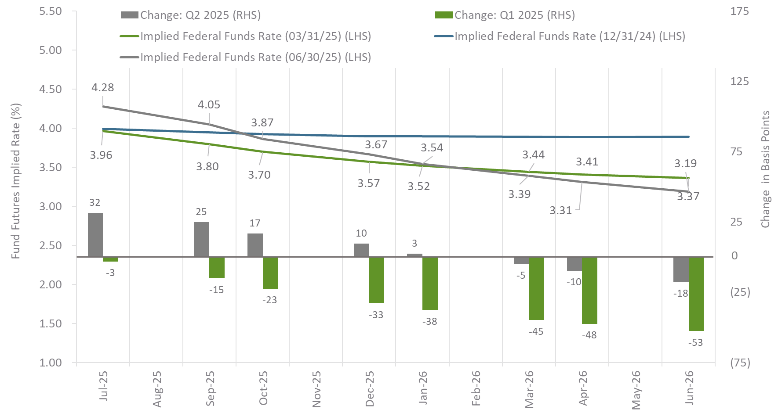
MONETARY POLICY:
RATE CUT EXPECTATIONS EASE AMIDST UNCERTAIN GROWTH AND INFLATION OUTLOOK
    Market expectations for additional Fed rate cuts accelerated in Q1 2025 amid escalating trade tensions, with participants pricing in three additional 25 basis point cuts by year-end. However, a more constructive tone in U.S.–China negotiations and resilient inflation data helped push back the expected timing of cuts in 2025. Futures now imply a more gradual path this year, but a slightly steeper pace of cuts in 2026 relative to end-Q1 projections, reflecting evolving views on growth, inflation, and policy risks.
Source: Bloomberg
Data as of: 06/30/2025
Please refer to the disclaimer for important information about this presentation and/or data.

Slide 59
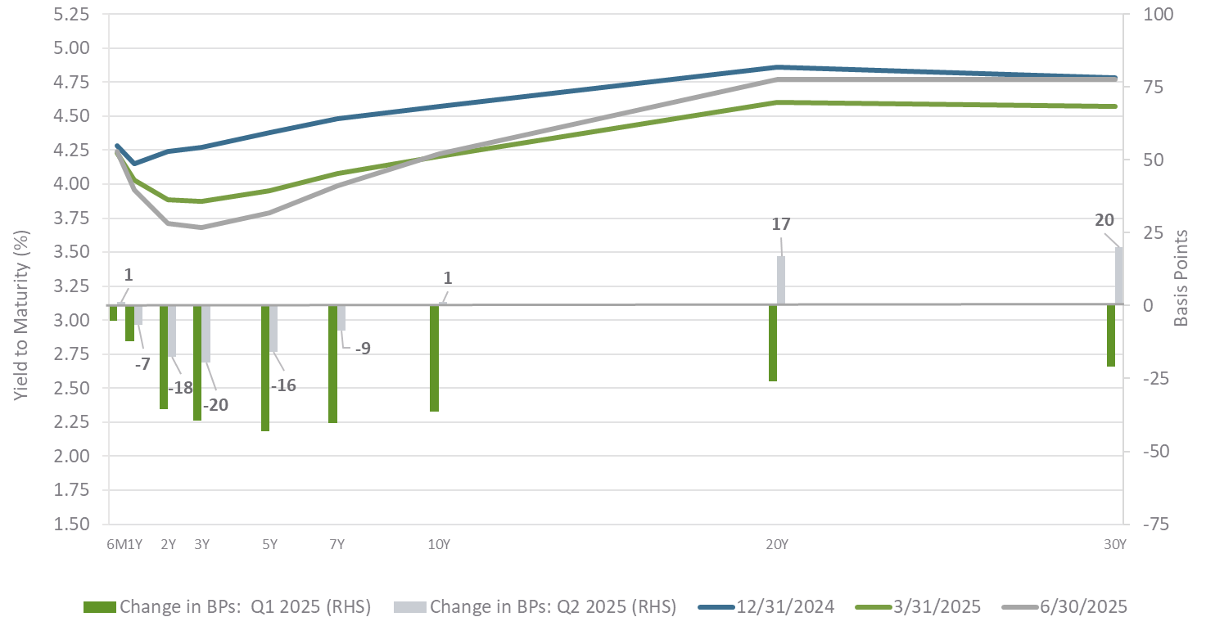
TREASURY MARKET:
YIELD CURVE STEEPENS AS LONG-TERM RATES RISE OF INFLATION AND FISCAL CONCERNS
    The U.S. Treasury yield curve steepened further in Q2 2025 as long-term yields rose and shorter-term rates declined. These moves reflect market expectations for further Fed rate cuts over the next year alongside growing term premium pressures. Persistent fiscal imbalances and elevated deficits contributed to higher long-end yields despite uncertainties around trade policy, growth, and inflation. As a result, the 2/10-year Treasury yield spread widened to 0.51% at quarter-end from 0.32% at the end of Q1, highlighting market sensitivity to both monetary policy expectations and fiscal dynamics as drivers of curve shape.
Source: Bloomberg
Data as of: 06/30/2025
Please refer to the disclaimer for important information about this presentation and/or data.

Slide 60
MARKET BASED PROBABILITY OF A RATE HIKE/CUT
Each data point along the blue line represents the market-implied overnight rate after the corresponding FOMC meeting date. These rates are implied by the Federal Funds Futures contracts. The grey bars represent the number of 25 basis point rate hikes/cuts that are currently priced in.
Source: Bloomberg, data as of July 11, 2025
Please refer to the disclaimer for important information about this presentation and/or data.

Slide 61
U.S. TREASURY YIELDS
The green line represents the U.S. Treasury Actives curve at the historical date in the above chart legend. The blue line represents the current U.S. Treasury Actives curve on the date in the above chart legend. The grey bars represents the change in yield between the current and historical curves as measured in basis points.
Source: Bloomberg, data as of July 10, 2025
Please refer to the disclaimer for important information about this presentation and/or data.

Slide 62
U.S. MONEY MARKET CURVES
The green line represents the current U.S. dollar A-1 CP curve on the date in the above chart title. The blue line represents the current U.S. Treasury bill curve on the date in the above chart title. The grey bars represents the difference in yield between the A-1 CP and T-bill curves as measured in basis points.
Source: Bloomberg, data as of July 11, 2025
Please refer to the disclaimer for important information about this presentation and/or data.

Slide 63

CONTACT
Tom Tight
Managing Director
 | (407) 765-0761
 | tom.tight@ptma.com
Please refer to the disclaimer for important information about this presentation and/or data.

Slide 64
QUESTIONS?
Please refer to the disclaimer for important information about this presentation and/or data.

