Slide 1
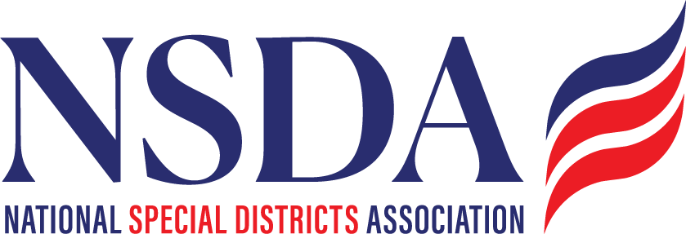
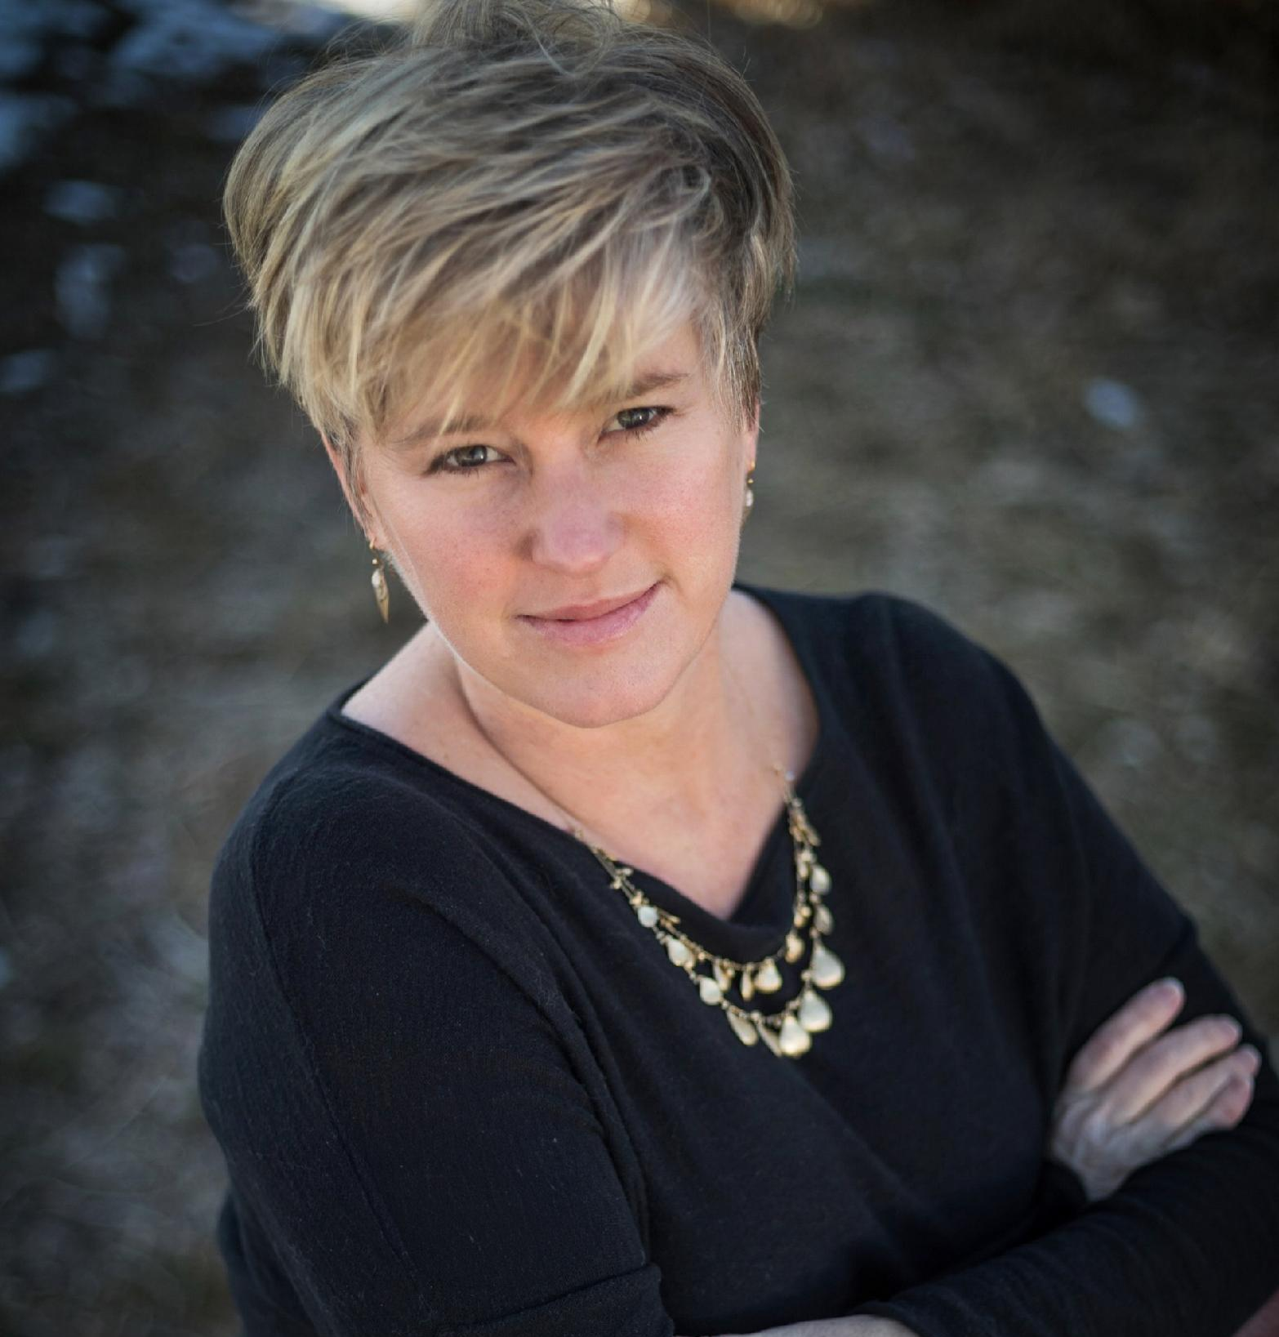
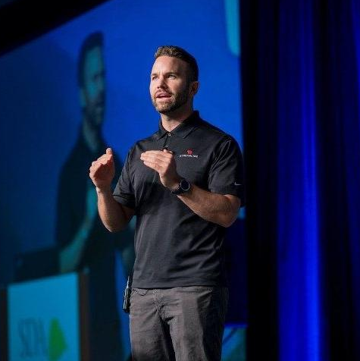

FEDERAL POLICY UPDATE FOR SPECIAL DISTRICTS
What's Changing
& How to Prepare
DOWNLOAD THIS PRESENTATION
Chantal Unfug
Mac Clemmens
tinyurl.com/sda-nsda
NSDA
Streamline / CivicPlus
Notes:
Title slide.

Slide 2



Today's agenda
Three parts, two presenters
PART 1
PART 2
PART 3
NSDA update
ADA compliance
Cybersecurity
Thank you for your leadership, Colorado — how NSDA is growing, federal advocacy, grants, connections and the bills that matter to districts.
What the DOJ web-accessibility rule requires, who has to comply and by when, and five steps to achieve (and maintain) compliance.
Five practices that keep special districts safe in the age of AI tools — and a real-or-fake challenge.
Chantal Unfug, NSDA
Mac Clemmens, Streamline / CivicPlus
Mac Clemmens, Streamline / CivicPlus

Slide 3







Thank you for your leadership, Colorado!
What NSDA membership delivers to Colorado's special districts
Advocacy
Grants & Funding
Education & Resources
The NSDA gives you a powerful voice through our advocacy to progress by focusing on issues that affect all special districts.
The NSDA has partnered with The Ferguson Group (TFG) to offer a range of grant services to our NSDA members.
The NSDA provides member resources: webinars, for grants and appropriations, practices, advocacy needs, and more.
Stronger Together
National Advocacy
Exclusive Resources
Valuable Connections
Stronger Districts
A united voice for special districts.
Advancing the interests of special districts in Washington, DC.
Tools, research, and education to help you succeed.
Build relationships and share solutions with peers.
Support, resources, and advocacy for every special district.

Slide 4
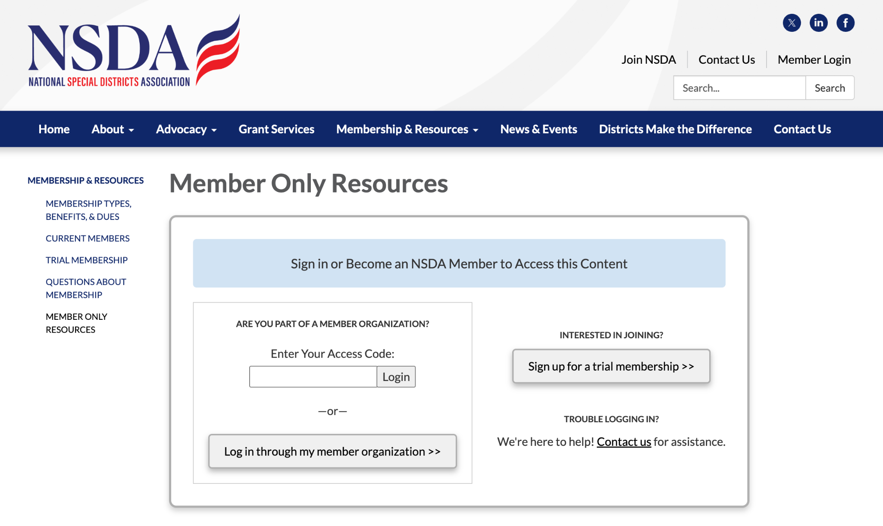





Access NSDA Federal News & Alerts
Member-only resources on the NSDA website — nationalspecialdistricts.org
WEBSITE CODE
Sign in to access this content - free with your NSDA membership!
What you'll find
Weekly recaps of Congress and agency activity
Alerts on bills affecting special districts
Grant and webinar announcements
STRONGER TOGETHER
NATIONAL ADVOCACY
EXCLUSIVE RESOURCES
VALUABLE CONNECTIONS
STRONGER DISTRICTS

Slide 5
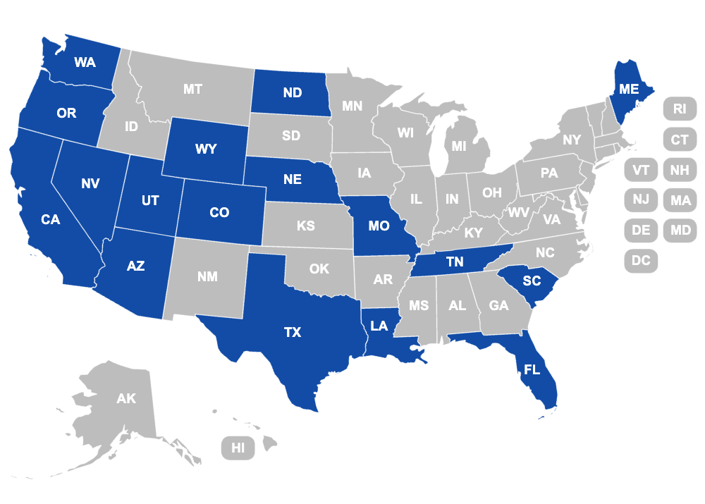

NSDA is growing
Stronger Together — a united voice for special districts
8
17
new members in 2026
states now represented
WELCOME, NEW MEMBERS
North Dakota Recreation and Park Association
Tennessee Association of Utility Districts
Lakeshore Villages Master Community Development District
St. Tammany Parish Mosquito Abatement District
St. Tammany Parish Drainage District
NSDA Original State Partners
NSDA New State Partners
Member states
STRONGER TOGETHER
NATIONAL ADVOCACY
EXCLUSIVE RESOURCES
VALUABLE CONNECTIONS
STRONGER DISTRICTS
Notes:
NSDA is growing: 8 new members in 2026, representation now 17 states. Red stars are original state partners; gold stars are new state partners.

Slide 6
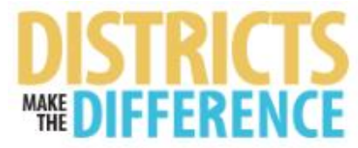
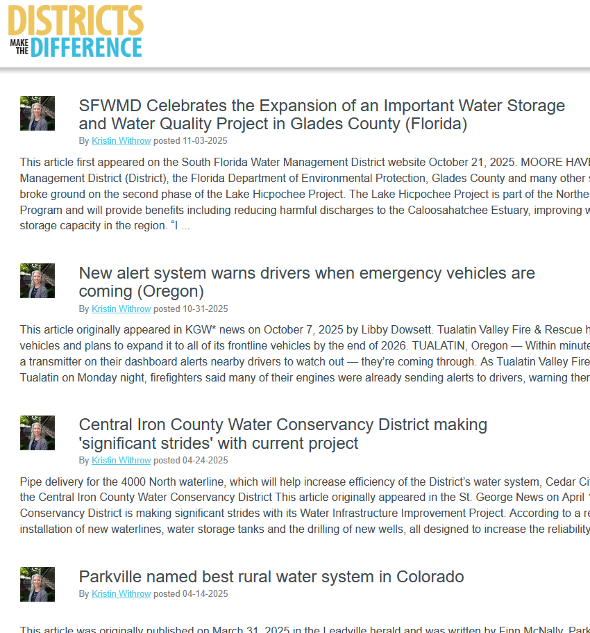
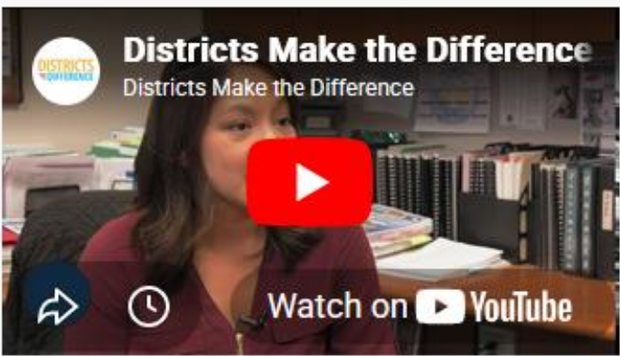
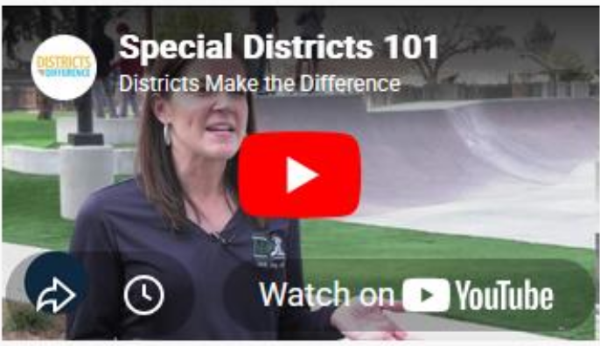
Districts Make the Difference
National Advocacy — telling the story of special districts
For over 100 years, special districts have kept our lights on, our water running, and our communities safe.
Districts Make the Difference
Stories from districts across the country — Florida, Oregon, Utah, Colorado and more — published on the Districts Make the Difference blog and shared through our social channels.
The blog: district success stories
Special Districts 101
STRONGER TOGETHER
NATIONAL ADVOCACY
EXCLUSIVE RESOURCES
VALUABLE CONNECTIONS
STRONGER DISTRICTS

Slide 7

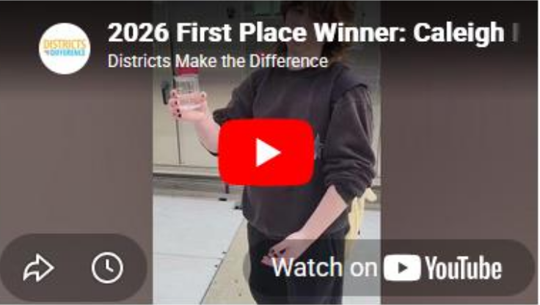
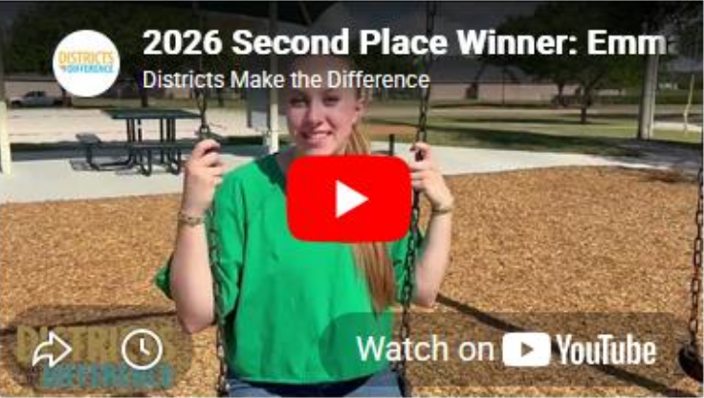
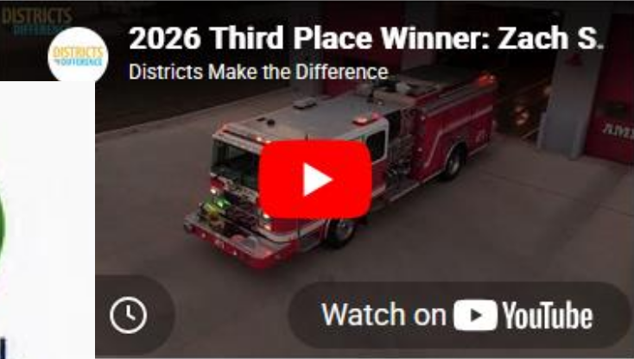

2026 Student Video Scholarship Contest
Districts Make the Difference — raising civic awareness among the nation's youth
The 2026 Student Video Scholarship Contest was open to U.S. high school students in all 50 states. The purpose of the annual contest is to raise awareness and promote civic education among the nation's youth as they embark upon adulthood and become participants in government. info@districtsmakethedifference.org
Follow @LocalDistricts on Facebook, Instagram, X and YouTube, or find Districts Make The Difference on LinkedIn. Contest announcements go out in January.
2026 First Place
2026 Second Place
2026 Third Place
$2,000 scholarship
$1,000 scholarship
$500 scholarship
STRONGER TOGETHER
NATIONAL ADVOCACY
EXCLUSIVE RESOURCES
VALUABLE CONNECTIONS
STRONGER DISTRICTS

Slide 8
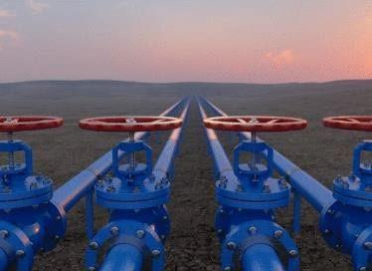


First ever federal advocacy program for special districts
Working with our National Advocacy Committee
Advocate
Access
Funding
Communicate
Educate
Issues, issues, issues:
Special District Fairness and Accessibility Act
Infrastructure Bills
Public Finance
Permitting Reform
US Census Bureau
Farm Bill
Funding for Districts
Disaster Resilience, Readiness, Response and Recovery
Trends across States
Water Infrastructure for Fire Fighting
Special districts deliver water, fire protection, parks, roads and more — the federal program gives them a seat at the table for the first time.
And today? Cybersecurity and ADA requirements
STRONGER TOGETHER
NATIONAL ADVOCACY
EXCLUSIVE RESOURCES
VALUABLE CONNECTIONS
STRONGER DISTRICTS

Slide 9
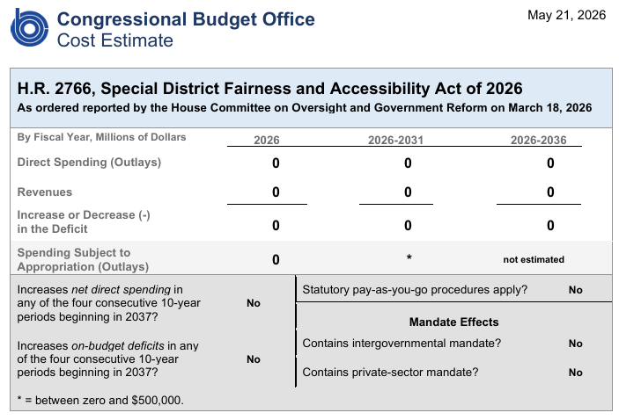

Defining special districts in federal law
H.R. 2766 — the Special District Fairness and Accessibility Act of 2026
This vital legislation will clarify the role and purpose of special districts across the country by defining special districts in federal law for the first time. Special districts will have a seat at the table in policy development and legislation in Washington, DC.
March 18, 2026 — passed out of Committee
The House Committee on Oversight and Government Reform advanced H.R. 2766 by a vote of 32–8 — the next step toward the House floor.
OUR ASK
Talk to your Executives about reaching your Congressional Members
Congressional Budget Office cost estimate, May 21, 2026 — $0 direct spending, $0 revenue, no intergovernmental or private-sector mandates.
STRONGER TOGETHER
NATIONAL ADVOCACY
EXCLUSIVE RESOURCES
VALUABLE CONNECTIONS
STRONGER DISTRICTS

Slide 10


Recent cybersecurity threats to the water sector
Stronger Districts — why cybersecurity is on today's agenda
What happened
Who is behind it
What it means for districts
Last month, CISA, the FBI and EPA reported a significant increase in cyberattacks targeting U.S. water utilities — including a coordinated July attack against more than 30 community water systems in Minnesota. Federal agencies specifically reported that attackers are focusing on programmable logic controllers (PLCs) used to operate wastewater and water treatment facilities, raising concerns about the security of critical infrastructure nationwide.
While CISA has not formally attributed the attacks to a specific source, federal advisories note that Iran-affiliated hackers have targeted industrial control systems used by utilities, and security officials suspect recent attacks may be connected to ongoing Iranian cyber activity against U.S. water systems.
As operators of local water systems, water and wastewater districts may face increased vulnerability to service disruptions and operational impacts.
That is why Part 3 of today's session is all about practical cybersecurity for special districts.
30+
Minnesota water systems hit in one July attack
STRONGER TOGETHER
NATIONAL ADVOCACY
EXCLUSIVE RESOURCES
VALUABLE CONNECTIONS
STRONGER DISTRICTS

Slide 11

ADA Title II web accessibility: new DOJ Interim Final Rule
Stronger Districts — a one-year extension, and special districts are covered
NEW COMPLIANCE DATES
Read the Interim Final Rule on federalregister.gov
April 26, 2027
Local governments with populations over 50,000
The U.S. Department of Justice (DOJ) released a new Interim Final Rule (IFR) on its implementation of Title II of the Americans with Disabilities Act (ADA) web-based accessibility requirements for state and local governments. The IFR provides new guidance to reduce the cost of compliance and, importantly, grants all state and local governments a one-year extension from their original compliance date.
April 26, 2028
Local governments with populations at or below 50,000 — and all special districts
Special districts are included. The IFR uses the definition of "public entity" in 42 U.S. Code § 12131, which is used interchangeably with "local government" — and includes special districts.
STRONGER TOGETHER
NATIONAL ADVOCACY
EXCLUSIVE RESOURCES
VALUABLE CONNECTIONS
STRONGER DISTRICTS
Notes:
DOJ IFR on ADA Title II web accessibility: one-year extension. New compliance dates per the Federal Register: April 26, 2027 (50,000+) and April 26, 2028 (under 50,000 and special district governments).

Slide 12







Access grant resources, news & services
NSDA has partnered with The Ferguson Group (TFG) to offer exclusive benefits to NSDA members.
NSDA member discounts and free webinars
Project Idea Portal — matching your project funding needs to grant opportunities
Grant training services
Grant announcements & updates
Grant guides
Grants database access — over 700 successful applications
Appropriations & earmarks support
Customized services
thefergusongroup.com
TFG'S FIVE-STEP PROCESS
STEP 1
Needs Analysis
STEP 2
Grant Funding Research
STEP 3
Position Priority Projects
STEP 4
Grant Writing
STEP 5
Organize Political Support
STRONGER TOGETHER
NATIONAL ADVOCACY
EXCLUSIVE RESOURCES
VALUABLE CONNECTIONS
STRONGER DISTRICTS

Slide 13


Example: FEMA cybersecurity grants for Colorado districts
State and Local Cybersecurity Grant Program (SLCGP) — a funding opportunity open to special districts
Federal status
Colorado SLCGP - FY2025 SLCGP grant application (Thanks Eric Dowdy)
The authorization is unresolved. SLCGP was created with a four-year authorization and appropriation under the 2021 infrastructure law. That run ended in September 2025, and Congress has since kept the program's authority alive through short-term extensions in funding bills — but has provided no new appropriation and has not reauthorized the program at this time.
Awardees receive a managed detection and response (MDR) service
Special districts are explicitly eligible — alongside local governments and public safety / emergency services agencies. Past Colorado special district awardees include parks & recreation, ambulance, sanitation, library, and fire protection districts.
At the end of August, DHSEM reopened the FY 2025 application period to bring in more local governments, public safety agencies and special districts. cdps_slcgp@state.co.us
Sept 30, 2026
Applications due
40% match
Required in this reopened round
STRONGER TOGETHER
NATIONAL ADVOCACY
EXCLUSIVE RESOURCES
VALUABLE CONNECTIONS
STRONGER DISTRICTS

Slide 14
EPA drinking water resilience & sustainability grants
Midsize and Large Drinking Water System Infrastructure Resilience and Sustainability Program
INAUGURAL ROUND — ANNOUNCED AUGUST 31, 2026
Who and what
$11.75 million
Eligible applicants: public water systems serving a population of 10,000 or more.
Funding use: planning, design, construction, implementation, operation, or maintenance of a program or project that increases resilience of public water systems to natural hazards and extreme weather events, or reduces cybersecurity vulnerabilities.
awarded across 10 projects
Denver Water, CO
Increase drinking water system resilience to wildfires and extreme weather through dam infrastructure upgrades that reduce flood risk and improve operational reliability.
$1,125,000
San Diego, CA
Address natural hazard and cybersecurity vulnerabilities through Programmable Logic Controller (PLC) replacement.
$2,375,000
Lake City, FL
Increase resilience to cybersecurity threats by modernizing the SCADA and pump control system.
Program details on epa.gov
$189,875
Note: the sole Colorado awardee was a natural hazard project rather than a cyber one.
STRONGER TOGETHER
NATIONAL ADVOCACY
EXCLUSIVE RESOURCES
VALUABLE CONNECTIONS
STRONGER DISTRICTS

Slide 15





Thank you to our Supporting Business Affiliate Partners
Valuable Connections — build relationships and share solutions with peers
A big welcome to our newest partner: Municipal Finance Corporation
NEW
STRONGER TOGETHER
NATIONAL ADVOCACY
EXCLUSIVE RESOURCES
VALUABLE CONNECTIONS
STRONGER DISTRICTS

Slide 16

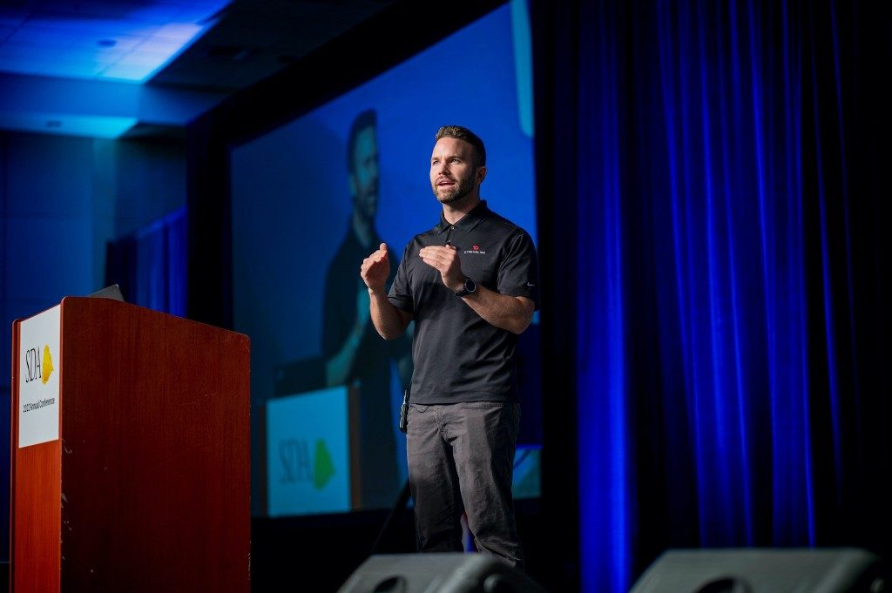
PART 2
ADA compliance: preparing for the DOJ accessibility mandate
What the rule requires, who has to comply and by when, and five steps to achieve — and maintain — compliance.
Mac Clemmens · Streamline / CivicPlus

Slide 17

Legal foundations for website accessibility
Five layers, from the broad law to the specific technical standard
1
ADA Compliance
The Americans with Disabilities Act protects the rights of people with disabilities. Its broad reach extends to websites, but it doesn't reference web accessibility specifically.
2
DOJ 28 CFR Part 35
New guidance released June 24, 2024 explaining how public entities must comply and how the Department of Justice will enforce website accessibility. (Full rule ↗)
3
Section 508
A law referenced by the ADA that more specifically outlines how to meet accessibility standards for electronic content, including websites.
4
State laws
Require that public entities comply with accessibility guidelines. Examples include HB 21-1110 in Colorado or the Unruh Act in California.
5
WCAG 2.1 AA Guidelines
The international web accessibility guidelines referenced (directly and indirectly) by both state and federal laws regarding web accessibility.

Slide 18




What does the 2024 DOJ update require?
Under the ADA Title II Final Rule, public entities must ensure that:
All digital content is accessible
Documents meet WCAG 2.1 AA
Websites, documents, and PDFs must be accessible to people with disabilities.
The same accessibility benchmark used for websites applies to documents.
Accessibility is more than looks
Internal content counts too
Structure, navigation, color contrast, alt text, and compatibility with assistive technology.
Public-facing and essential internal content — forms, reports, and portals.

Slide 19

Quick poll
How are you planning on managing PDF remediation?
Show of hands
A
We manage remediation in-house.
B
We work with a professional remediation partner.
C
We utilize AI tools to help with remediation.
D
We have no current plans for remediation.

Slide 20

HOW?
Real-world experiences
What districts like yours are actually doing about document accessibility.

Slide 21





5 steps to achieve (and maintain) compliance
No need to fear — accessibility is achievable. See why it’s important.
1
2
3
4
5
Designate an Accessibility Officer
Approve an Accessibility Statement
Scan and assess your current status
Identify the compliance route that works for you
Consider a third-party ADA audit
Step 4 is where most of the decisions — and most of the cost — live, so we'll spend the most time there.

Slide 22

1
Designate an Accessibility Officer
Someone must be responsible — not necessarily an "accessibility expert," but a clear point of contact.
WHO
Key tasks
Select a person in your organization to handle accessibility needs (usually the person who updates your website).
Acts as the bridge between IT, communications, legal, and vendors.
Keeps track of accessibility plans, documentation, and timelines.
Maintain accessibility policy
Coordinate training and audits
Ensure content and vendor tools meet WCAG 2.1 AA
1
DESIGNATE AN OFFICER
2
APPROVE A STATEMENT
3
SCAN & ASSESS
4
PICK YOUR ROUTE
5
CONSIDER AN AUDIT
Notes:
Acts as the bridge between IT, communications, legal, and vendors. Keeps track of accessibility plans, documentation, and timelines. Key tasks: maintain accessibility policy; coordinate training and audits; ensure vendor tools and content meet WCAG 2.1 AA.

Slide 23
2
Approve an Accessibility Statement
A clear policy — and a contact for accessibility requests — is one of the strongest signs of good-faith compliance.
Formally adopt an Accessibility Policy approved by leadership, council, or the board.
Outline your agency's intent to comply with WCAG 2.1 AA and the ADA Title II rule.
Here's a sample to start
Post it publicly on your website (often linked in the footer).
getstreamline.com/accessibility-policy
Define how requests for accommodation should be submitted (usually a form, email, or phone number) — best to have two methods.
Copy it, adapt it, get it approved, post it.
Review annually to reflect new technologies, vendors, or laws.
1
DESIGNATE AN OFFICER
2
APPROVE A STATEMENT
3
SCAN & ASSESS
4
PICK YOUR ROUTE
5
CONSIDER AN AUDIT
Notes:
This simple step signals transparency and accountability. Having a clear policy — and a contact listed for accessibility requests — is one of the strongest indicators of good-faith compliance.

Slide 24
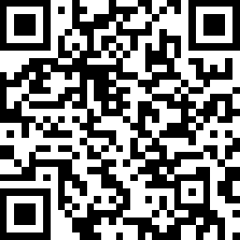
3
Scan and assess your current status
Run an accessibility scan across your website and document library.
IDENTIFY
TOOLS
How many PDFs and public documents you have
Free accessibility checkers
PAC 2026, PDF Accessibility Checker, etc.
Which are accessible vs. not
DocAccess.com
Free scans, categorizes, and estimates remediation effort.
What issues appear most often (missing tags, alt text, etc.)
Scan QR to try a free scan
1
DESIGNATE AN OFFICER
2
APPROVE A STATEMENT
3
SCAN & ASSESS
4
PICK YOUR ROUTE
5
CONSIDER AN AUDIT

Slide 25



4
Identify the compliance route that works for you
The most common options are:
OPTION A
OPTION B
OPTION C
DIY document remediation
Third-party manual services
Automated or AI-assisted software
Best for agencies with internal staff capacity and very small document volumes.
Best for large, one-time backlogs or high-stakes public documents.
Ideal for agencies with ongoing document publishing.
1
DESIGNATE AN OFFICER
2
APPROVE A STATEMENT
3
SCAN & ASSESS
4
PICK YOUR ROUTE
5
CONSIDER AN AUDIT

Slide 26

4
(A) DIY document remediation
Best for agencies with internal staff capacity.
How it works
Challenges
Tools like Adobe Acrobat Pro or PAC 2026 can be used.
Labor-intensive
Works for very small document volumes.
Requires technical training
You keep full control and pay no vendor cost.
Hard to scale
1
DESIGNATE AN OFFICER
2
APPROVE A STATEMENT
3
SCAN & ASSESS
4
PICK YOUR ROUTE
5
CONSIDER AN AUDIT

Slide 27
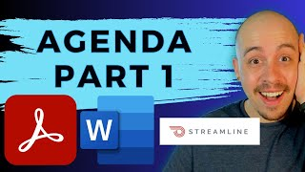
4
Other resources for DIY remediation
Free, practical help for districts remediating their own documents
The Accessibility Guy — a great YouTube channel focused not only on how to remediate your documents, but also on creating accessible documents going forward. He has two videos going into detail on creating accessible agendas that use Streamline to verify!
DOJ's Small Entity Implementation Guide — detailed legal requirements for local governments on how to comply with the ADA online, such as the definition of archived content.
Part 1: Make a simple agenda fully compliant
Part 2: Make a more complex document fully compliant
1
DESIGNATE AN OFFICER
2
APPROVE A STATEMENT
3
SCAN & ASSESS
4
PICK YOUR ROUTE
5
CONSIDER AN AUDIT

Slide 28
4
(B) Third-party manual services
Best for large, one-time backlogs or high-stakes public documents.
How it works
Challenges
Specialists manually tag and repair each PDF.
High cost ($7–$25 per page)
High accuracy on the documents you send them.
3–10 day turnaround time
May not be sustainable for ongoing uploads or compliance updates
1
DESIGNATE AN OFFICER
2
APPROVE A STATEMENT
3
SCAN & ASSESS
4
PICK YOUR ROUTE
5
CONSIDER AN AUDIT

Slide 29


4
(C) Automated or AI-assisted software
Ideal for agencies with ongoing document publishing.
How it works
Automatically converts PDFs into WCAG-compliant format (like HTML, DocAccess).
What we like
Sustainable, continuous compliance — every new document published is accessible from day one.
Scales to large document libraries quickly and cost-effectively.
Cost effective.
1
DESIGNATE AN OFFICER
2
APPROVE A STATEMENT
3
SCAN & ASSESS
4
PICK YOUR ROUTE
5
CONSIDER AN AUDIT

Slide 30
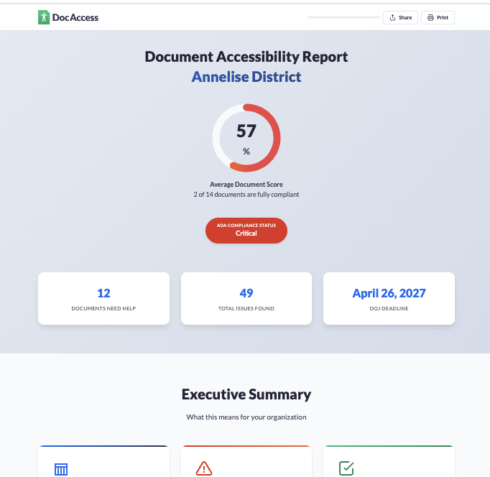
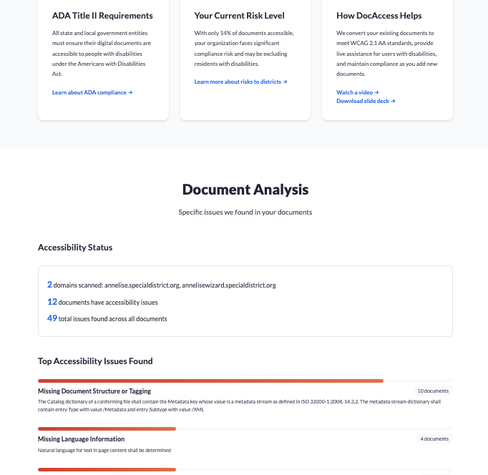
4
Sample document accessibility report
What a free DocAccess scan gives you: an executive summary and a document-by-document analysis
Every scan tells you
Documents scanned
Accessible vs. not
Most common issues
Estimated remediation effort
Executive summary
Document analysis
1
DESIGNATE AN OFFICER
2
APPROVE A STATEMENT
3
SCAN & ASSESS
4
PICK YOUR ROUTE
5
CONSIDER AN AUDIT

Slide 31
4
How to decide your approach?
Match the route to your document volume, budget, and how often you publish
Approach | Best for | Strengths | Challenges
DIY | Small districts, limited budgets | Control, no vendor cost | Time-consuming, error risk, hard to reach 100% compliance
Third-party | Large backlogs, key reports | Accuracy | Expensive, not ongoing, slow turnaround
Software / AI | Ongoing publishing and compliance, community experience | Scalable, fast, cost-efficient | Needs setup & oversight, indemnity
1
DESIGNATE AN OFFICER
2
APPROVE A STATEMENT
3
SCAN & ASSESS
4
PICK YOUR ROUTE
5
CONSIDER AN AUDIT

Slide 32
5
Consider a third-party ADA audit
Independent testing strengthens your plan — especially for larger agencies.
If you're a larger agency, consider a third-party test.
Use software that is audited — ask for a copy of the last report or VPAT.
Ask your vendors
"When was your product last audited, and can you share the report or VPAT?"
Especially if manual testing was performed, you can include it in your plan.
1
DESIGNATE AN OFFICER
2
APPROVE A STATEMENT
3
SCAN & ASSESS
4
PICK YOUR ROUTE
5
CONSIDER AN AUDIT

Slide 33
Accessibility is a journey — not a one-time project
Three habits that keep you compliant after the deadline
Ongoing publishing = ongoing compliance
Build accessibility into workflows and training
Partner when needed for scale and expertise

Slide 34


Things to watch for in the future
Open questions the whole sector is working through
Technologies
Liability
Transparency
How will new technologies make remediation and accessibility easier?
Who will be responsible for liability — the website vendors or the districts?
Will districts stop communicating online out of fear?
Our answer on transparency: No! We must keep telling our story.
Notes:
Technologies: How will new technologies make remediation and accessibility easier? Liability: Who will be responsible for liability—the website vendors or the districts? Transparency: Will districts stop communicating online out of fear? (answer: No! We must keep telling our story!)

Slide 35



PART 3
5
Cybersecurity practices
Keeping special districts safe in the age of AI tools.
Presented by Mac Clemmens
Notes:
MAC: Opening comments: commit to speaking human, thanking them for their interest. (Note: these topics have technical terms but will be explained in a way that makes sense to non-technical attendees.)

Slide 36
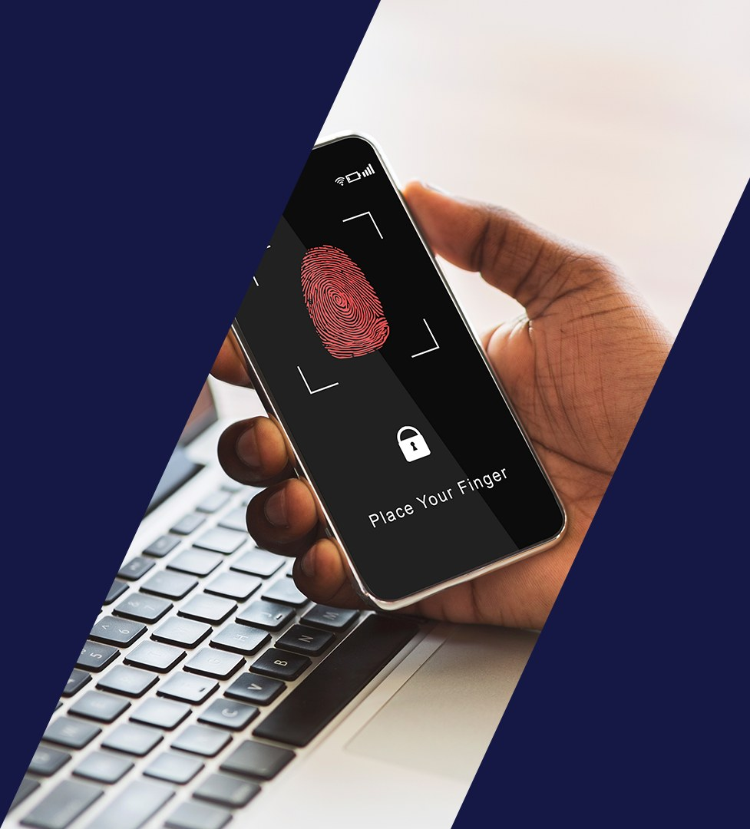

1
Enable Multi-factor Authentication (MFA)
Keeping your email safe will keep your organization safe. It's free to enable!
Turn it on everywhere you can
Mainly Microsoft 365 for most districts — but anywhere you have the opportunity. Quick poll: how many of you have MFA set up on M365 today?
1
ENABLE MFA
2
GET A .GOV
3
ENABLE DMARC
4
BE PHISHING-READY
5
CALL TO CONFIRM
Notes:
MN – Mainly about 365 but in general, anywhere they have the opportunity. Office 365 poll. Link on how to: Multifactor authentication for Microsoft 365 - https://docs.microsoft.com/en-us/microsoft-365/admin/security-and-compliance/multi-factor-authentication-microsoft-365?view=o365-worldwide

Slide 37
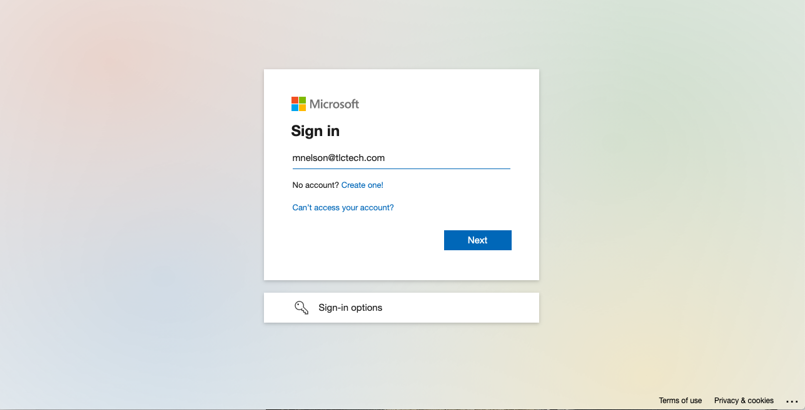
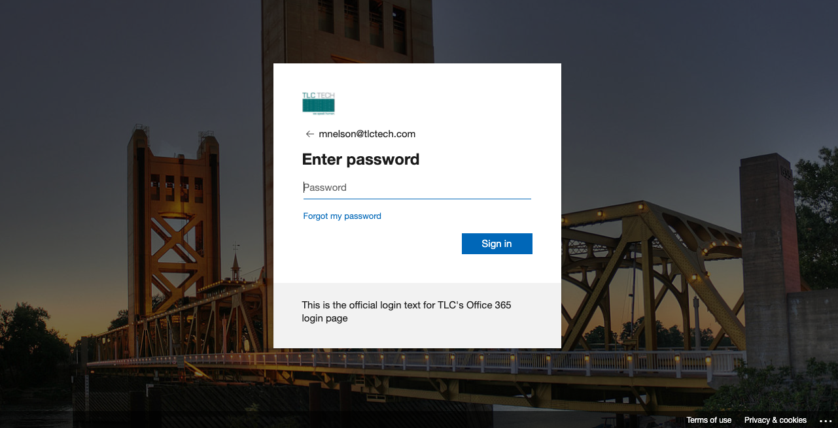
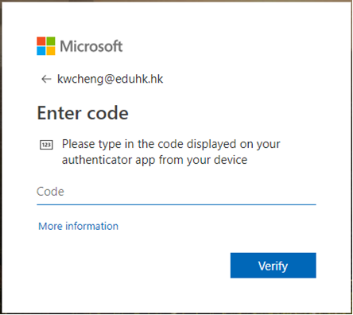
What MFA looks like in practice
Three screens, a few seconds — and a stolen password alone is no longer enough
1 · Enter your email (mac@getstreamline.com)
2 · Enter your password — note our logo, not the basic Microsoft one
3 · Enter the code from your authenticator app
1
ENABLE MFA
2
GET A .GOV
3
ENABLE DMARC
4
BE PHISHING-READY
5
CALL TO CONFIRM
Notes:
Explain why they have 2 pages for email and THEN login. Point out OUR logo versus the basic MS logo. Link to setting up MFA on Microsoft (very geeky). Real-time poll: how many of you have MFA currently set up on M365?

Slide 38


2
Get a .gov domain
What is it? A domain reserved for U.S. government organizations — including special districts.
Free at get.gov
Helps protect against spam and spoofing
Rank higher in search results
Get the .gov guide →
1
ENABLE MFA
2
GET A .GOV
3
ENABLE DMARC
4
BE PHISHING-READY
5
CALL TO CONFIRM
Notes:
This needs to be turned on by your admin. Included with certain Office 365 plans, may be an add-on to lower priced licenses. Can also be a third-party provider outside of Microsoft (Proofpoint, Mimecast, Titan Spam Filtering).

Slide 39
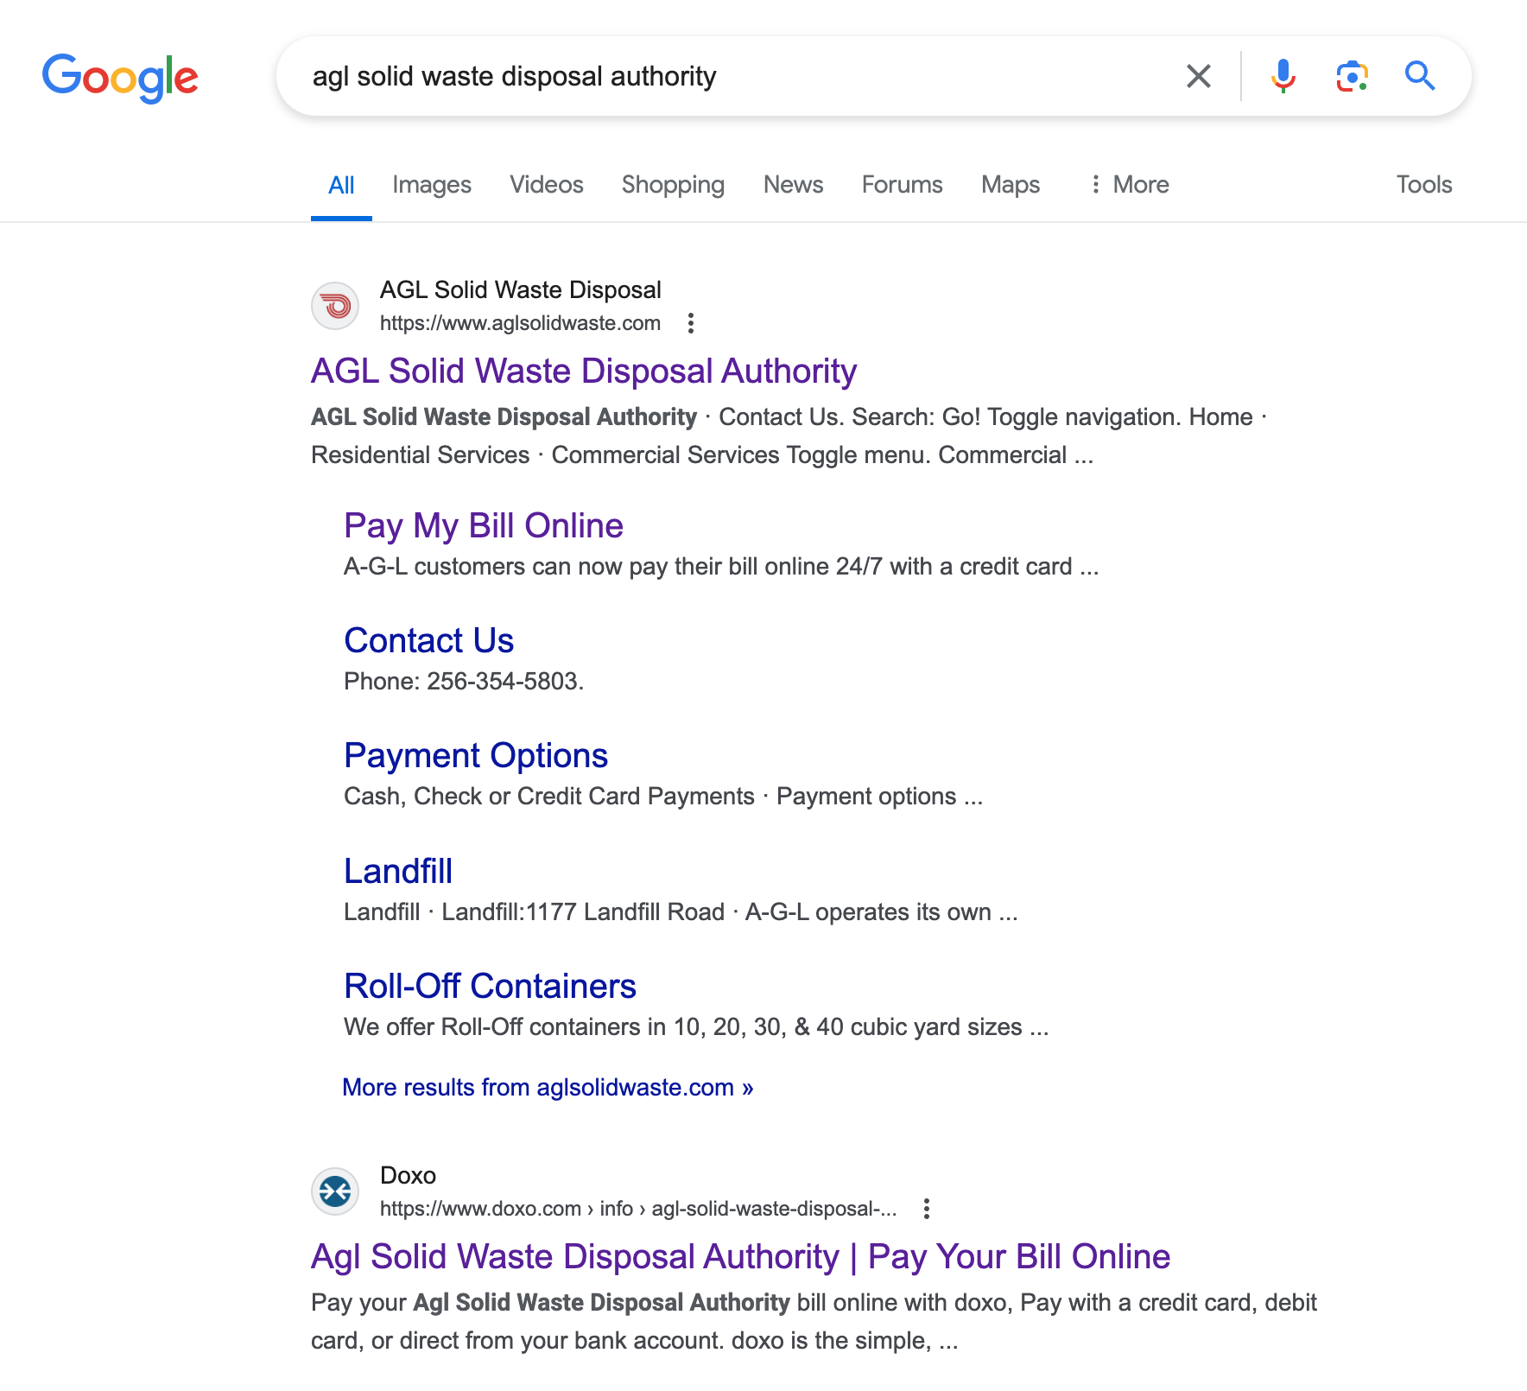
Real site or scam site?
Two results for the same district — a .gov domain makes the real one obvious
Top result — real site
The district's own domain, with its real contact and payment pages.
Lower result — scam site
A look-alike "Pay Your Bill Online" page. With a .gov domain, residents can tell them apart at a glance.
1
ENABLE MFA
2
GET A .GOV
3
ENABLE DMARC
4
BE PHISHING-READY
5
CALL TO CONFIRM

Slide 40

3
Make sure DMARC is enabled
…to keep others from sending mail as you.
D-huh?
Domain-based Message Authentication, Reporting, and Conformance. It tells receiving mail servers what to do with messages that claim to come from your domain but fail authentication.
Free check: MXToolbox.com
1
ENABLE MFA
2
GET A .GOV
3
ENABLE DMARC
4
BE PHISHING-READY
5
CALL TO CONFIRM
Notes:
Domain-based Message Authentication, Reporting, and Conformance.

Slide 41


4
Be ready for phishing
Be suspicious of those you know… and here's why.
The most common way in
Most breaches start with one convincing email. The next few slides are real examples — and how AI is making them much harder to spot.
1
ENABLE MFA
2
GET A .GOV
3
ENABLE DMARC
4
BE PHISHING-READY
5
CALL TO CONFIRM
Notes:
MN: Be suspicious of those you know… and why.

Slide 42
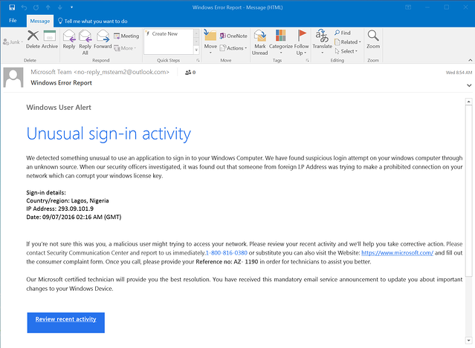
Phishing example
A classic "unusual sign-in activity" email
TELL-TALE SIGNS
Urgency: "review recent activity" now
A big button that goes somewhere else
Odd sender address behind a familiar name
Generic greeting and small errors
1
ENABLE MFA
2
GET A .GOV
3
ENABLE DMARC
4
BE PHISHING-READY
5
CALL TO CONFIRM
Notes:
Show examples – Mac has.

Slide 43
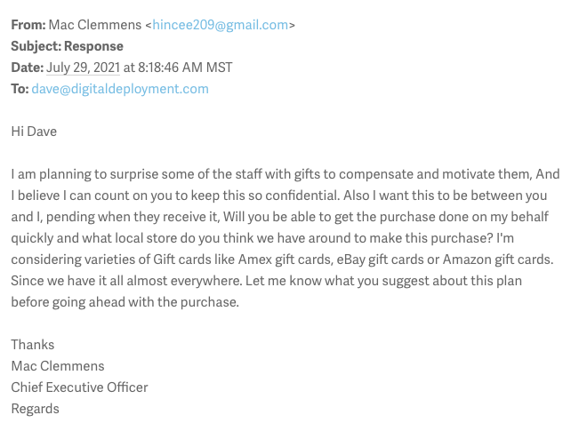
A more personal one
It looks like it's from the CEO — look closer
The "From" name says Mac Clemmens — but the address is a free Gmail account, not the company domain.
The signature block copies a real title ("Chief Executive Officer") to look legitimate.
Secrecy plus gift cards plus urgency: "keep this between us… make the purchase quickly."
1
ENABLE MFA
2
GET A .GOV
3
ENABLE DMARC
4
BE PHISHING-READY
5
CALL TO CONFIRM
Notes:
MAC

Slide 44
4
AI has made it even worse
Attackers can now write like you — and about the people they're targeting.
Two prompts is all it takes
"Help me rewrite this email to sound like these blog posts written by Mac Clemmens."
"Personalize the message based on information in Dave's biography on the website."
1
ENABLE MFA
2
GET A .GOV
3
ENABLE DMARC
4
BE PHISHING-READY
5
CALL TO CONFIRM
Notes:
MN: Be suspicious of those you know… and why.

Slide 45
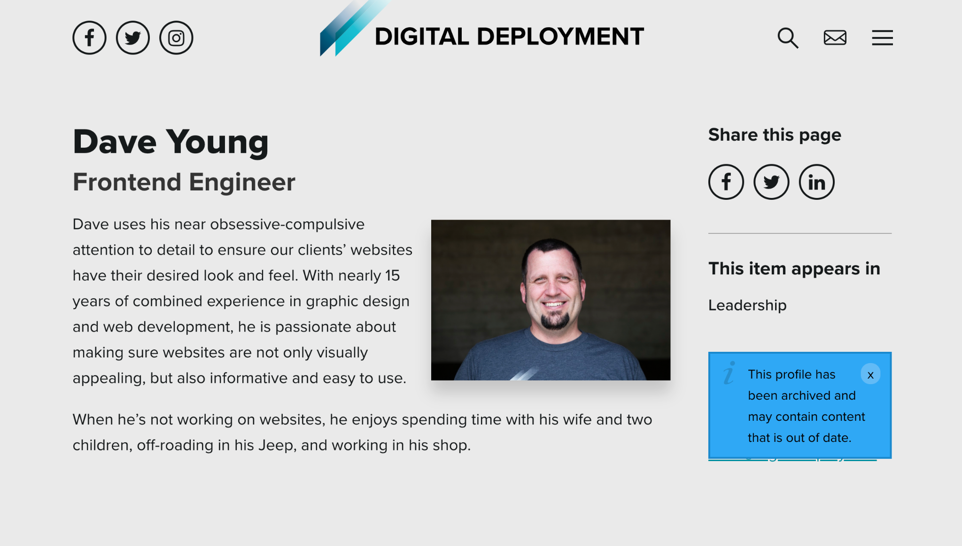

Everything the attacker needs is public
A staff bio on the company website gives an AI plenty to personalize with
FROM THE BIO
15 years of experience
"Obsessive-compulsive attention to detail"
Tinkers in his shop, off-roads in his Jeep
Loves making websites look impeccable
1
ENABLE MFA
2
GET A .GOV
3
ENABLE DMARC
4
BE PHISHING-READY
5
CALL TO CONFIRM

Slide 46
The AI-written version
Same ask — now it sounds exactly like the boss, and it knows about Dave's Jeep
Hey Dave,
Given your exceptional attention to detail, which has always been evident in ensuring our clients' websites look impeccable, I wanted to reach out. With your 15 years of experience, I know you understand the importance of both aesthetic appeal and user-friendliness.
I'm thinking of rewarding our staff with surprise gifts as a token of appreciation and motivation. I trust you'll keep this information under wraps. I'd like this to remain between us until the gifts are handed out. Could you help with the purchase soon? Knowing your keen eye for detail, do you have any recommendations for local stores to buy these gift cards? I'm considering options like Amex, eBay, or Amazon.
When you're not busy tinkering in your shop or off-roading in your Jeep, I'd love to get your feedback. Looking forward to your insights before we move forward with this idea.
Best regards,
Mac Clemmens
This might be far more difficult to spot!
Dave has to think even more critically.
1
ENABLE MFA
2
GET A .GOV
3
ENABLE DMARC
4
BE PHISHING-READY
5
CALL TO CONFIRM
Notes:
MAC

Slide 47
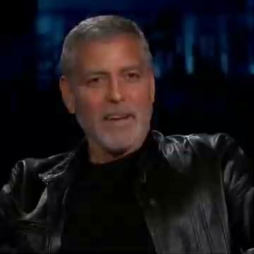
It isn't just email anymore
Deepfake video and voice: click the image to play the clip
▶ Play video (Google Drive)
1
ENABLE MFA
2
GET A .GOV
3
ENABLE DMARC
4
BE PHISHING-READY
5
CALL TO CONFIRM

Slide 48
4
Phishing strategies
Need to test your staff from time to time.
Test monthly, automated, sent at staggered times
Breach Secure Now or Bullphish ID are good companies to use
Treat every miss as a training moment, not a gotcha
1
ENABLE MFA
2
GET A .GOV
3
ENABLE DMARC
4
BE PHISHING-READY
5
CALL TO CONFIRM
Notes:
MN: Companies that help test your staff. Should be monthly. Automated. Should be sent at staggered times (better testing).

Slide 49


5
Call when confirming wire transfers and payments
…and how to know which phone numbers to use.
The one habit that stops wire fraud
Every new vendor, every changed bank account, every "urgent" payment request gets a phone call — to a number you already trust.
1
ENABLE MFA
2
GET A .GOV
3
ENABLE DMARC
4
BE PHISHING-READY
5
CALL TO CONFIRM
Notes:
Conversation between Mac and Michael.

Slide 50
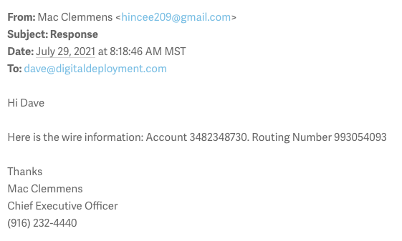
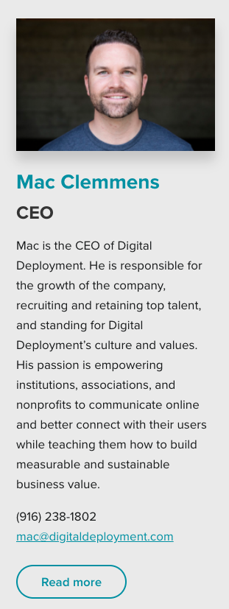
The wire-fraud version
The bio says one phone number. The email says another. Which one do you call?
The email's callback number is the attacker's. The real number is on the website bio — call that one.
1
ENABLE MFA
2
GET A .GOV
3
ENABLE DMARC
4
BE PHISHING-READY
5
CALL TO CONFIRM

Slide 51



How to be safe with wire transfers
Three rules — put them in your payment policy
1
2
3
Always call YOUR number
Verify who you're texting
Two-person control
Call the vendor at the number in your contacts to verify — not the number on the request.
Tools like iMessage Contact Key Verification (on iPhone) confirm you're messaging the right person.
Any new vendor or updated change requires a second person to sign off: one initiates, one approves.
1
ENABLE MFA
2
GET A .GOV
3
ENABLE DMARC
4
BE PHISHING-READY
5
CALL TO CONFIRM
Notes:
Happens due to MITM (monster/man in the middle) attack — this is why 2FA is so important. Mac will share health care example; MN will share last-minute wiring change instructions example.

Slide 52
Keep learning!
What you're doing today is a perfect example of how to spot AI-powered cyber threats.

Slide 53
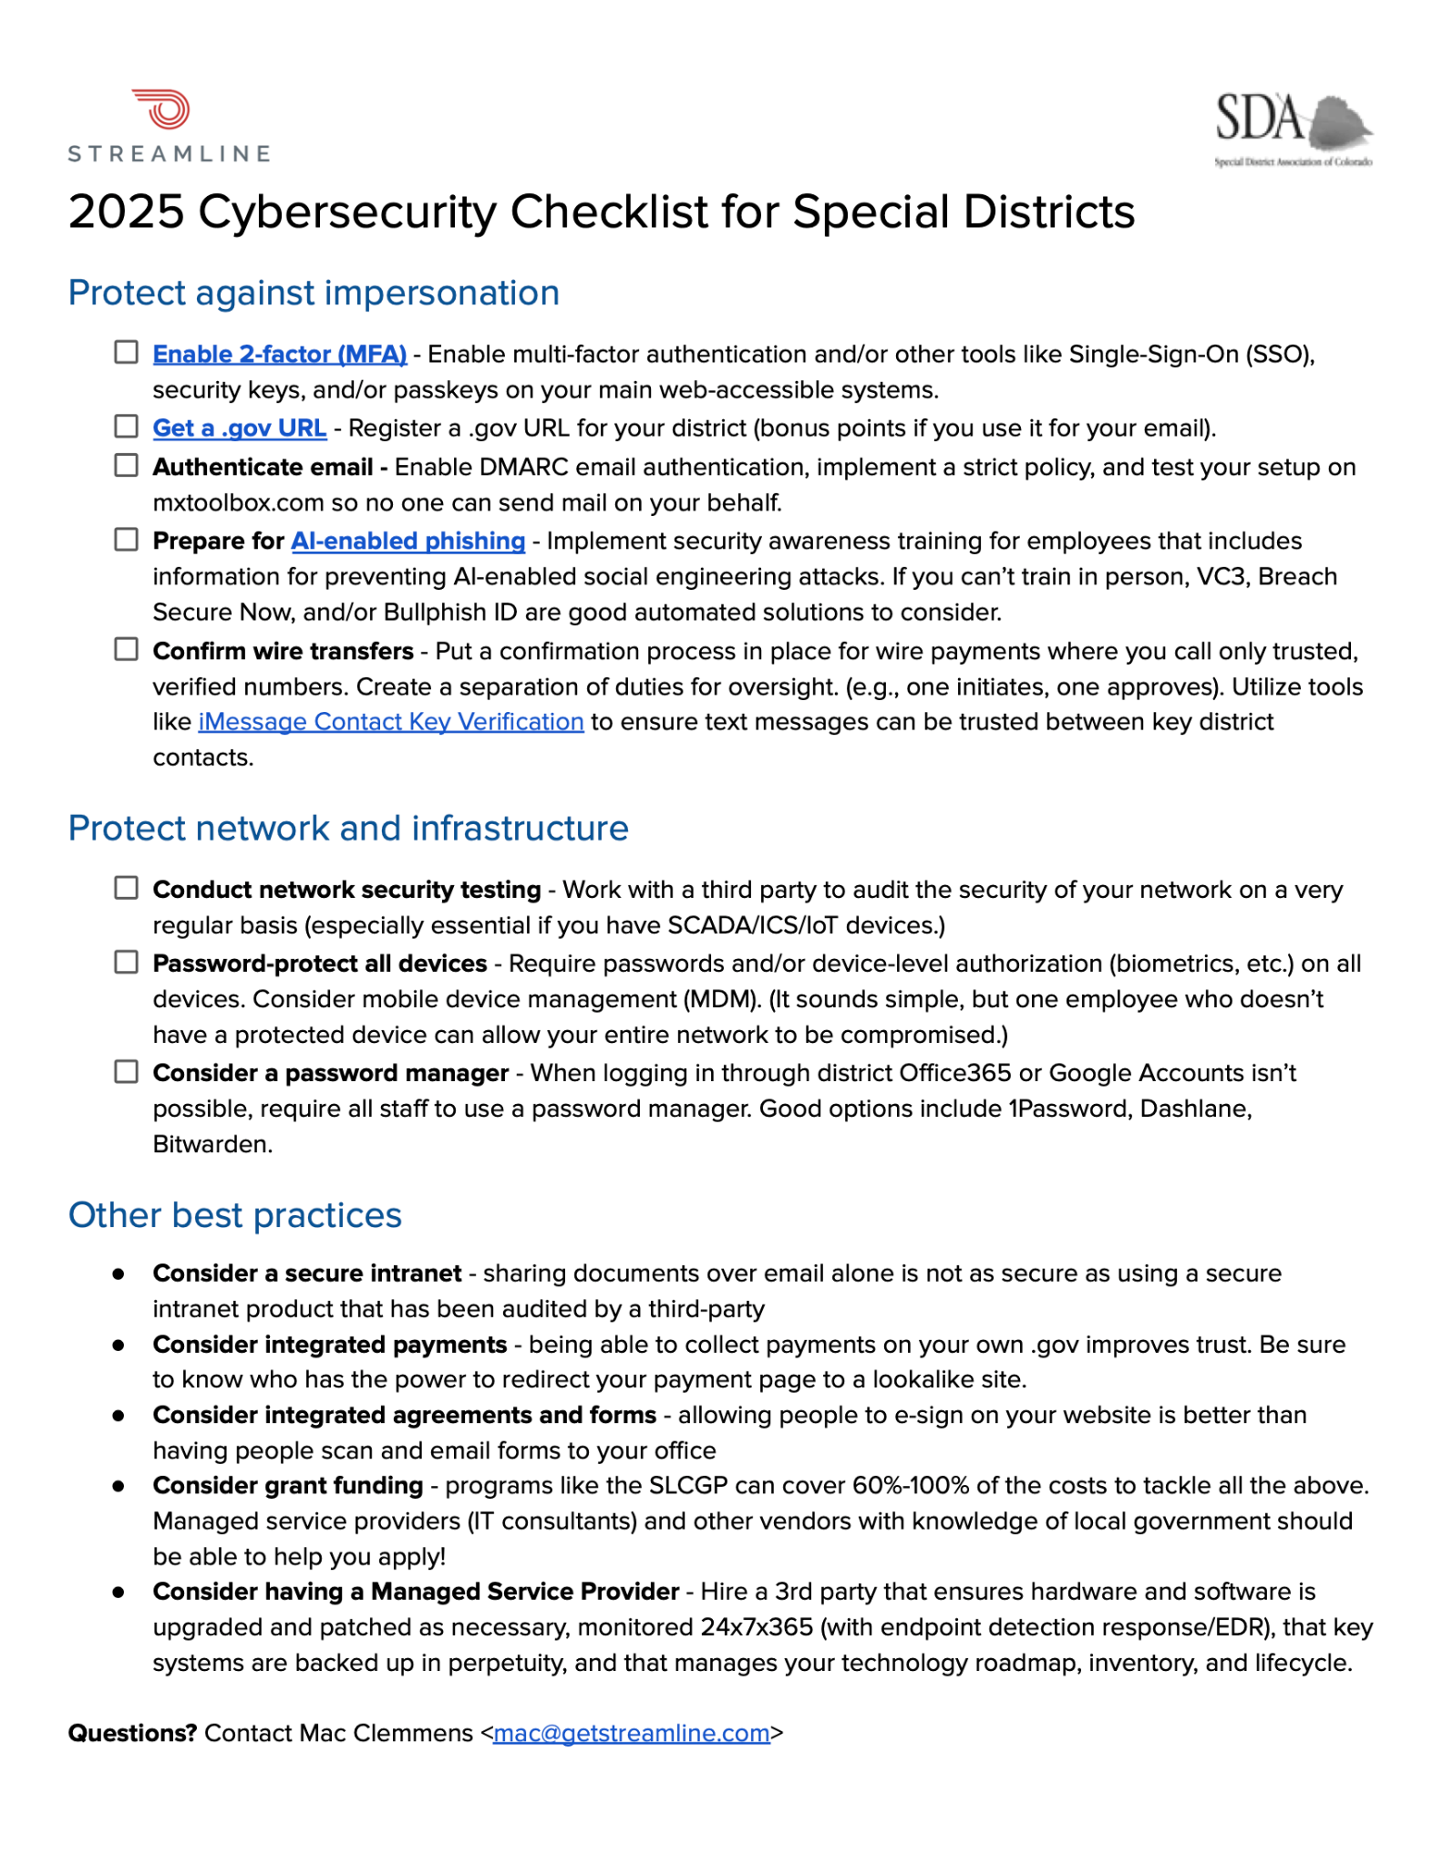
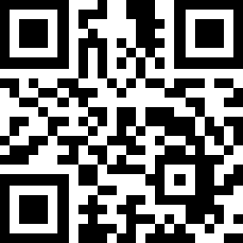
Get the checklist
tinyurl.com/sdacyber

Slide 54
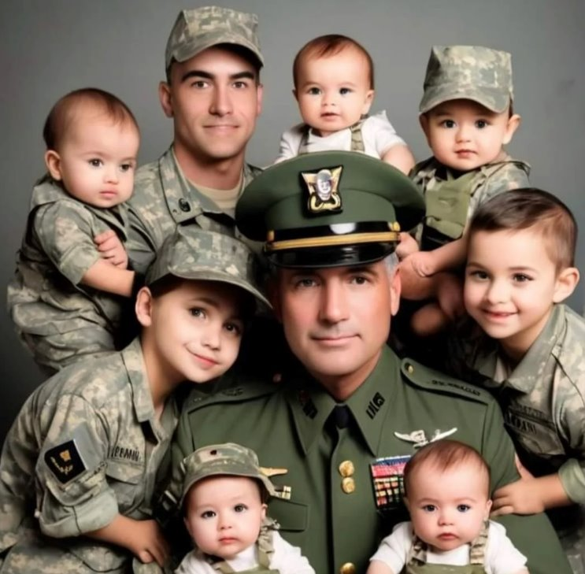
real or fake?
1 / 10

Slide 55
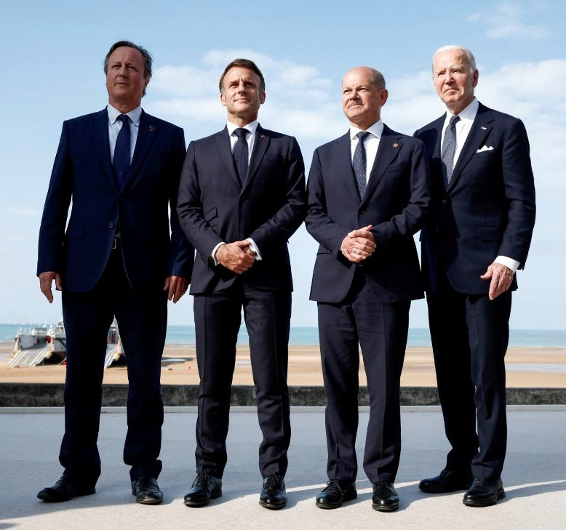
real or fake?
2 / 10

Slide 56

real or fake?
3 / 10

Slide 57

real or fake?
4 / 10

Slide 58

real or fake?
5 / 10

Slide 59

the reveal
6 / 10
The giveaway: look closely at the badge and the patch

Slide 60

real or fake?
7 / 10

Slide 61
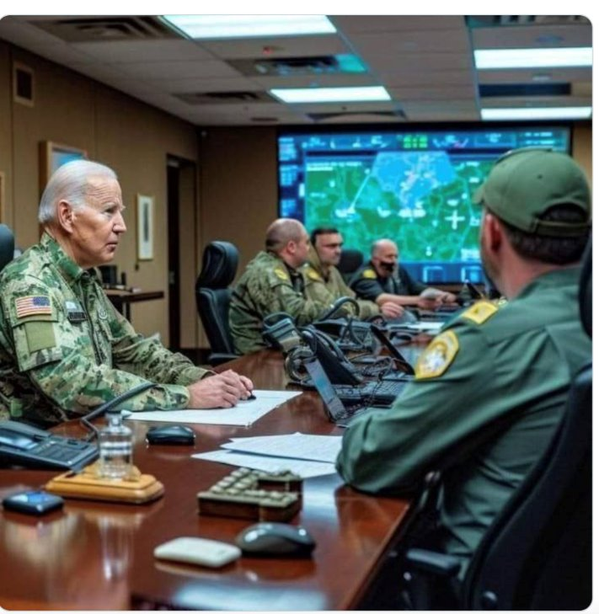
real or fake?
8 / 10

Slide 62
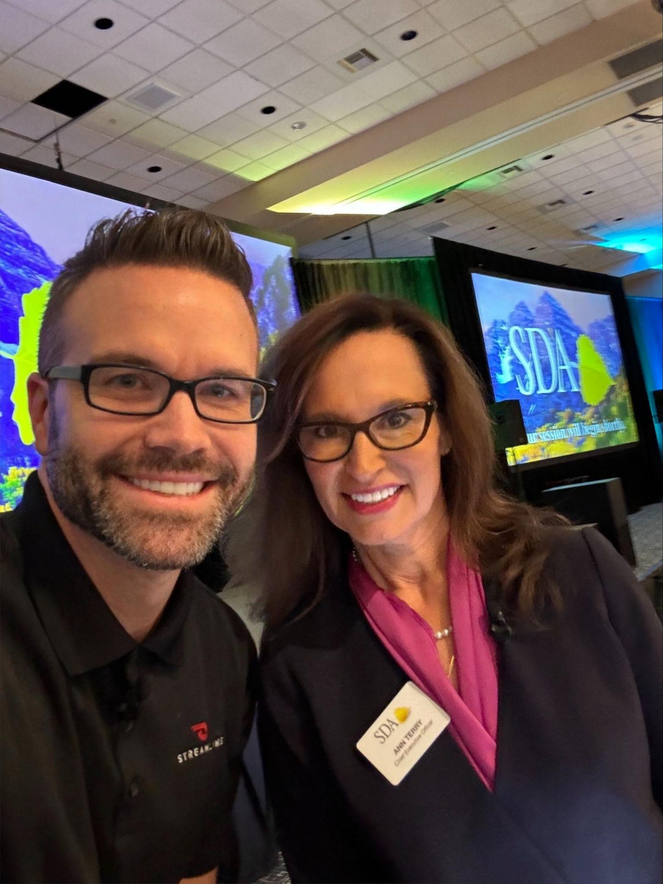
real or fake?
9 / 10

Slide 63
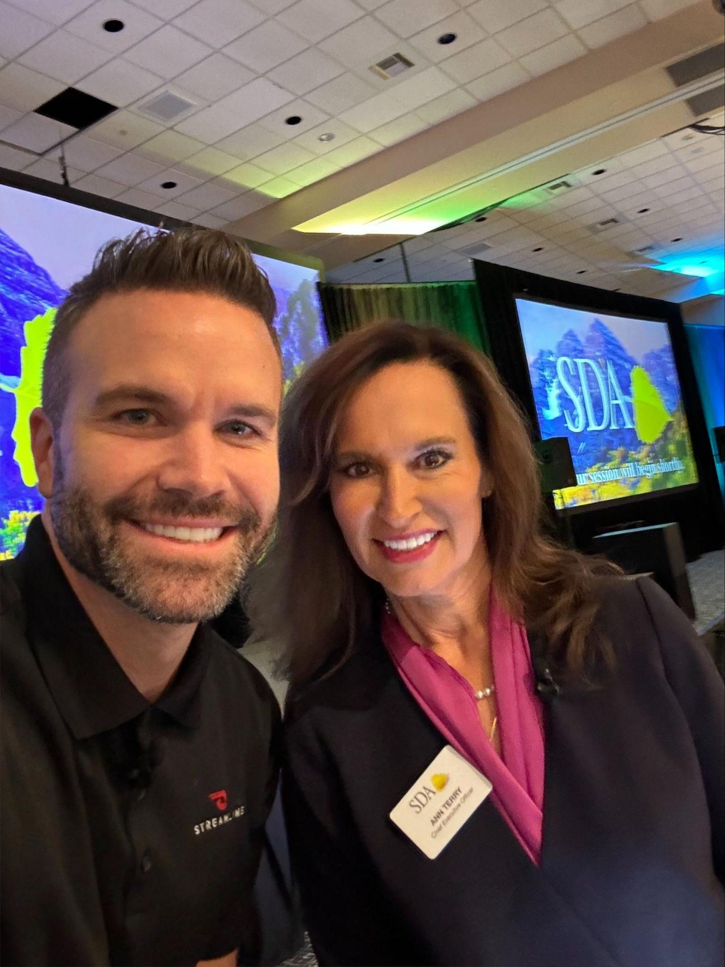
real or fake?
10 / 10

Slide 64
Reach out!
We're here to help.
Mac Clemmens Streamline / CivicPlus
mac.clemmens@civicplus.com
Chantal Unfug NSDA
chantalu@nationalspecialdistricts.org
DOWNLOAD THIS PRESENTATION
tinyurl.com/sda-nsda

